Slide 1
Evaluation of 2015 SDG&E Commercial Thermostat Program
2016 PLMA Spring Conference
Smart Thermostat Interest Group Workshop
Prepared by:
Josh Schellenberg, Principal
Dan Thompson, Project Analyst
May 10, 2016

Slide 2
Overview
Program Overview
Ex Post Methodology
Ex Post Results
Ex Ante Methodology
Enrollment Forecast
Ex Ante Results
Additional Findings
Recommendations

Slide 3
Program Overview

Slide 4
The San Diego Gas & Electric (SDG&E) Commercial Thermostat program is a growing AC load control program
Smart thermostat installations are used for AC load control demand response in SDG&E’s service territory
1,243 small and medium business (SMB) customers (11,292 thermostats) participated in 2015 DR events
1,079 commercially managed residential customers (1,130 thermostats) participated in 2015 DR events
Two primary load control strategies:
50% cycling
4-degree setback
Any participant can override the load control at any point
Hours of Availability | Hours of Actual Use | Number of Available Dispatches | Number of Actual Dispatches
72 hours | 16 hours | 18 events | 4 events

Slide 5
Ex Post Methodology

Slide 6
Impacts were estimated using matching with difference-in-differences regression and same-day adjustment
The regression adjusts for differences remaining after matching.
The matching algorithm selects control customers with a similar load profile to participants.

Slide 7
Ex Post Results

Slide 8
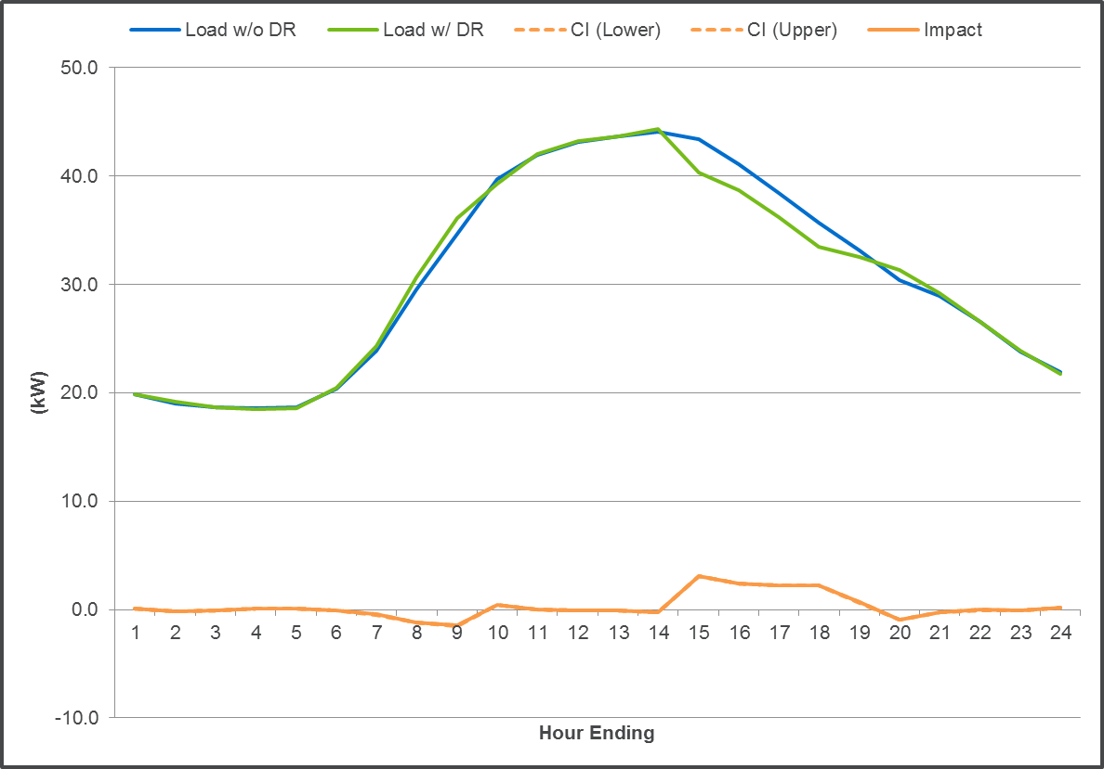
The average 2015 event day impact was 2.49 kW per customer and 0.27 kW per thermostat for commercial customers

Slide 9
The per thermostat impacts for commercial customers remained relatively constant in percent terms after the first event hour.

Slide 10
The relationship between weather and impacts was not detectable given the sample sizes and consecutive events.
Three of the four events were on consecutive days

Slide 11
A small number of thermostats installed in commercially-operated residences returned smaller and noisier impacts.

Slide 12
The impact of the commercial thermostat program during SDG&E and CAISO system peaks were 3.02 MW and 3.44 MW, respectively
SDG&E system peak
September 9th
Between 3 PM and 4 PM (3:43 PM)
Commercial Thermostat impact: 3.02 MW
CAISO system peak
September 10th
Between 4 PM and 5 PM (4:53 PM)
Commercial Thermostat impact: 3.44 MW

Slide 13
Ex Ante Methodology

Slide 14
Ex Ante impacts were calculated by combining 2015 per-thermostat impacts with Summer Saver weather sensitivity
Ex post estimates were developed with the key output being the average per-thermostat impact (0.27 kW)
Regression models were estimated that relate hourly usage to weather
A regression model was estimated that relates the Summer Saver 50% cycling impacts to temperatures using five years of events
Summer Saver impacts were predicted for the ex ante weather scenarios using the model in step 3
The ratio of impacts to weather observed in the Summer Saver program was applied to the per-thermostat impact (step 1) for the commercial thermostat program

Slide 15
Enrollment Forecast

Slide 16
The Commercial Thermostat program is expected to grow by 17%

Slide 17
Ex Ante Impacts

Slide 18
The per-customer impacts are expected to increase ~5%
The August CAISO 1-in-2 day is hotter than the August SDG&E 1-in-2 day.
The per-customer impact changes over time due to small changes in the customer mix.

Slide 19
The aggregate impacts are expected to increase by ~15%
The aggregate impact changes for the same reasons as above.
It also changes due to increasing enrollment.

Slide 20
The aggregate ex post impacts increased while the 2017 ex ante impacts decreased from the 2014 evaluation to the 2015 evaluation
 | Evaluation Year | Aggregate Impact (MW) | Thermostats Enrolled | Mean17
Ex Post | 2014 | 0.7 | 3,282 | 82.9
 | 2015 | 3.1 | 12,422 | 84.1
Ex Ante (2017) | 2014 | 3.41 | 19,973 | 75.6
 | 2015 | 2.84 | 16,346 | 74.9
Aggregate ex post impacts increased by nearly 4.5 times from 2014 to 2015 due to:
378% increase in enrolled thermostats
1.2 degree increase in average event temperatures
Ex Ante estimates for 2017 fell from the 2014 to the 2015 evaluation due to:
18% drop in projected enrollment
0.7 degree drop in average temperatures

Slide 21
Additional Findings

Slide 22
2015 impacts per thermostat throughout the event hours were very similar for each load control strategy

Slide 23
Smart thermostats delivered the largest impacts for retail customers; hotels underperformed relative to other industries
There variance in performance across industries is high.

Slide 24
Energy savings ranged from 2% to 4% of whole-building electricity usage, 1.7 kWh per day per thermostat (620 kWh per year)

Slide 25
Energy savings in the peak period (2-6 PM) during the summer on non-event weekdays by industry

Slide 26
Discussion

Slide 27
For comments or questions, contact: Josh Schellenberg Principal jschellenberg@nexant.com
Dan Thompson Project Analyst dthompson@nexant.com
Nexant, Inc. 101 Second St., 10th Floor San Francisco, CA 94105 415-369-1000

