Slide 1
General Order (GO) 156 Report
Year 2022 Utilities & CCAs Procurement of Goods, Services, and Fuel from Women, Minority, Disabled Veteran, LGBT, and Persons with Disabilities Business Enterprises
Stephanie Green
Supplier Diversity Manager
California Public Utilities Commission
September 28, 2023
Notes:
Hello my name is Stephanie Green and I oversee the General Order 156 Supplier Diversity Program at the CPUC. It is a pleasure to be back again in person, and to see you all here today. Today I will be providing you with an overview of our 2022 program results.

Slide 2
CPUC Supplier Diversity Program
General Order 156 and Public Utilities Code (PU Code) §§ 366.2 (m), 910.3, and 8283:
  Requires utilities and electric service providers to submit annual plans to increase procurement from women, minority, disabled veteran, LGBT, and persons with disabilities business enterprises (diverse suppliers) in all categories; and annual implementation reports.
  Requires community choice aggregators (CCA) to annually submit plans to increase procurement from small, local, and diverse businesses in all categories; and diverse supplier procurement reports.
  Encourages cable television and direct broadcast satellite providers, wholesale power generators, distributed energy resource contractors, and energy storage system companies to adopt plans to increase procurement from diverse suppliers.
  Requires the CPUC to annually report to the legislature on utilities’ diverse supplier procurement performance.
  GO 156 provides voluntary procurement goals of 15% from minority business enterprises (MBE), 5% from women business enterprises (WBE),1.5% from disabled veteran business enterprises (DVBE), and from LGBT business enterprises (LGBTBE), 0.5% for 2022, 1.0% for 2023, and 1.5% for 2024 and beyond.
Notes:
Established in General Order 156 and public utilities code, the Supplier Diversity Program encourages the utilities and Electric Service providers do two things. First, they must report on their annual performance for the past year. Second, they must include plans on how they're going to increase procurement from diverse businesses (women, minority, disabled veteran, LGTBE, and Persons with Disabilities)
In addition to utilities and energy service providers, Community Choice Aggregators are also a part of the Supplier Diversity Program and must submit their annual reports and plans on how they will increase procurement from small, local and diverse businesses.
It also requires the CPUC to annually report to the legislature on utilities’ supplier diversity performance. This years report is 95 pages long.
The program has voluntary goals (no quotas or set asides) which are 15% for minority-owned, 5% for women-owned, and 1.5% for disabled veteran business enterprises. LGBTE goal was 0.5% in 2022 and it is 1.0% in 2023 and it next year if will increase to a permanent goal of 1.5%. We have no goal for PDBE.

Slide 3
2022 GO 156 Report to the Legislature
Described utilities’ supplier diversity programs progress and diverse supplier procurement results.
Included a summary of CCAs supplier diversity initiatives, achievements, and barriers. Also, an overview of energy service providers first year of reporting.
27 utilities,17 CCAs, and 10 ESPs submitted an annual supplier diversity report to the CPUC.
Notes:
Our annual report to the legislature described utilities’ supplier diversity program results and progress.
It summaries the CCAs program results and challenges. The report also included an overview of energy service providers first year of reporting.
27 utilities,17 CCAs, and 10 ESPs submitted reports this year.

Slide 4


























Participating Utilities
Notes:
This slide highlights our 27 reporting utilities

Slide 5

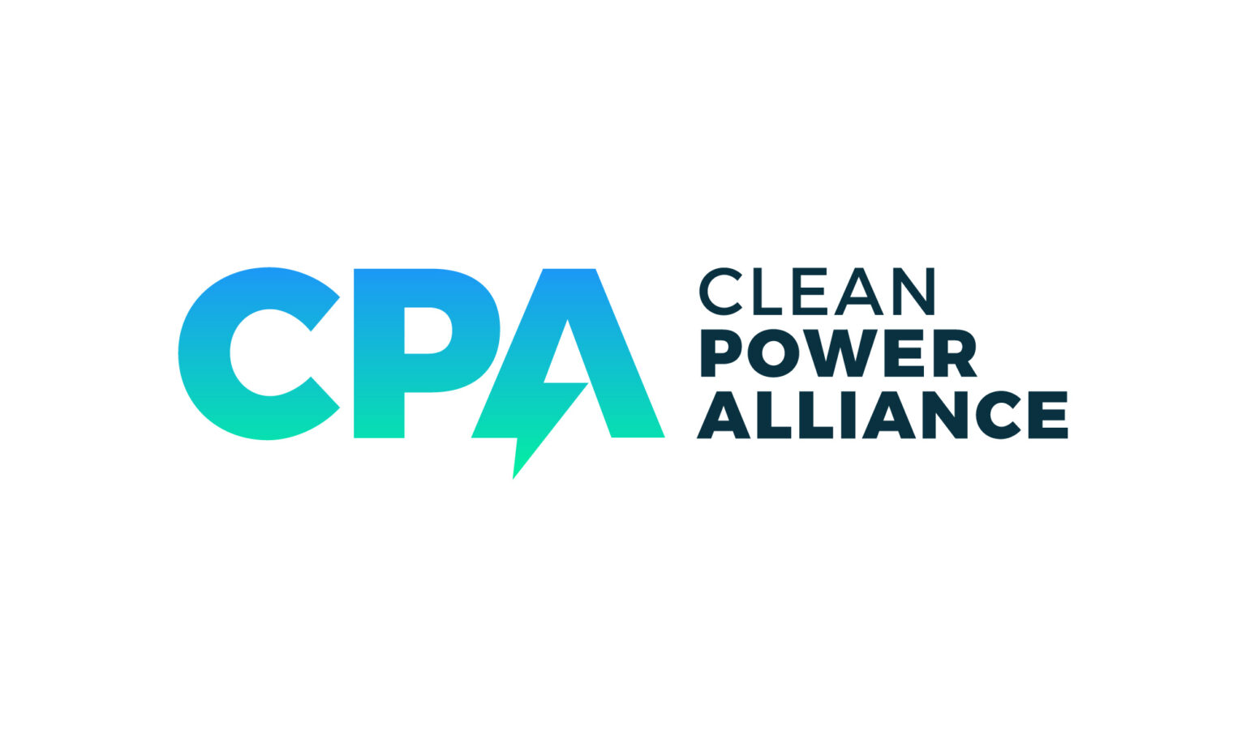















Participating Community Choice Aggregators
Notes:
This slide highlights our 17 Community Choice Aggregators

Slide 6










Participating Energy Service Providers
Notes:
This slide highlights our 10 ESPs submitted an annual report this year

Slide 7
2022 Utilities diverse suppliers Procurement Overview
Total Diverse Spend
$14.3 billion (30.6%)
8(a)
$7.2 million (0.02%)
MBE
$8.8 billion
(18.9%)
DVBE
$851 million (1.8 %)
LGBTBE
$41 million (0.09%)
WBE
$4.6 billion (9.8 %)
PDBE
$8.7 million
(0.02%)
Subcontracting
$2.8 billion
(6.1%)
Notes:
- So how did we do in 2022, we had our largest diverse spend yet at 14.3 Billion , which equates to 30.6% of the total spend. Our minority spend was 18.9 % , women spend was 9.8% , DVBE 1.8% , LGTB 0.09% and our new category Persons with Disabilities reporting for it first year came in at was 0.02%. It was a quite successful year.
- I will note that our large utilities generated 97.8% of the procurement and the small utilities 2.2%. Energy sector -65%, Communications 33% and Water 2% of diverse spend.

Slide 8
2021/2022 Utilities diverse suppliers Procurement
Notes:
- This slide shows a year over year comparison between 2021 and 2022 results.
- In 22 total diverse procurement came in at 30.6%. A slight decrease from 21. Total procurement increased by 16.36% (from 12.3 Bil to 14.3 Bil), so the percentage spend decreased accordingly.
- Minority spend had a slight increase going to 18.9%. Women, DVBE, LGTB , subcontracting all experienced slight decreases.
- In its first reporting year Person with Disabilities came in at 0.02%

Slide 9
2022 Top 10 Performers
Notes:
- This I like our Academy Awards, I would like to acknowledge our top performers.
- Ranging from 67% -35% diverse spend.
From highest to lowest we have: Suburban Water, Southwest Gas, Park&Apple Water, Cal Am Water, SoCalGas, SDGE, PGE, Bear Valley Electric, San Jose Water and SCE.
- It is noteworthy that of the 10 top performers 4 were from our water industry and 6 energy sector. We had no firms from the communications/cable sector.

Slide 10
Utilities with less than 22% diverse suppliers Procurement in 2022
Notes:
- Some firms struggled this year and did not meet the program 22% goal. We will continue to work with them and hope that they will meet the goals in the future.
- These firms are: Liberty, Verizon, Charter, Lumen, Comcast, Wild Goose, Transbay Cable, Lodi Gas, Pacificcorp and TPX. I will just note there are no water companies on this list. The water sector is doing quite well.

Slide 11
Utilities Who Met All Four GO 156 Goals in 2022
Minority 15% Women 5% DVBE 1.5% LGBT 0.5%
California American Water
24.9% 17.5% 2.23% 1.31%
Notes:
- This is the first year the program had 4 goals, as it was the first reporting year with the LGTBE Goal. So this is like our Olympics and the Gold Medal goes to CalAm Water, they were the only firm to meet all 4 program goals.
- It can be very challenging to meet all 4 goals, some firms meet 3 or 2 goals and others even struggled to meet 1 goal. So Congratulations to CAL AM on this success.

Slide 12
2022 CCAs diverse suppliers Procurement
Notes:
- CCAs procured 5.4 million or 2.21% diverse spend. This is an increase of 54.2 percent from their 2021 diverse spend ($3.5 million) and an increase of 184.2 percent from their 2020 diverse spend ($1.9 million).
- It is also important to note 35 years ago when the utilities first started reporting they were at 2-3% as well. So the CCAs are building their programs and we look forward to their continued progress.

Slide 13
Accomplishments and Challenges
Reported $14.3 billion, the highest procurement spend in the program's history.
Continued to provide technical assistance and capacity building programs and engage diverse suppliers using various technologies.
Successfully engaged prime contractors to embrace supplier diversity and develop programs.
10 Energy Service Providers submitted diversity reports for the first time in 2022.
Barriers due to organization business practices and contract terms and conditions continue to affect supplier diversity programs.
Not enough diverse suppliers in certain fields such as fuel and power procurements.
CCAs are constrained by Proposition 209.
Over 90% of CCAs procurement is power with limited diverse supplier participation.
Notes:
Accomplishments: Reported $14.3 billion, the highest procurement spend in the program history.
our participating entities provided technical assistance and capacity building . They offered virtual and in person educational workshops and presentations.
Utilities engaged their prime contractors to encourage subcontracting. They provided training, goal setting, tracking, and reporting guidance.
in 2022 10 Energy Service Providers submitted diversity reports for the first time.
Challenges: - Structural barriers exists such as unfavorable terms and conditions (such as payment terms), Centralized procurement systems, consolidated contracting, proprietary technologies and some firms have limited scope of operations in California.
There are not enough diverse suppliers in certain fields such as fuel and power procurements.
CCAs are constrained by Proposition 209, which has procurement prohibitions with regards to race, sex and ethnicity.
Over 90% of CCAs procurement is power and there are very few to no diverse suppliers in this field.

Slide 14
Supplier Clearinghouse
Certification Type
(CURRENT AS OF (08/25/2023)
Notes:
- The Supplier Clearinghouse certification plays a key role in the supplier diversity program as it ensures the spend we report is with verified diverse firms, certification is essential.
- The Clearinghouse reported over 9000+ firms certified in the database. The highest number to date. It also implemented new Persons with Disabilities Business Enterprise category.
- On this chart you can see WBE firms are 29%, MBE-32%, DVBE -14.4 %, PDBE -17%, LGTBE 7.3% and SBA 8A is negligible 0.03%.

Slide 15
Supplier Clearinghouse
Business Size
(CURRENT AS OF 8/25/2023)
Notes:
-Now I will tell you a little more about the Clearinghouse. The database is 66% women and 34% male, this is because of our women owned certification.
-The database has a strong ethnic mix. 37% white (which is our women owned firms) , 25% Hispanic, 20% Asian, 16% African American and 3% Native American.
-We continue to get applications from our reciprocal partners- NGLCC, NMSDC, WBENC and DisabilityIN.
- The businesses in the database range in size, but 56% (more than half) are smaller in size (under $1million).

Slide 16
Supplier Clearinghouse
Certified Suppliers by SIC Code
Notes:
This slide shows the suppliers in our database are in a wide range of industries, with a range of capabilities and are ready to meet the needs of our reporting entities.

Slide 17
Supplier Clearinghouse RFP
The Supplier Clearinghouse is an independent services operation contracted by the Investor-Owned Utilities of California to administer the certification process of the women, minority, LGBT, persons with disabilities, and disabled veteran businesses.
The CPUC and the Utilities intend to issue an RFP on/around January 15, 2024; with new services commencing on January 1, 2025.
We will be seeking bidders with capabilities, qualifications, and years of experience to operate the Supplier Clearinghouse.
More details of the RFP’s requirements, scope of work, deliverables to be provide with the RFP documents.
Notes:
We would like to let everyone know we will be taking the vendor contract for the Supplier Clearinghouse Operator out to bid and that RFP will go out January 1, 2024 . You can contact me if you want to learn more.

Slide 18
CPUC Supplier Diversity Program Action Items
Complete phase of Rulemaking 21-03-010
Provide guidance and advocate for the inclusion of diverse suppliers in the procurement activities of GO 156 covered entities.
Monitor the progress of GO 156 covered entities' supplier diversity programs especially their progress in incorporating the new LGBTBE goal and diverse category (persons with disabilities business enterprise).
Continue to engage electric service providers and CCAs to develop supplier diversity programs and submit annual reports.
Increase the pool of qualified diverse suppliers in the Supplier Clearinghouse database.
Complete Supplier Clearinghouse RFP process and vendor selection
Notes:
In terms of action items:
- We want to complete phase of Rulemaking 21-03-010
- We will Advocate for the inclusion of diverse suppliers in the procurement
- We will Monitor the progress of supplier diversity programs especially with regards to incorporating LGBTBE and persons with disabilities.
- We will continue to work electric service providers and CCAs to develop their programs and submit annual reports.
- We would like to continue to increase the number of diverse suppliers in the Clearinghouse database.
- Complete Supplier Clearinghouse RFP process and vendor selection

Slide 19
Questions?

Slide 20

Thank you!
Stephanie Green
stephanie.green@cpuc.ca.gov
415-703-5245

