Slide 1
Electric System Reliability
CPUC Energy Division
Julian Enis, Resiliency and Microgrids
February 17, 2021

Slide 2
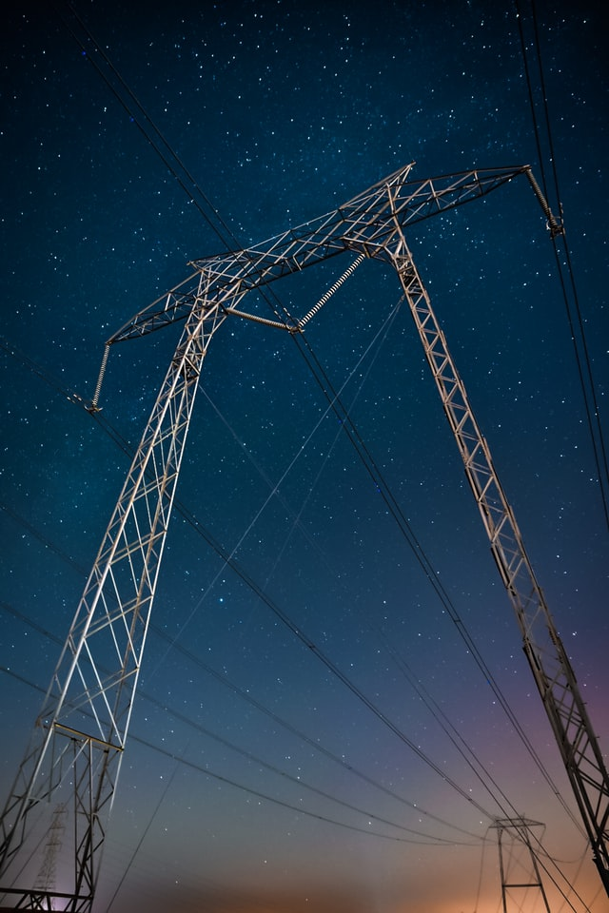
Electric System Reliability
The basics:
  How is electric reliability defined?
  Why do we keep track of electric reliability metrics?
  What are the utilities required to report to CPUC?
  How do the California IOUs compare to the rest of the US?
  How granular are current reporting standards and how do we keep track of the worst performing circuits?
  What can be improved?
Photo by Casey Horner on Unsplash

Slide 3
How is electric system reliability defined?
Statistical representations of outages and what they really mean.

Slide 4
Electric System Reliability Metrics
IEEE 1366 defines the four main metrics by which electric system reliability is measured: SAIDI, SAIFI, CAIDI, and MAIFI. These are the generally accepted standards by which electric utilities across the US measure and report system reliability.
SAIDI = System Average Interruption Duration Index
SAIFI = System Average Interruption Frequency Index
CAIDI = Customer Average Interruption Duration Index
MAIFI = Momentary Average Interruption Frequency Index

Slide 5
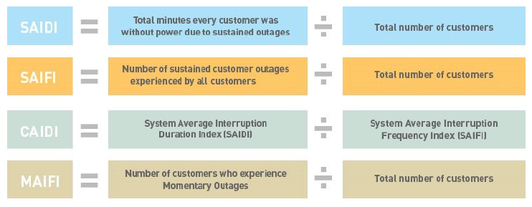
Electric System Reliability Metrics
Written definitions of SAIDI, SAIFI, CAIDI, and MAIFI are presented below.
Note: Appendix A contains more detailed mathematical definitions and visual explanations of these four metrics.

Slide 6
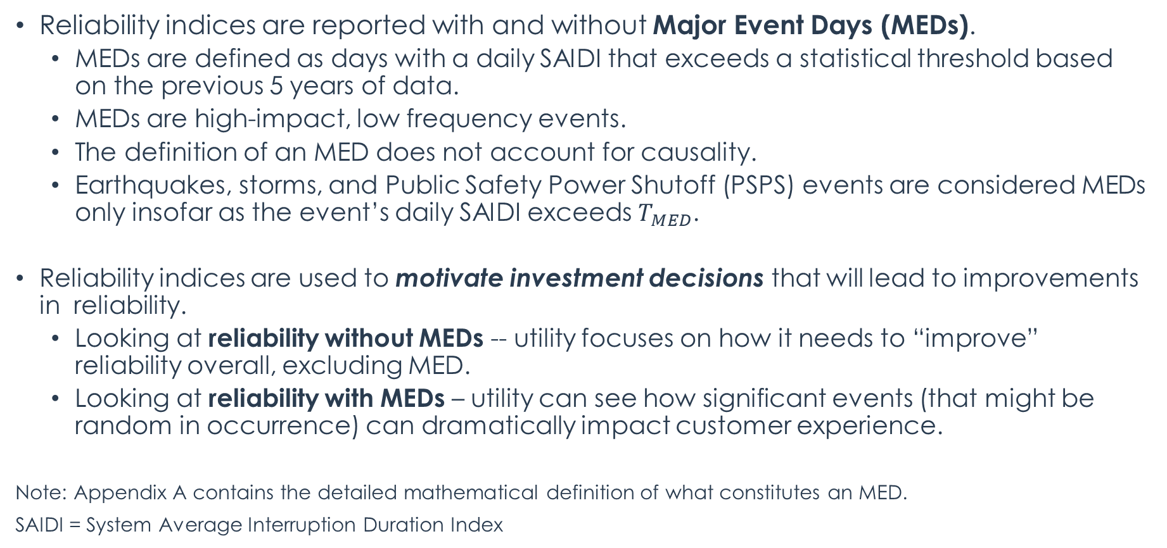
Reliability Indices With and Without Major Event Days
Reliability indices are reported with and without Major Event Days (MEDs).
  MEDs are defined as days with a daily SAIDI that exceeds a statistical threshold based on the previous 5 years of data.
  MEDs are high-impact, low frequency events.
  The definition of an MED does not account for causality.
  Earthquakes, storms, and Public Safety Power Shutoff (PSPS) events are considered MEDs only insofar as the event’s daily SAIDI exceeds $T_{MED}$.
Reliability indices are used to motivate investment decisions that will lead to improvements in reliability.
  Looking at reliability without MEDs -- utility focuses on how it needs to “improve” reliability overall, excluding MED.
  Looking at reliability with MEDs – utility can see how significant events (that might be random in occurrence) can dramatically impact customer experience.
Note: Appendix A contains the detailed mathematical definition of what constitutes an MED.
SAIDI = System Average Interruption Duration Index

Slide 7
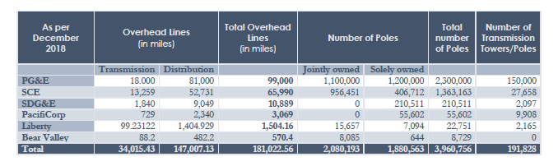
Drawbacks of Statistical Representation of Data
The massive size of the utility system – with its regional, climate, and density variations can make system level reliability indices data challenging to interpret.
Reliability statistics focus on outage duration and customer counts, which may obscure regional variation.
Notes:
Reliability indices are defined statistically based solely on outage duration and customer counts, which at less granular levels can obscure regional variations. Furthermore, utility transmission and distribution systems in California are massive, meaning that system level metrics can potentially account for thousands of miles of infrastructure (see below, data as of 2018 not including undergrounded infrastructure).

Slide 8
Why do we keep track of reliability metrics?
How the data is used to improve the electric system.

Slide 9
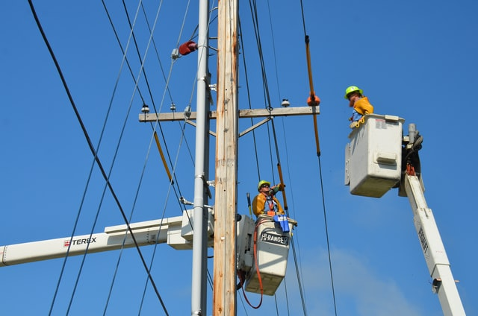
How Utilities Use Electric Reliability Metrics
Tracking performance of circuits to address service issues.
Scoring criteria for remediation measures and cost-effectiveness assessment.
Worst performing circuits by circuit SAIDI and circuit SAIFI are targeted for remediation.
Persistent issues with blue-sky service and impacts of major events can be tracked.
Photo by American Public Power Association on Unsplash
SAIDI = System Average Interruption Duration Index
SAIFI = System Average Interruption Frequency Index

Slide 10
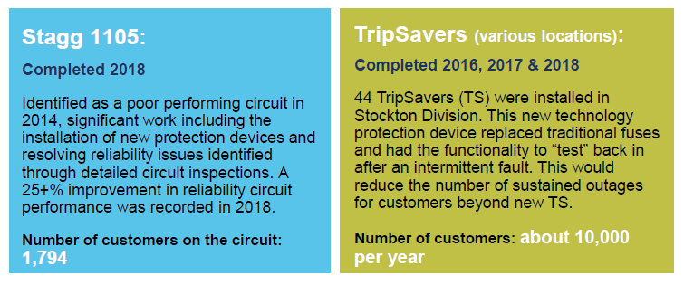
How Utilities Use Electric Reliability Metrics
The following is an example of how the utilities use this data to prioritize investments. PG&E presented these examples as a part of their annual meeting on the 2018 reliability metrics.
Source: PG&E, An Inside Look at Electric Reliability, 2018 Electric Reliability Report
Presentation given in Stockton, CA

Slide 11
What are the utilities required to report to CPUC?
Annual reporting requirements laid out by Commission Decision.

Slide 12
Regulatory and Reporting Standards
D.96-09-045: Reliability Standard and Reporting
  Recording and reporting requirements for frequency and duration of system outages, circuits that persistently perform poorly, and accidents affecting reliability.
D.00-05-022: GO 166, Standard 12
  Defined Major Events and set a restoration time benchmark (CAIDI of 570 minutes).
Advice Letters Adopting IEEE 1366 Definition of Major Event Days (2011)
  Utilities could exclude days that exceeded the MED threshold from calculations.
D.16-01-008: Reliability Reporting Standard for CA Utilities
  Appendix B of this Decision contains an annual reporting template and specifies comprehensive reporting requirements, including division level and historical performance. The Decision also requires the utilities to hold an annual workshop on electric system reliability and make circuit level reliability data available upon request to the public.
CAIDI = Customer Average Interruption Duration Index; MED = Major Event day

Slide 13






Annual Reporting Requirements
Annual reliability reporting is required from PG&E, SCE, SDG&E, Bear Valley Electric Service, PacifiCorp, and Liberty Utilities/CalPeco Electric. Reports from 1997 to the present can be found here: https://www.cpuc.ca.gov/general.aspx?id=4529.

Slide 14
How do the California utilities compare to the rest of the US?
A broader perspective on reliability.

Slide 15
Reliability Metrics and Utility Performance
Reliability data can be shown in many ways, each of which can tell a different, and sometimes conflicting, part of the story about a utility’s performance. A large amount of reliability data from the reports each year needs to be parsed and distilled to glean useful insights. The following is illustrative of the difficulty and uncertainty of this task:
 | PG&E 2019 SAIDI | PG&E 2018 SAIDI | 2019 National Average SAIDI | San Francisco Division SAIDI | Humboldt Division SAIDI
Without MED (minutes) | 117.7 | 99.9 | 133.3 | 56.8 | 274.6
With MED (Minutes) | 1365.1 | 282.9 | 263.8 | 71.6 | 6899.9
SAIDI = System Average Interruption Duration Index

Slide 16
Key Takeaways from 2019 Data
Excluding MEDs, the CA IOUs generally have lower measured SAIDI and SAIFI than the national average for 2019.
  This means that for the average customer on the entire system, there were less outage minutes and outages were less frequent than the national average.
  The lower numbers are likely due to outages being averaged over the large customer counts in the IOUs’ service territories
Excluding MEDs, the CA IOUs generally have higher measured CAIDI than the national average for 2019.
  This means that when an outage does occur, the duration for the average customer is longer than the national average.
SAIDI = System Average Interruption Duration Index
SAIFI = System Average Interruption Frequency Index
CAIDI = Customer Average Interruption Duration Index
MED = Major Event Day

Slide 17
2019 CA IOU Reliability vs. National Average
 | Excluding MED |  |  |  |  |  |  | Including MED
 | Nat'l Avg | PG&E | SCE | SDG&E | BVES | Liberty | Pac. | Nat'l Avg | PG&E | SCE | SDG&E | BVES | Liberty | Pac.
SAIDI (Minutes) | 133.3 | 117.7 | 90.75 | 68.64 | 85 | 68.64 | 106.3 | 263.8 | 1365.1 | 177.97 | 122.96 | 258.8 | 416.51 | 419.7
SAIFI (Interruptions) | 1.272 | 1.01 | 0.87 | 0.596 | 0.7 | 0.596 | 0.838 | 1.703 | 1.874 | 1.04 | 0.639 | 1.9 | 2.96 | 1.236
CAIDI (Minutes) | 104.4 | 116.5 | 104.8 | 115.2 | 127.4 | 115.2 | 127 | 149.1 | 728.5 | 171.17 | 192.38 | 127.4 | 140.73 | 340
MAIFI (Interruptions) | - | 1.269 | 1.23 | 0.299 | 0 | 0.299 | 0.721 | - | 1.78 | 1.38 | 0.299 | 0 | 0.31 | 0.721
SAIDI = System Average Interruption Duration Index
SAIFI = System Average Interruption Frequency Index
CAIDI = Customer Average Interruption Duration Index
MAIFI = Momentary Average Interruption Frequency Index
MED = Major Event Day
Note: Red squares indicate that the metric exceeds the national average. National average is calculated from USEIA data on annual reliability figures which does not include MAIFI.

Slide 18
SAIDI Values for CA IOUs vs. SW States and Nat’l Average 2019
SAIDI = System Average Interruption Duration Index
MED = Major Event Day
Note: National data includes 681 electric utilities, Southwestern States include 56 electric utilities (AZ, CA, CO, NM, NV, and UT).

Slide 19
SAIDI Values for PG&E from 2010 – 2019
SAIDI = System Average Interruption Duration Index
MED = Major Event Day

Slide 20
SAIFI Values for CA IOUs vs. SW States and Nat’l Average 2019
SAIFI = System Average Interruption Frequency Index
MED = Major Event Day
Note: National data includes 681 electric utilities, Southwestern States include 56 electric utilities (AZ, CA, CO, NM, NV, and UT).

Slide 21
CAIDI Values for CA IOUs vs. SW States and Nat’l Average 2019
CAIDI = Customer Average Interruption Duration Index
MED = Major Event Day
Note: National data includes 681 electric utilities, Southwestern States include 56 electric utilities (AZ, CA, CO, NM, NV, and UT).

Slide 22
How granular are current reporting standards and how do we keep track of the worst performing circuits?
Current reporting standards and how persistently problematic circuits are identified and targeted for remediation.

Slide 23
Granular Reporting of Reliability Metrics
Granular reporting of reliability metrics paints a more detailed picture of the regional variation inherent in each of the utilities’ reliability metrics. D.16-01-008 required the utilities to include division level reliability metrics in their annual reports. This data can show where recurring issues are happening and areas where the greatest improvement is needed, but also shows how widely the metrics vary over entire service territories.
The following slide shows PG&E’s division SAIDI and CAIDI for the year 2019. Note the effect of including MEDs in the calculation on the individual indices and the wide variation in division metrics.
SAIDI = System Average Interruption Duration Index
CAIDI = Customer Average Interruption Duration Index
MED = Major Event Day

Slide 24
Granular Reporting of Reliability Metrics
Note: PG&E uses AIDI instead of SAIDI to denote that the metric represents the division level.

Slide 25
Granular Reporting of Reliability Metrics
D.16-01-008 also requires the utilities to report out on the top 1% of Worst Performing Circuits (WPCs) on the system by circuit SAIFI and SAIDI. For each utility, this translates to the following reporting requirements:
PG&E | SCE | SDG&E | PacifiCorp | Liberty | BVES
32 | 46 | 10 | 3 | 2 | 1
SAIFI = System Average Interruption Frequency Index
SAIDI = SAIDI Average Interruption Duration Index

Slide 26
Circuits Appearing on WPC Lists in Multiple Years
Data is available from 2015 and shows that many Worst Performing Circuits are repeat offenders, having been on Worst Performing Circuit lists for multiple years. The following table illustrates the percentage of circuits that have appeared on WPC lists in more than three years.
Utility | Distinct Circuits on WPC Lists 2015-2019 | Number of Circuits Appearing in 3 or More Years’ WPC Lists | %
PG&E | 76 | 25 | 33%
SCE | 214 | 39 | 18%
SDG&E | 68 | 4 | 6%
PacifiCorp | 15 | 0 | 0%
Liberty | 5 | 2 | 40%
BVES | 5 | 0 | 0%

Slide 27
Factors Affecting Circuit Reliability
Circuits tend to appear on Worst Performing Circuits lists for multiple years as remediation programs that target controllable factors can take years to complete and may only achieve modest reductions in circuit SAIFI and SAIDI.
Uncontrollable factors like environmental conditions play a large role in determining circuit reliability, some of which are beyond the utility’s control and can’t be addressed by traditional circuit remediation investments such as grid hardening, installation of covered conductor, etc.
  In PG&E’s 2019 report for example, the Alleghany 1101 circuit was noted as deficient with a large spike in SAIDI in 2019 caused by a single unknown event coupled with inaccessible mainline sections that were difficult to inspect.
The next slide shows a breakdown of PG&E’s main causes of sustained distribution outages in 2019.
SAIFI = System Average Interruption Frequency Index
SAIDI = SAIDI Average Interruption Duration Index

Slide 28
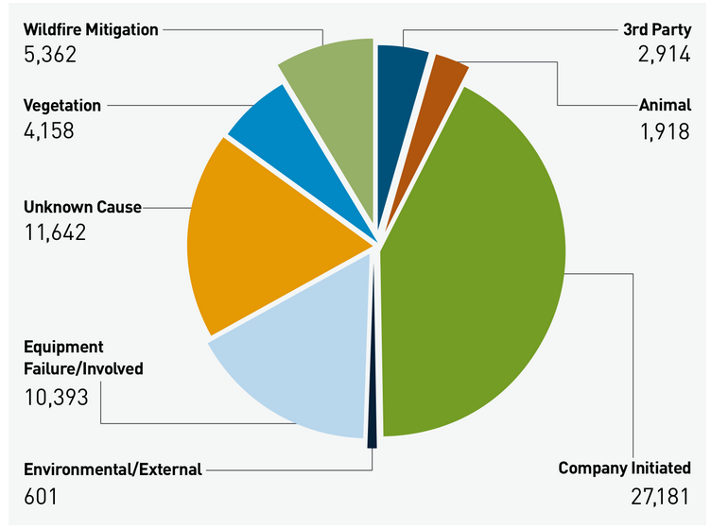
Factors Affecting Circuit Reliability
Source: Electric Reliability Reports - PGE

Slide 29
What can be improved?
Next steps.

Slide 30

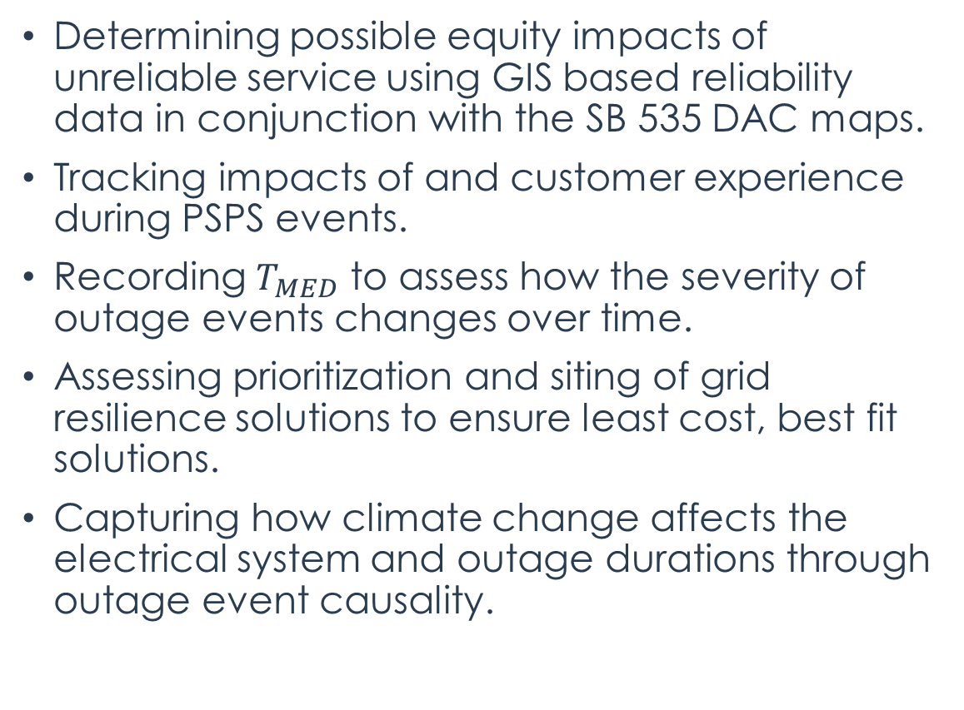
Other Possible Uses for Electric Reliability Data
Determining possible equity impacts of unreliable service using GIS based reliability data in conjunction with the SB 535 DAC maps.
Tracking impacts of and customer experience during PSPS events.
Recording $T_{MED}$ to assess how the severity of outage events changes over time.
Assessing prioritization and siting of grid resilience solutions to ensure least cost, best fit solutions.
Capturing how climate change affects the electrical system and outage durations through outage event causality.
Photo by Guillaume Bourdages on Unsplash

Slide 31
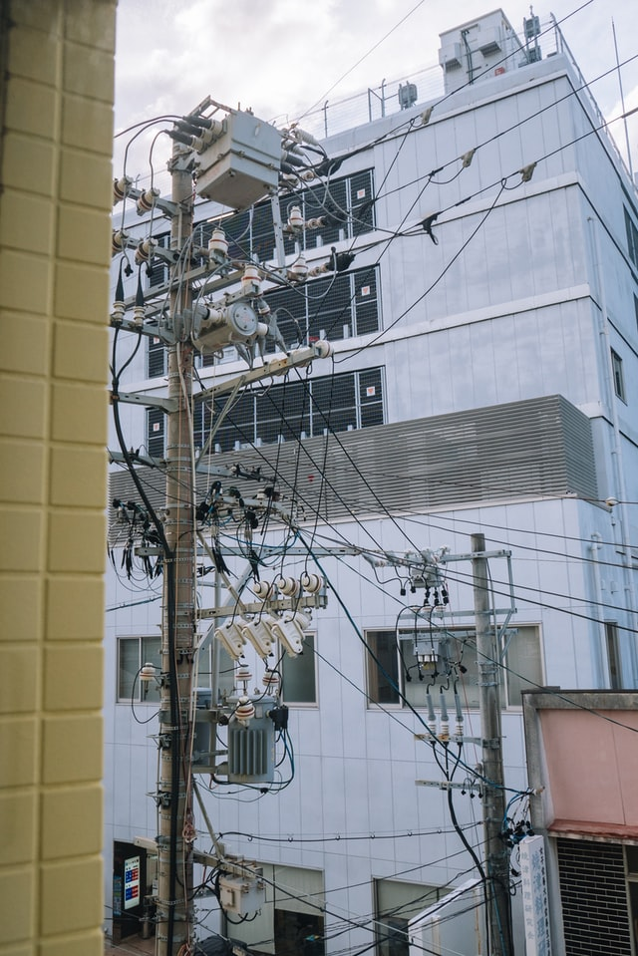
Next Steps
Improvements to current reporting being contemplated:
  Improvement in usability of data presented in annual reports:
Outreach and Validation:
  Engage a diverse set of stakeholder about the usefulness of data.
  Talk to the utilities about expanding access to reliability data.
  Monitoring annual public reliability meetings.
Future improvements we would like to see:
  GIS formats of data complete with historical metrics.
  Enhanced data granularity (circuit level).
  Reliability effects of PSPS and other outage types.
  Narrative description of mitigation measures taken to remediate poor circuit performance.
Overlaps with ongoing efforts:
  Value of resiliency and resiliency metrics.
  Microgrids Incentive Program.
  PG&E Regionalization.
Photo by Edvin Johansson on Unsplash

Slide 32
Questions?

Slide 33
Additional slides can be made available upon request.
Julian.Enis@cpuc.ca.gov

Slide 34

Julian.Enis@cpuc.ca.gov

Slide 35
Appendix A
Mathematical definitions and visual explanations of reliability metrics.

Slide 36
Electric System Reliability Metrics
Visually, these statistics can be calculated from the data below for a given outage event:
Total Number of Customers Served
Number of Customers Interrupted
t = Restoration Time for the Event
  t < 5 minutes = momentary outage
  t > 5 minutes = sustained outage
t
t
t
t
t
t
t
t
t
t
t
t

Slide 37
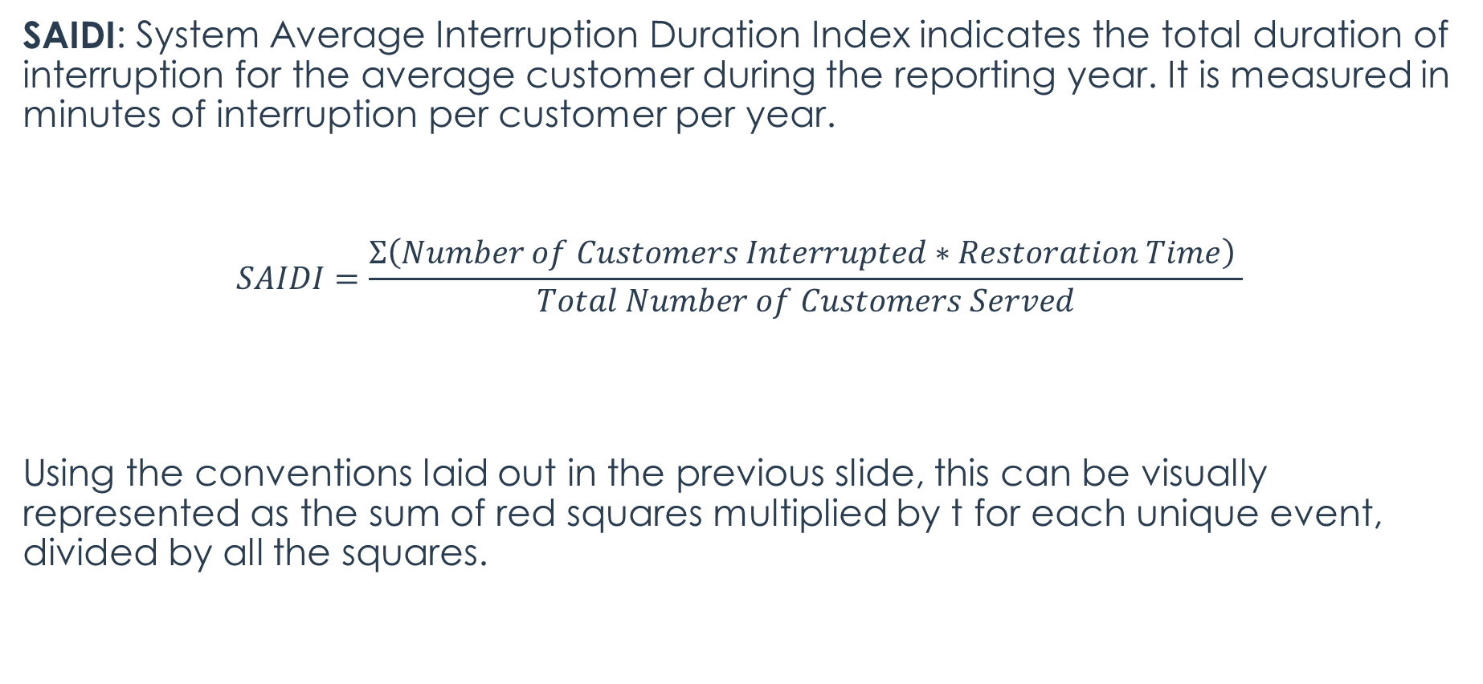
Electric System Reliability Metrics
SAIDI: System Average Interruption Duration Index indicates the total duration of interruption for the average customer during the reporting year. It is measured in minutes of interruption per customer per year.
$$SAIDI=\frac{Σ\left(Number of Customers Interrupted∗Restoration Time\right) }{Total Number of Customers Served}$$
Using the conventions laid out in the previous slide, this can be visually represented as the sum of red squares multiplied by t for each unique event, divided by all the squares.

Slide 38
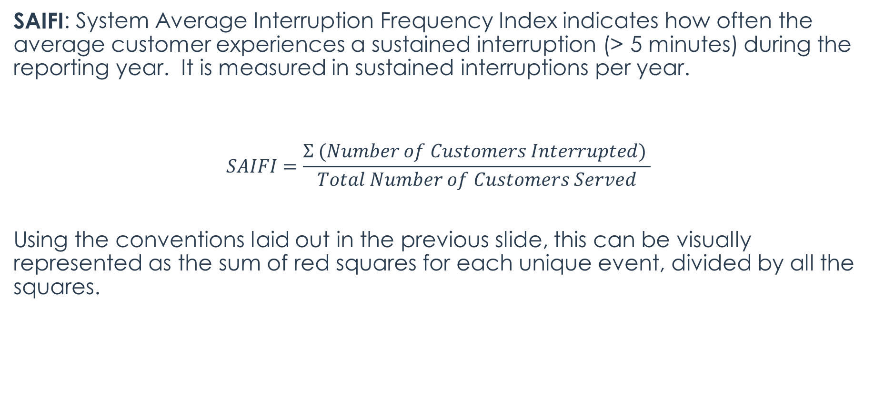
Electric System Reliability Metrics
SAIFI: System Average Interruption Frequency Index indicates how often the average customer experiences a sustained interruption (> 5 minutes) during the reporting year. It is measured in sustained interruptions per year.
$$SAIFI=\frac{Σ (Number of Customers Interrupted) }{Total Number of Customers Served}$$
Using the conventions laid out in the previous slide, this can be visually represented as the sum of red squares for each unique event, divided by all the squares.

Slide 39
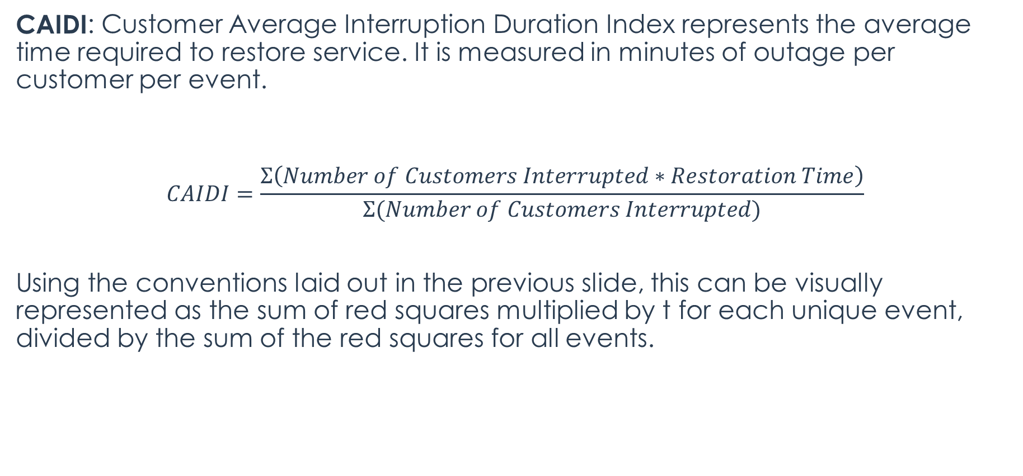
Electric System Reliability Metrics
CAIDI: Customer Average Interruption Duration Index represents the average time required to restore service. It is measured in minutes of outage per customer per event.
$$CAIDI=\frac{Σ\left(Number of Customers Interrupted∗Restoration Time\right)}{Σ(Number of Customers Interrupted)}$$
Using the conventions laid out in the previous slide, this can be visually represented as the sum of red squares multiplied by t for each unique event, divided by the sum of the red squares for all events.

Slide 40
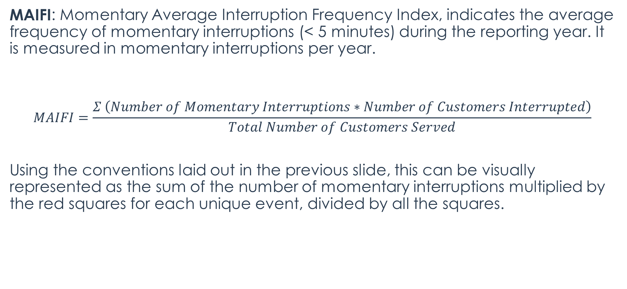
Electric System Reliability Metrics
MAIFI: Momentary Average Interruption Frequency Index, indicates the average frequency of momentary interruptions (< 5 minutes) during the reporting year. It is measured in momentary interruptions per year.
$$MAIFI=\frac{Σ \left(Number of Momentary Interruptions∗Number of Customers Interrupted\right)}{Total Number of Customers Served}$$
Using the conventions laid out in the previous slide, this can be visually represented as the sum of the number of momentary interruptions multiplied by the red squares for each unique event, divided by all the squares.

Slide 41
Electric System Reliability Metrics
AIDI: Average Interruption Duration Index, represents the average time required to restore service for a particular district or circuit. It is measured in minutes of outage per customer per event and is calculated the same as SAIDI for a particular district or circuit. Also known as dSAIDI or District System Average Interruption Duration Index.
AIFI: Average Interruption Frequency Index, indicates how often the average customer experiences a sustained interruption over a predefined period for a particular district or circuit. It is measured in sustained interruptions per year and is calculated the same as SAIFI for a particular district or circuit. Also known as dSAIFI or District System Average Interruption Frequency Index.
Note: AIDI and AIFI are not official metrics as defined by IEEE 1366, however some utilities use these designations to differentiate district/circuit level reliability data from system level data.

Slide 42
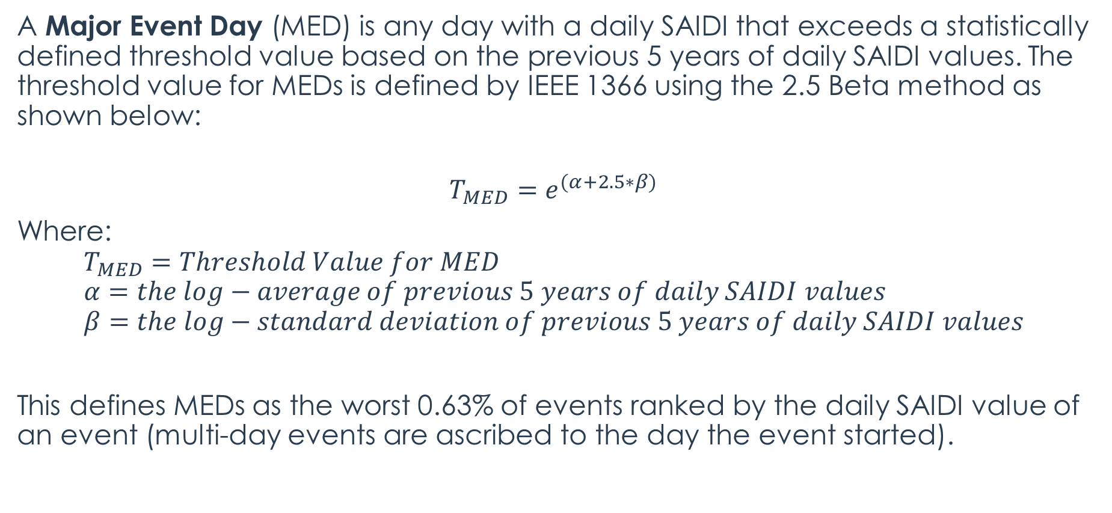
Electric System Reliability Metrics
A Major Event Day (MED) is any day with a daily SAIDI that exceeds a statistically defined threshold value based on the previous 5 years of daily SAIDI values. The threshold value for MEDs is defined by IEEE 1366 using the 2.5 Beta method as shown below:
$$T_{MED}=e^{(α+2.5∗β)}$$
Where:
$$T_{MED}=Threshold Value for MED \\ α=the log−average of previous 5 years of daily SAIDI values \\ β=the log−standard deviation of previous 5 years of daily SAIDI values$$
This defines MEDs as the worst 0.63% of events ranked by the daily SAIDI value of an event (multi-day events are ascribed to the day the event started).

