Slide 1
Briefing on the
Distributed Energy Resources (DER)
Action Plan 2.0
Presented April 21, 2022
DER Action Plan 2.0 Steering Committee: Simon Baker, Gabe Petlin, Paul Phillips, and Joy Morgenstern

Slide 2
Agenda
  Background and Purpose of Draft DER Action Plan 2.0
  Overview of Action Plan Vision by Track
  Implementation and Reporting 2022 - 2026
Notes:
Discuss Next Steps.
Initiate DER Action Plan refresh and new DRP OIR?
Timeline for discussions with other Commissioners?

Slide 3
DER ACTION PLAN 2.0- BACKGROUND
Distributed Energy Resources are electric distribution-connected energy resources
  Energy efficiency
  Demand response
  Dynamic and time-variant rates
  (e.g., Time of Use, Critical Peak Pricing, and Real-Time)
  Customer generation (e.g., solar photovoltaic (PV) systems)
  Energy storage
  Electric vehicles (EV)
  DER are accessible to customers through
Direct incentive programs
Tariffs
Procurement processes managed by the electric IOUs
Third-party implementers
Community choice aggregators (CCAs).
Notes:
Note: Grant will jump in to clarify that we are mainly going to focus EE, DR, customer generation and BTM storage. If leg staff has any questions about anything else on this list let us know offline.

Slide 4
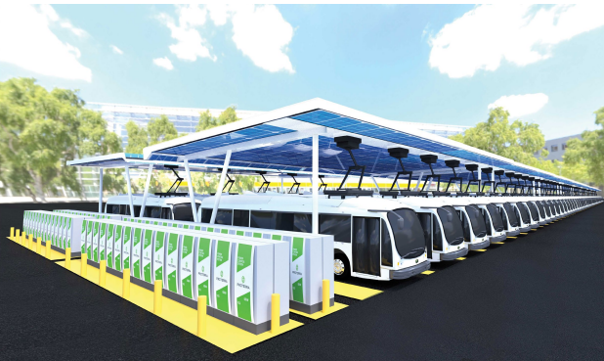
Market & Policy Drivers for a High DER Future
Rapid technological advancements
Declining prices
Consumer preferences
New and emerging energy providers
Potential to help achieve state policy goals
  Improve electric service reliability, resiliency and environmental performance
  Mitigate the increasing rate of electric service costs
Source: CleanTechnica

Slide 5
DER ACTION PLAN 2.0- GOALS & PURPOSE
What is the DER Action Plan?
  A roadmap for CPUC decision-makers, staff, and stakeholders to facilitate forward-thinking DER policy.
What does the DER Action Plan do?
  Aligns the CPUC’s vision with possible CPUC, utility and stakeholder actions to ensure coordinated policy implementation related to grid planning, affordability, load flexibility, market integration, and customer programs.
  Coordinate with Environmental & Social Justice Action Plan
What is the goal of the DER Action Plan?
  Maximize the value of DERs on the electric IOUs systems to support affordable and equitable rates but does NOT determine outcomes of individual proceedings.

Slide 6
STAKEHOLDER ENGAGEMENT
Collaboration
Subject matter experts (SMEs)
DER Action Plan 2.0 Committee
  Representatives of Commissioner Houck's Office
  ALJ Division Management
  Energy Division Management, and
  Energy Division subject matter experts
  – a one year + process.
Vetting
A draft plan was presented in August 2021 to a stakeholder workshop with 200+ in attendance.
  Tribal Consultation- September
  35 written comments
  CEC and CAISO briefings
Adoption
April 21 – Commission meeting
Notes:
Note: Grant will jump in to clarify that we are mainly going to focus EE, DR, customer generation and BTM storage. If leg staff has any questions about anything else on this list let us know offline.

Slide 7
DER ACTION PLAN DRAFT 2.0
VISION ELEMENTS & ACTIONS

Slide 8
DER Action Plan 2.0 – 4 TRACKS
TRACK ONE
Load Flexibility & Rates
  Purpose: Improve demand-side resource management through more effective, integrated demand response (DR) and retail rate structures.
  How: Promote widespread, scalable, and flexible load strategies enabled by electrification and DER deployment.
  Real-time & dynamic pricing
  Load management technologies
  Universal access pricing platform
  Customized rate marketing and education of all customer segments
TRACK TWO
Grid Infrastructure
Purpose: Guide utility infrastructure planning and operations to maximize the value to ratepayers of DERs interconnected to the electric grid.
How: Modernize the grid and improve distribution planning
Explore DSO models
Planning responsive to community and tribal needs
Improve interconnection performance
Data communications for grid operator visibility
Anticipate impact of electrification on grid infrastructure
TRACK THREE
Market Integration
Purpose: Support renewable integration, GHG reduction, and grid reliability through efficient integration of DERs into wholesale markets.
How: Enable market integrated DERs to produce multiple benefits.
Resource Adequacy
Reliability
Efficient wholesale market grid services
TRACK FOUR
DER Customer Programs
Purpose: Improve coordination, planning and developing consistent metrics across DER customer programs to maximize their contributions to GHG reductions and other state energy goals.
How: enable all customers to effectively manage energy usage
equitable participation and distribution of benefits
alignment with evolving rate design and load flexibility
alignment with distribution planning & IRP objectives

Slide 9
DER ACTION PLAN 2.0
Proceeding and Initiatives List
TRACK ONE
Load Flexibility & Rates
Net Energy Metering
PG&E Day Ahead Hourly Real Time Pricing (DAHRTP) Rate and Pilot Application to Evaluate Customer Understanding and Supporting Technology
SDG&E, PG&E and SCE GRC Phase 2
Rate Design Applications for evaluating and implementing default residential TOU rate designs.
SDG&E Application for Approval of Electric Vehicle High Power (EV-HP) Charging Rate Application
Load Flexibility Management OIR, recommended by CPUC staff.
CEC’s Load Management Standard
TRACK TWO
Grid Infrastructure
High DER Future OIR
Streamlining Interconnection of Distributed Energy Resources and Improvements to Rule 21
Microgrids OIR
PG&E, SCE and SDG&E General Rate Case Phase 1
TRACK THREE
Market Integration
Resource Adequacy
Successor Storage and/or Demand Response OIR(s), as recommended by CPUC staff
Rule 21
FERC Order 2222 and Other FERC Proceedings
Potential CAISO Initiatives:
  Energy Storage and Distributed Energy Resources,
  Energy Storage Enhancements,
  Hybrid Resources,
  Transmission Planning Process,
  Storage as a Transmission Asset,
  Dispatch Enhancements (decremental market power and bid floor).
TRACK FOUR
DER Customer Programs
Self-Generation Incentive Program
Energy Efficiency
Building Decarbonization
Integrated Distributed Energy Resources
Transportation Electrification
Demand Response
Net Energy Metering
Energy Savings Assistance Program

Slide 10
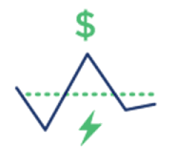


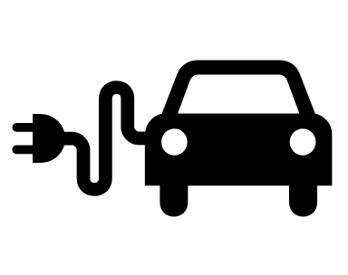
DER ACTION PLAN 2.0
Scope and Structure
TRACK ONE
Load Flexibility & Rates
8 Vision Elements
14 Action Elements
TRACK TWO
Grid Infrastructure
5 Vision Elements
21 Action Elements
TRACK THREE
Market Integration
4 Vision Elements
8 Action Elements
TRACK FOUR
DER Customer Programs
6 Vision Elements
17 Action Elements

Slide 11
DER ACTION PLAN IMPLEMENTATION
AND REPORTING
2022 – 2026

Slide 12
Implementation & Reporting
2022
Implementation of DER Action Plan 2.0 begins
2023-2025
Potential Mid-Point Status Report update of all Action Items
2025-2026
Anticipate DER Action Plan 3.0 update
Action Items have a 5-year time horizon
Steering Committee and staff track progress
Potential public presentation to Commissioners

Slide 13

Q&A/Discussion
Californi a Public Utilities Commis si on

Slide 14
THANK YOU!
Gabriel Petlin
Energy Division, Grid Planning, Energy Storage and Non-Wires Alternatives Section
Gabriel.Petlin@cpuc.ca.gov

