Slide 1
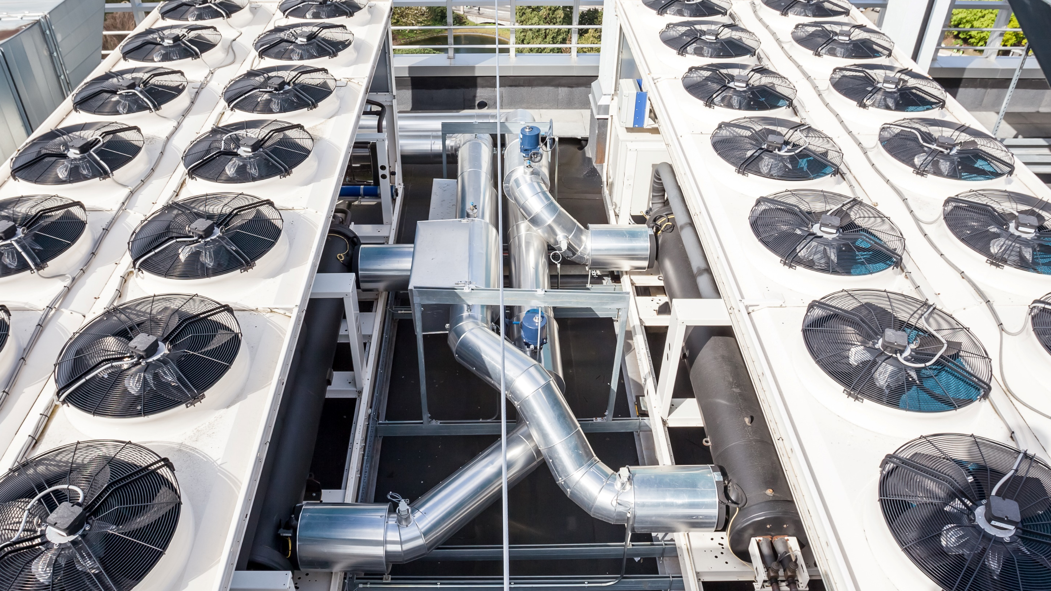
Combined Refrigerant Avoided Cost and Fuel-Substitution Calculators w/Technical Guidance Presentation
RACC-FSC_v3.0 Workbook and RACC-FSC Technical Guidance for
California Public Utilities Commission – Energy Division
March 6, 2024

Slide 2
CPUC Leads
Christina Torok
Refrigerants
Erik Johnson
Refrigerants
Travis Holtby
Fuel Substitution
Peter Biermayer
Deemed Measures
DNV Contributors
Brad Hoover
Project Sponsor
Bryan Kilgore
Project Manager
Rachel Murray
Subject Matter Expert
Acknowledgements to Energy + Environmental Economics, Inc. (E3) and Solaris Technical LLC for their contributions to and review of these tools.

Slide 3

Agenda
3:00 pm Background
3:10 Refrigerant Code Updates
3:15 RACC Examples
3:35 FSC Examples
3:55 Technical Guidance Document
4:05 RACC-FSC Workbook
4:15 Next Steps
4:20 Questions
Please post questions in Q&A
Responses will be provided between agenda items
Global warming emissions from:
Refrigerant Leakage
Electric Generation/Usage
Natural Gas Distribution/Usage

Slide 4

Background

Slide 5
Core Functionality of Tools
RACC
Refrigerant Avoided Cost Calculator
Calculates lifecycle emissions due to refrigerants in measure and baseline equipment
Uses California Air Resources Board (CARB) lifecycle equipment emissions rates to determine:
  Annual operational leakage
  End-of-life leakage
Determines net present value (NPV) lifecycle costs of refrigerant leakage emissions
Must be completed for measure packages or custom applications that involve addition of refrigerant or changes to refrigerant types or charges
FSC
Fuel Substitution Calculator
Determines whether fuel substitution measures pass Part 1 and Part 2 of the fuel substitution test:
  No increase to source energy* usage
  No increase in net CO2e emissions
Accounts for refrigerant leakage
Accounts for methane leakage
  Upstream of natural gas power plants
  Behind the meter (residential, only)
Must be completed for deemed or custom fuel substitution measures
*Source energy represents the total amount of raw fuel that is required to operate a given piece of equipment or end-use. It includes transmission, delivery, and production losses.

Slide 6
RACC and FSC Updates
RACC
Refrigerant Avoided Cost Calculator
Deemed Measure RACC v2.2: 8/2023
RACC v1b updated: 9/2022
Deemed Measure RACC v1.3-Rev4: 11/2021
RACC v1b: 6/2021
FSC
Fuel Substitution Calculator
DRAFT Fuel Substitution Calculator v2.0: 10/2022 (never approved)
Fuel Substitution Calculator v.1.1: 12/2020
RACC-FSC
Refrigerant Avoided Cost Calculator and Fuel Substitution Calculator
RACC-FSC_v3.0_DRAFT: 2/28/2024
RACC and FSC were combined to ensure that both used same assumptions:
Code updates | GWP baselines | Leakage rates | ACCs & Heat rates

Slide 7

U.S. Environmental Protection Agency (EPA)
California Air Resources Board (CARB)
Refrigerant Code Updates

Slide 8
Key EPA and CARB Refrigerant GWP Updates
Equipment | 2024 | 2025 | 2026
HVAC: Systems and Chillers | GWP: ≤ 3,985 R-410A (GWP 2,088) | EPA: GWP ≤ 700 CARB: GWP < 750
HVAC: Products (Portable, Window, PTAC,† & PTHP‡) | EPA: GWP: - CARB: GWP <750 | EPA: GWP < 700* CARB: GWP < 750
HVAC: Variable Refrigerant Flow | GWP: ≤ 3,985 R-410A (GWP 2,088) |  | EPA: GWP ≤ 700 CARB: GWP < 750
HP Water Heater | EPA: - ENERGY STAR:® GWP ≤ 2,088 | EPA: -
HP Clothes Dryer | EPA: - ENERGY STAR: GWP ≤ 1,430 | EPA: -
*EPA limits for products manufactured after January 1, 2025
†Packaged Terminal Air Conditioner
‡Packaged Terminal Heat Pump

Slide 9
Key EPA and CARB Refrigerant GWP Updates
Equipment | 2024 | 2025 | 2027 | 2030
New Retail Refrigeration > 50 lb. refrigerant | CARB GWP: <150
Existing Retail Refrigeration > 50 lb. (> 20 stores) | CARB GWP: - EPA GWP: - | CARB GWP: - EPA GWP: - | CARB GWP: < 2,500 (average) EPA GWP: - | CARB GWP: 1,400 (average) EPA GWP: -
Existing Retail Refrigeration > 50 lb. (< 20 stores) | CARB GWP: - EPA GWP: - |  |  | CARB GWP: 1,400 (average) EPA GWP: -
New Stand-alone Refrigeration Unit | EPA/CARB GWP: - ENERGY STAR® GWP: 2 | EPA GWP: < 150

Slide 10
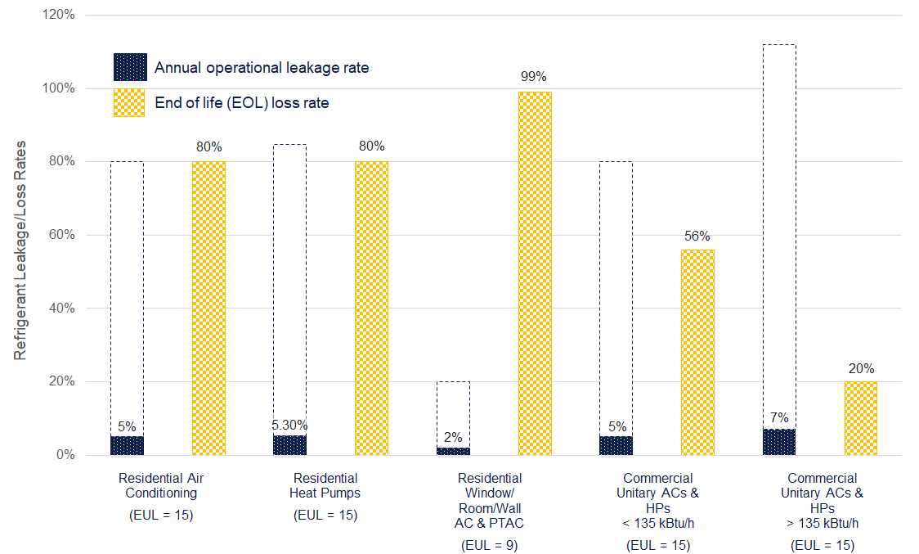
Refrigerant Leakage/Loss Rates

Slide 11

Refrigerant Avoided Cost Calculator (RACC)
Key Updates & Examples

Slide 12

Key RACC Updates*
Incorporates EPA and CARB refrigerant global-warming potential (GWP) limits:
  Establishes GWP-limit baselines
  Uses future GWP-limit baseline for Accelerated Replacement (AR) measure application type (MAT)
Eliminates pro-rating of end-of-life refrigerant emissions for counterfactual cases of AR MAT
Enables possible avoided emissions credit when recovery/reclamation of existing equipment’s high-GWP refrigerant is documented†
Adds graphs to provide visual representation of refrigerant emissions over equipment life(s)
Connects to DEER database for updates
U.S. Environmental Protection Agency (EPA)
California Air Resources Board (CARB)
* Compared to Deemed_Measure_RACC_Workbook_v2.2.xlsx
† Documentation requirements are under development and will need to be agreed upon during measure package/custom application development for avoided emissions credit to be claimed.
Notes:
Incorporates EPA and CARB refrigerant GWP limits:
Establishes GWP-limit baselines
For AR MAT, uses future GWP-limit baseline
Eliminates pro-rating of end-of-life refrigerant emissions for counterfactual cases of AR MAT
Enables avoided emissions credit when recovery/reclamation of existing equipment’s high-GWP refrigerant is documented
Adds graphs to provide visual representation of refrigerant emissions over equipment life(s)

Slide 13
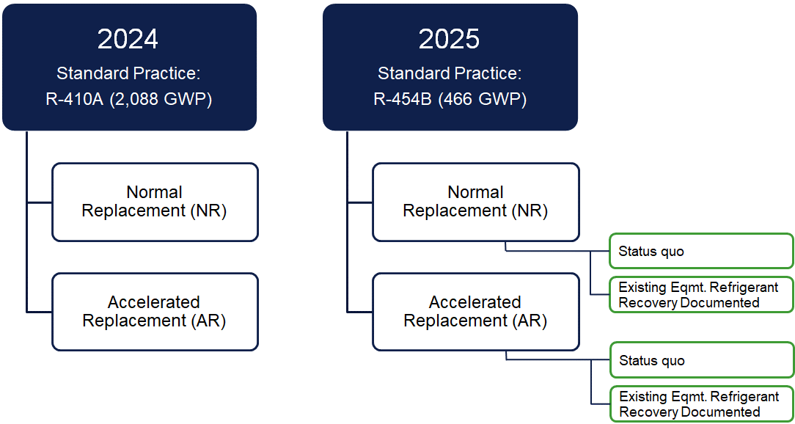
RACC Analysis Charts: Res. HP replacing AC/gas furnace*
* Using SWHC045-03 fuel-substitution measure package permutations approved for PY2024-2025

Slide 14
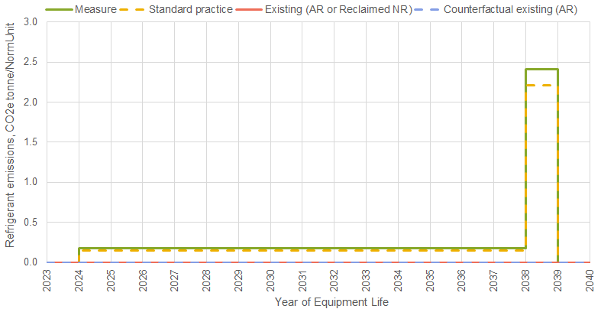
2024 Heat Pump Fuel Substitution: Refrigerant Emissions
Sector = Residential
MAT = Normal Replacement (NR)
Measure:
Heat Pump
R-410A (2,088)
3.5 lb. charge/ton
Standard:
AC w/Gas furnace
R-410A (2,088)
3.2 lb. charge/ton
Net Refrigerant Benefit (2022$):
-$74.95
Emissions due to end-of-life (EOL) leakage
2.06 CO_{2e} tonne per Ton of cooling capacity
CARB assumptions:
5% annual leakage
80% end-of-life leakage
for residential HPs and ACs
Emissions due to annual leakage (operational)

Slide 15
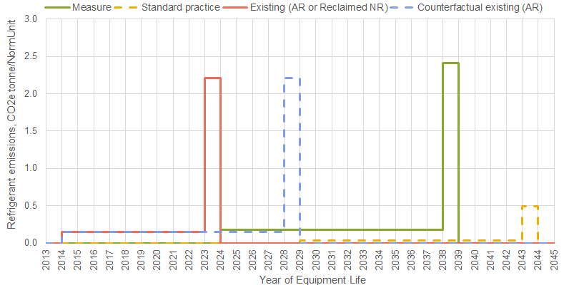
2024 Heat Pump Fuel Substitution: Refrigerant Emissions
Sector = Residential
MAT = Accelerated Replacement (AR)
Measure:
Heat Pump
R-410A (2,088)
3.5 lb. charge/ton
Standard:
AC w/Gas furnace
R-454B (466)
3.2 lb. charge/ton
Existing/Existing:
AC w/Gas furnace
R-410A (2,088)
3.2 lb. charge/ton
Net Refrigerant Benefit (2022$):
-$466.73
Emissions due to end-of-life (EOL) leakage
2.06 CO_{2e} tonne per Ton of cooling capacity
CARB assumptions:
5% annual leakage
80% end-of-life leakage
for residential HPs and ACs

Slide 16
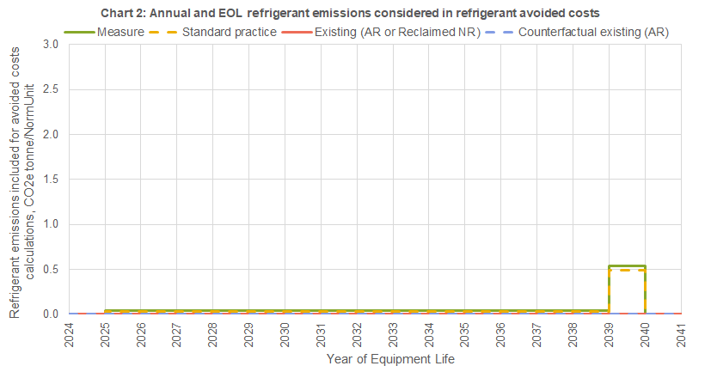
2025 Heat Pump Fuel Substitution: Refrigerant Emissions
Sector = Residential
MAT = Normal Replacement (NR)
Measure:
Heat Pump
R-454B (466)*
3.5 lb. charge/ton
Standard:
AC w/Gas furnace
R-454B (466)
3.2 lb. charge/ton
Net Refrigerant Benefit (2022$):
-$17.64
Emissions due to end-of-life (EOL) leakage
0.54 CO_{2e} tonne per Ton of cooling capacity (compared to 2.06 in 2024)
* The only current viable and compliant alternative to R-454B is HFC-32 (675), a.k.a. R-32.

Slide 17
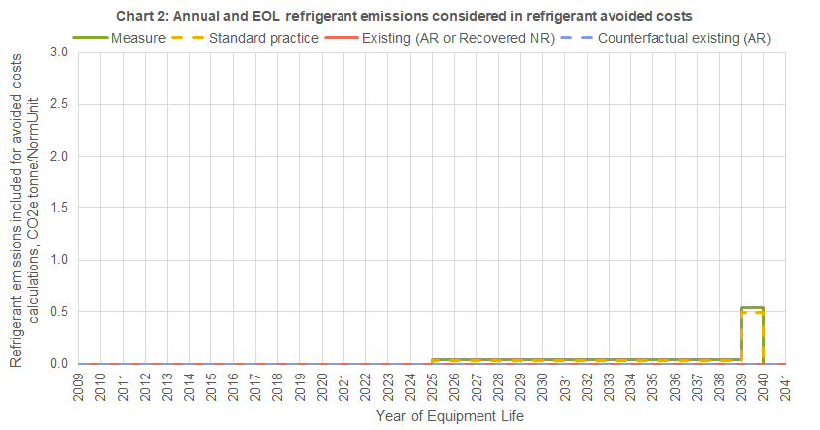

2025 Heat Pump Fuel Substitution: Refrigerant Emissions
Sector = Residential
MAT = NR Normal Replacement
Measure:
Heat Pump
R-454B (466)
3.5 lb. charge/ton
Standard:
AC w/Gas furnace
R-454B (466)
3.2 lb. charge/ton
Existing:
AC w/Gas furnace
R-410A (2,088)
3.2 lb. charge/ton
Existing equipment refrigerant recovery documentation provided
Net Refrigerant Benefit (2022$):
$289.16

Slide 18
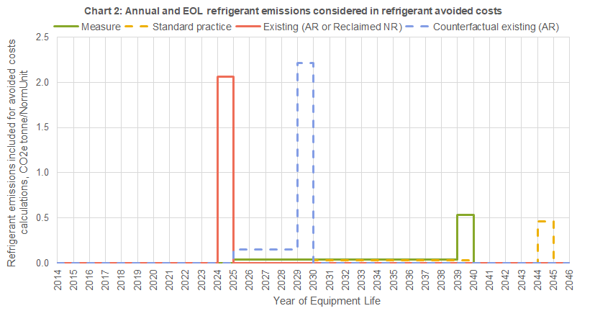
2025 Heat Pump Fuel Substitution: Refrigerant Emissions
Sector = Residential
MAT = Accelerated Replacement (AR)
Measure:
Heat Pump
R-454B (466)
3.5 lb. charge/ton
Standard:
AC w/Gas furnace
R-454B (466)
3.2 lb. charge/ton
Existing/Existing:
AC w/Gas furnace
R-410A (2,088)
3.2 lb. charge/ton
Net Refrigerant
Benefit (2022$):
$69.64

Slide 19
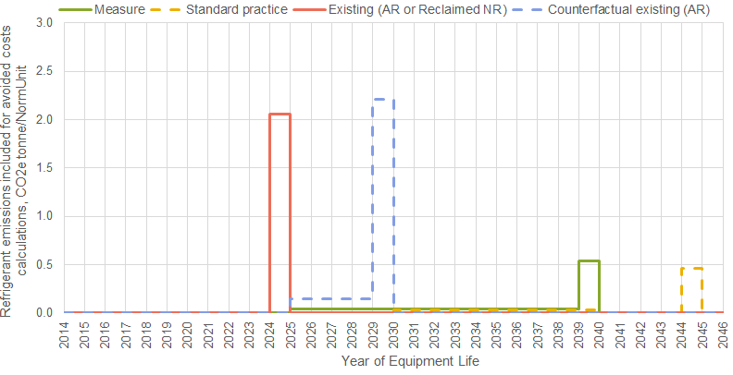
2025 Heat Pump Fuel Substitution: Refrigerant Emissions
Sector = Residential
MAT = Accelerated Replacement (AR)
Measure:
Heat Pump
R-454B (466)
3.5 lb. charge/ton
Standard:
AC w/Gas furnace
R-454B (466)
3.2 lb. charge/ton
Existing/Existing:
AC w/Gas furnace
R-410A (2,088)
3.2 lb. charge/ton
Net Refrigerant
Benefit (2022$):
$376.44
Existing equipment refrigerant recovery documentation provided

Slide 20
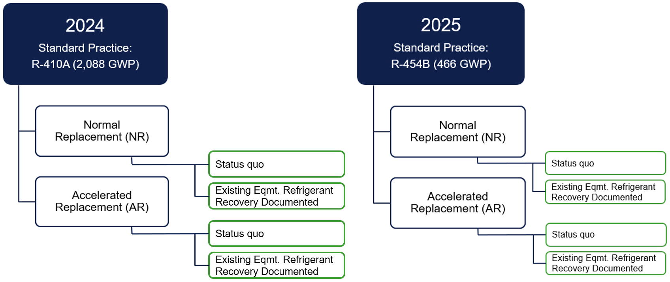
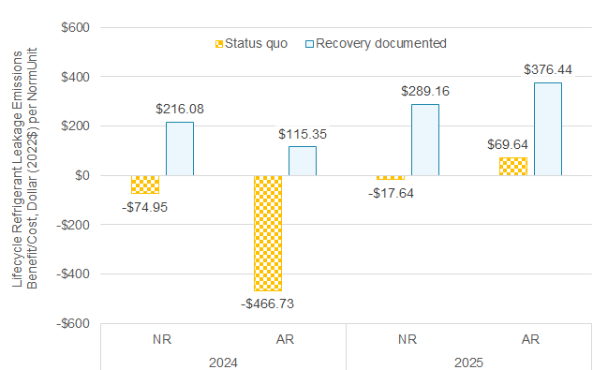
Lifecycle Refrigerant Benefit for Residential Heat Pump Fuel Substitution Measure, Dollar per Cap-Ton (2022$)
*Documentation requirements are still very much under development and will need to be agreed upon during measure package/custom application development for avoided emissions credit to be claimed.

Slide 21
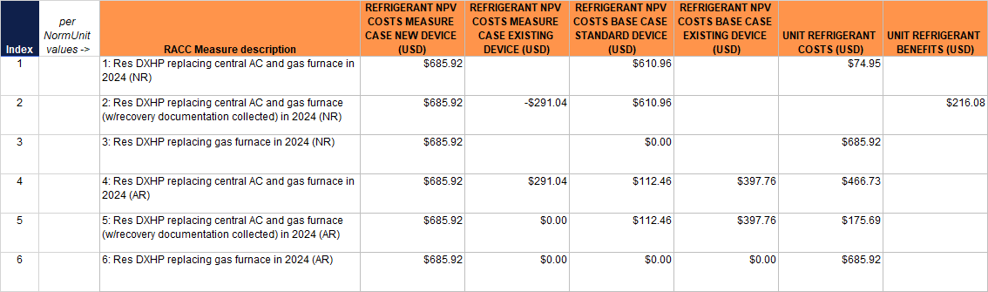
Export for Measure Package Developers on 4 eTRM export

Slide 22

Fuel Substitution Calculator (FSC)
Key Updates & Examples

Slide 23

Key FSC Updates
Accounts for lifecycle refrigerant leakage emissions
Accounts for methane leakage emissions
Uses lifecycle emissions due to annual and end-of-life refrigerant leakage drawn from the RACC worksheet
Imputes residential space cooling adoption by climate zone when existing cooling equipment was not present (compares 2009 RASS to 2019 RASS data)
Calculates maximum refrigerant GWP threshold by permutation to pass Part 2 of the Fuel Substitution Test
RACC-FSC is connected to DEER tables to enable updates to EULs, ACCs, etc. without re-issuing workbook

Slide 24
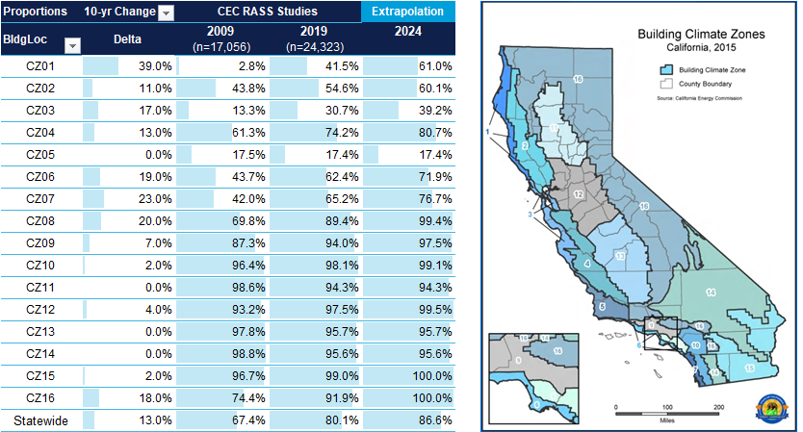
Residential Space Cooling Proportions by Climate Zone
Notes:
The weights to be used for new fuel substitution offerings—where existing equipment did not include cooling—are extrapolated from the 2019 RASS proportions of homes with room/central AC using the trendline formed by the difference between those proportions and those reported by the 2009 RASS.

Slide 25
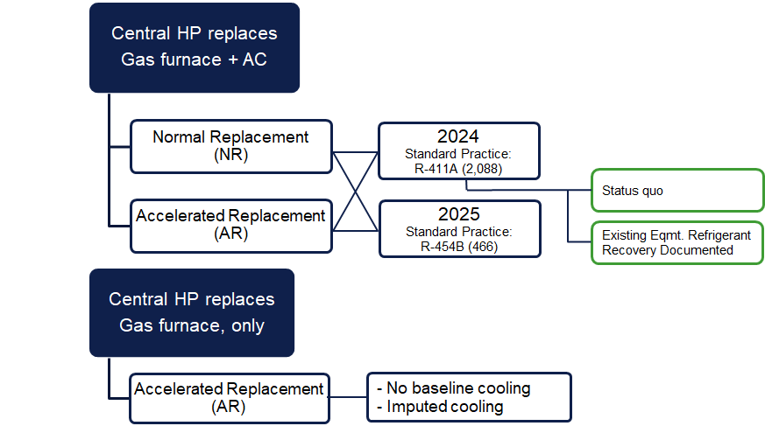
FSC Analysis Pivot Tables
Res. HP replacing gas furnace w/ & w/o AC*
* Using SWHC045-03 fuel-substitution measure package permutations approved for PY2024-2025

Slide 26
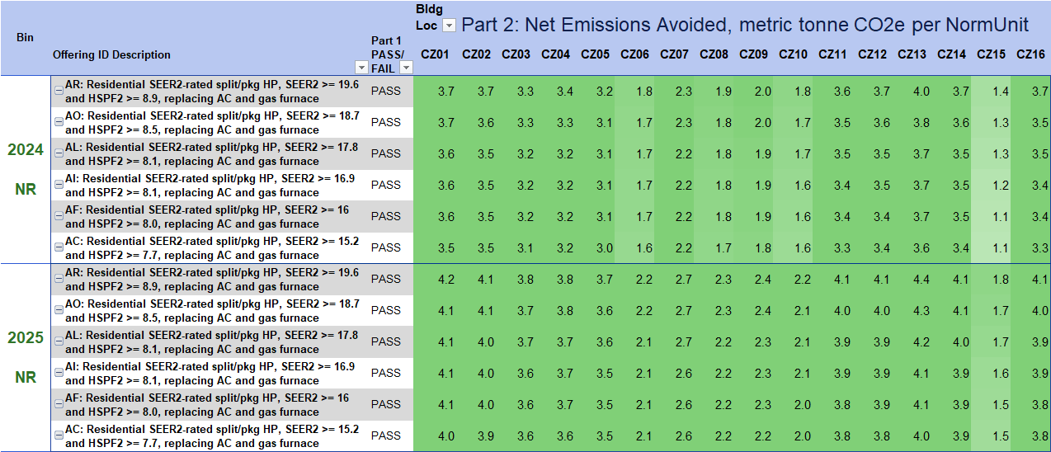
FuelSub Test Results at Single-family Homes
Central Heat Pump Replacing Central AC and Gas Furnace – NR*
SEER2 19.6
R-410A (2,088 GWP)
SEER2 15.2
SEER2 19.6
R-454B (466 GWP)
SEER2 15.2
* Using SWHC045-03 fuel-substitution measure package permutations approved for PY2024-2025

Slide 27
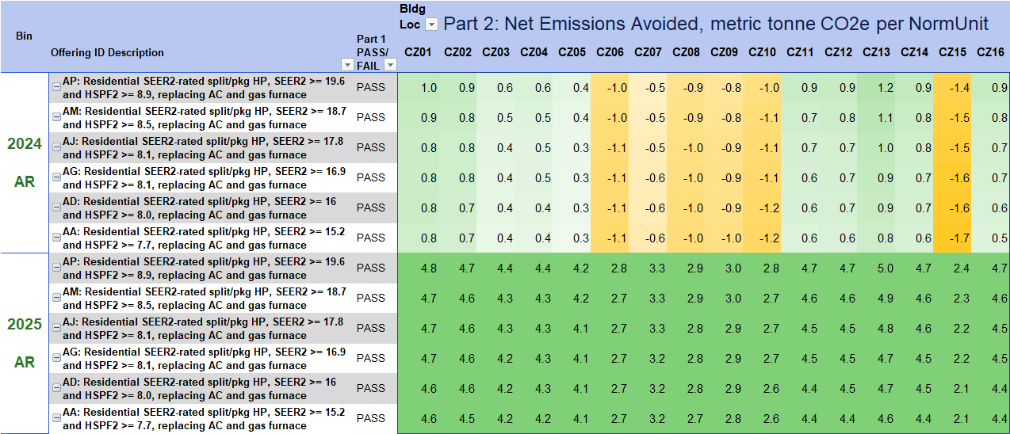

FuelSub Test Results at Single-family Homes: Central Heat Pump
Replacing Central AC and Gas Furnace – Accelerated Replacement
SEER2 19.6
SEER2 15.2
SEER2 19.6
SEER2 15.2

Slide 28
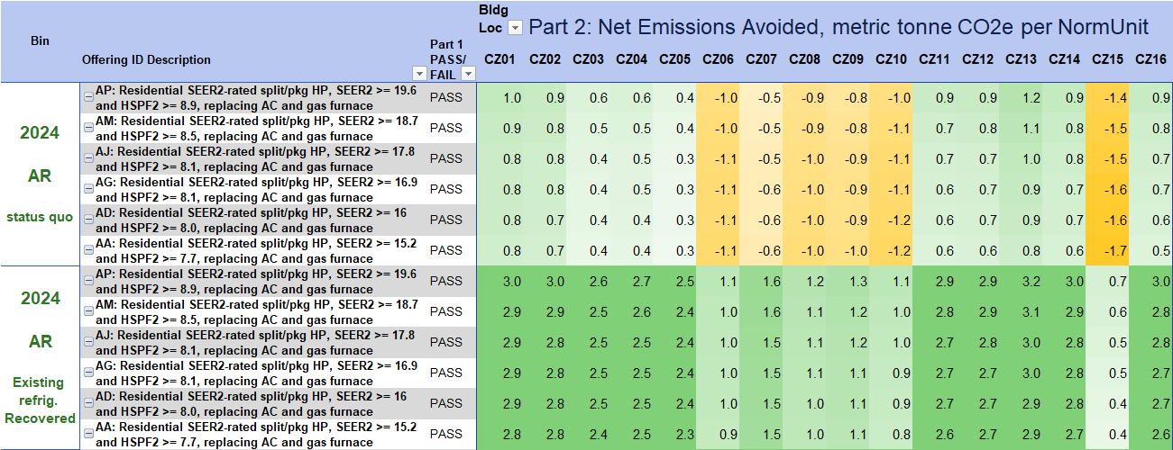
FuelSub Test Results at Single-family Homes: Central Heat Pump
Replacing Central AC and Gas Furnace, without and with EOL refrigerant recovery/reclamation
SEER2 19.6
SEER2 15.2
SEER2 19.6
SEER2 15.2

Slide 29
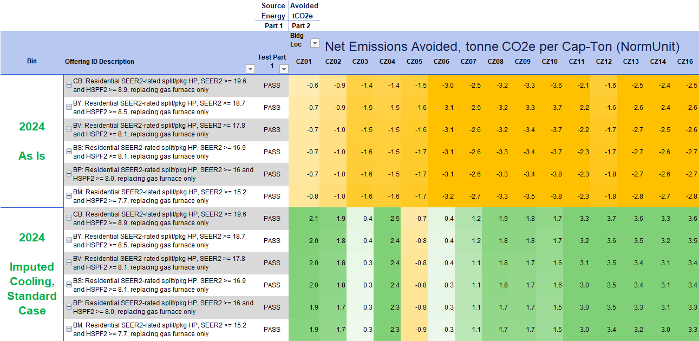

FuelSub Test Results at Single-family Homes: Central Heat Pump
Replacing Gas Furnace, only, with/without Imputed Cooling
SEER2 19.6
AR
SEER2 15.2
SEER2 19.6
AR
SEER2 15.2

Slide 30

Technical Guidance Document
Refrigerant ACC and Fuel-Substitution Calculator Technical Guidance

Slide 31
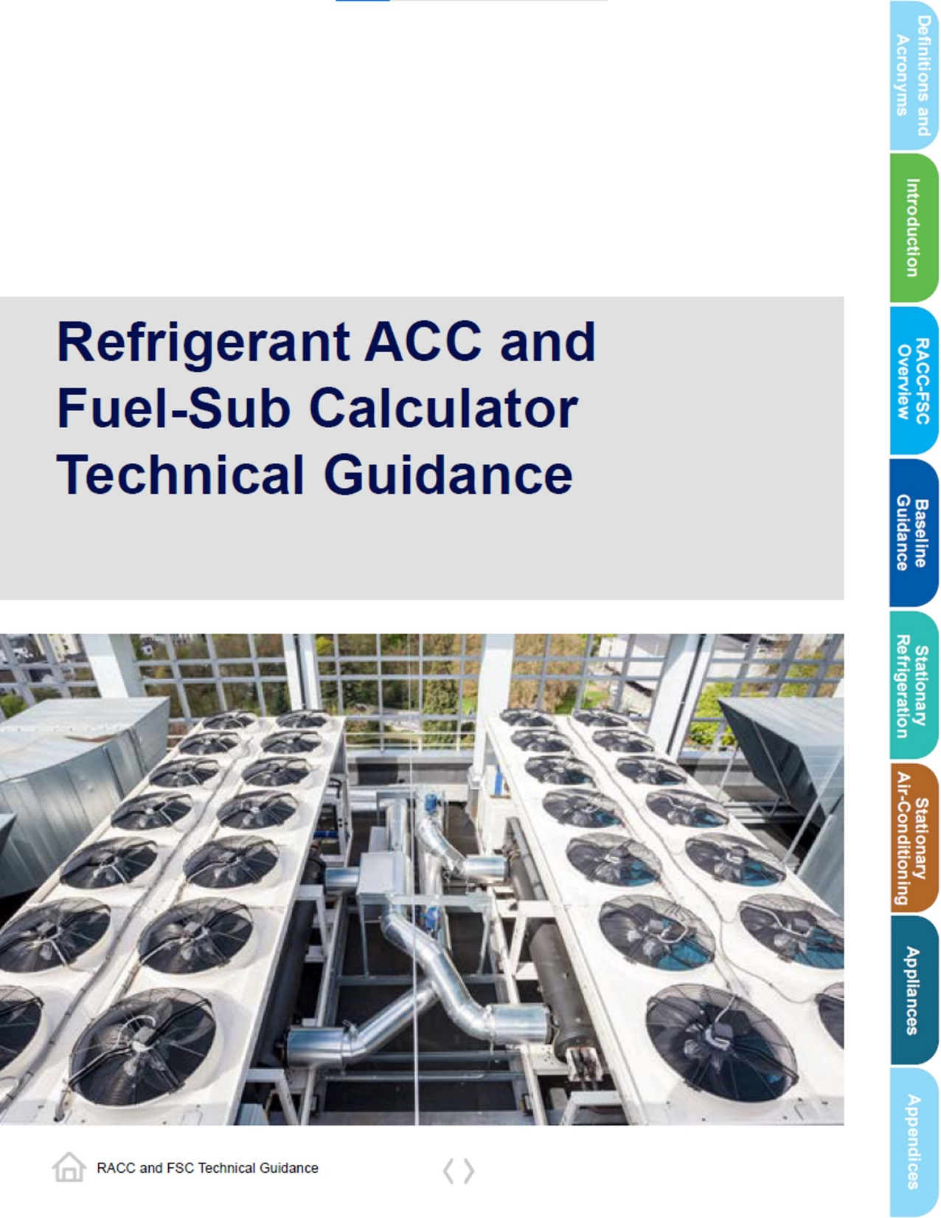
Guidance Document overview
Document posted to PDA on 2/28/2024 with RACC-FSC Workbook
Document Includes:
  Detailed review of RACC-FSC workbook
  Baseline Guidance
    Appropriate baselines
    EUL/RUL considerations
    Refrigerant charge
    Current refrigerant emissions policies
  Measure Example Walkthroughs
    Stationary Refrigeration
    Stationary Air-Conditioning
    Appliance

Slide 32




Navigating the Guidance Document
PDF document produced using InDesign
Easy navigation through the document
  Section tabs allow quick-access to each section
  Return to cover page
  Previous/Next page
  Click to open dialogue boxes for additional notes/guidance

Slide 33
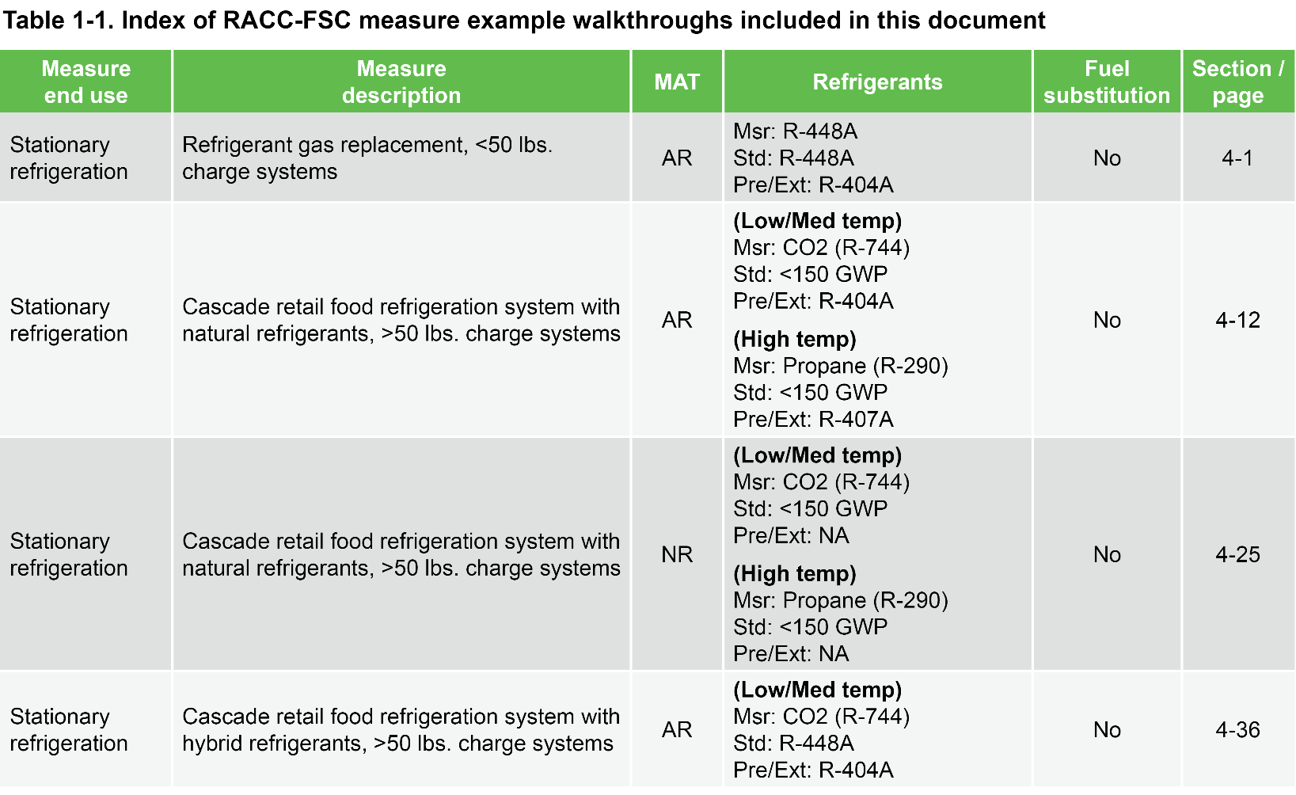
Example Walkthrough Index
Found in the Introduction Section
Provides quick overview of measure examples
  Description
  Measure Application Type
  Refrigerant types
  Fuel substitution flag
  Link to measure example document

Slide 34
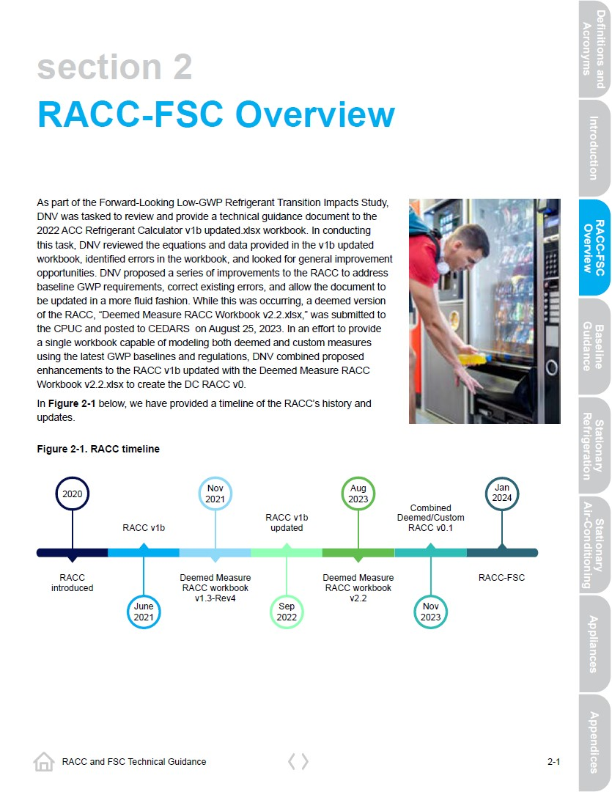
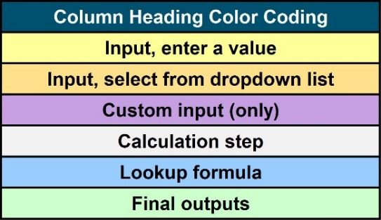
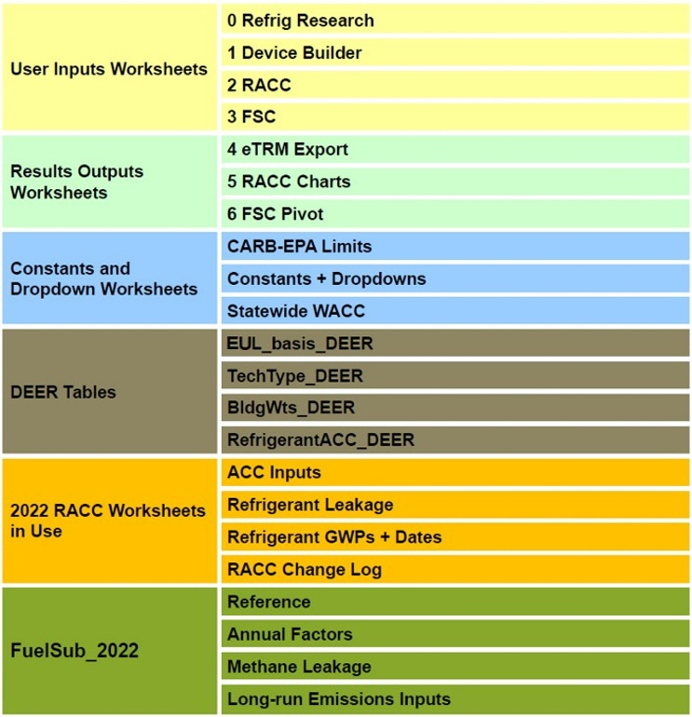
RACC-FSC Overview Section
Provides overview of each worksheet
  Describes each column and
  Worksheet methodology
Defines color coding for worksheets and columns

Slide 35
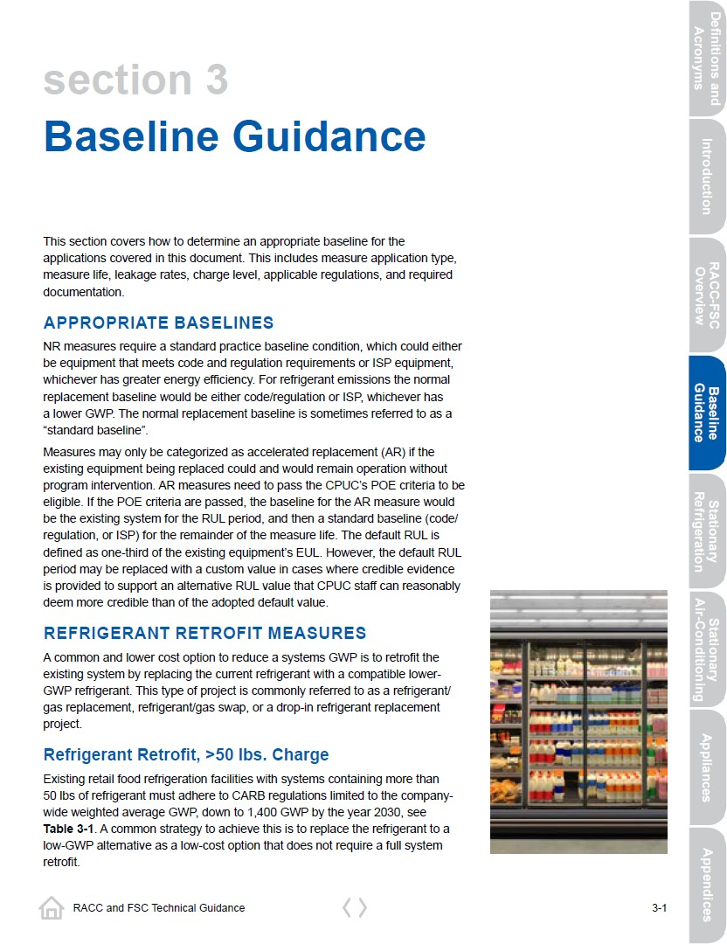
Baseline Guidance Section
Appropriate baselines
Refrigerant retrofit measures
EUL/RUL considerations
Leakage rates
Refrigerant charges
Hybrid system measures
Refrigerant emission policies (CARB/EPA)

Slide 36
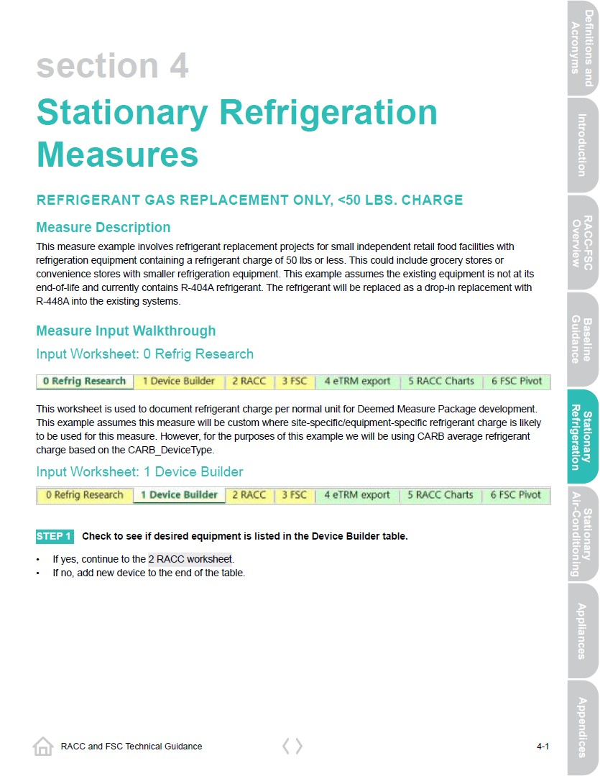
Example Walkthroughs
Refrigeration Measures
Sample of measure example type:
Natural refrigerant retail refrigeration
Hybrid (natural / HFC) retail refrigeration
Commercial ice machines
Stand-alone units
Refrigerated food processing and dispensing
Cold storage warehouse

Slide 37
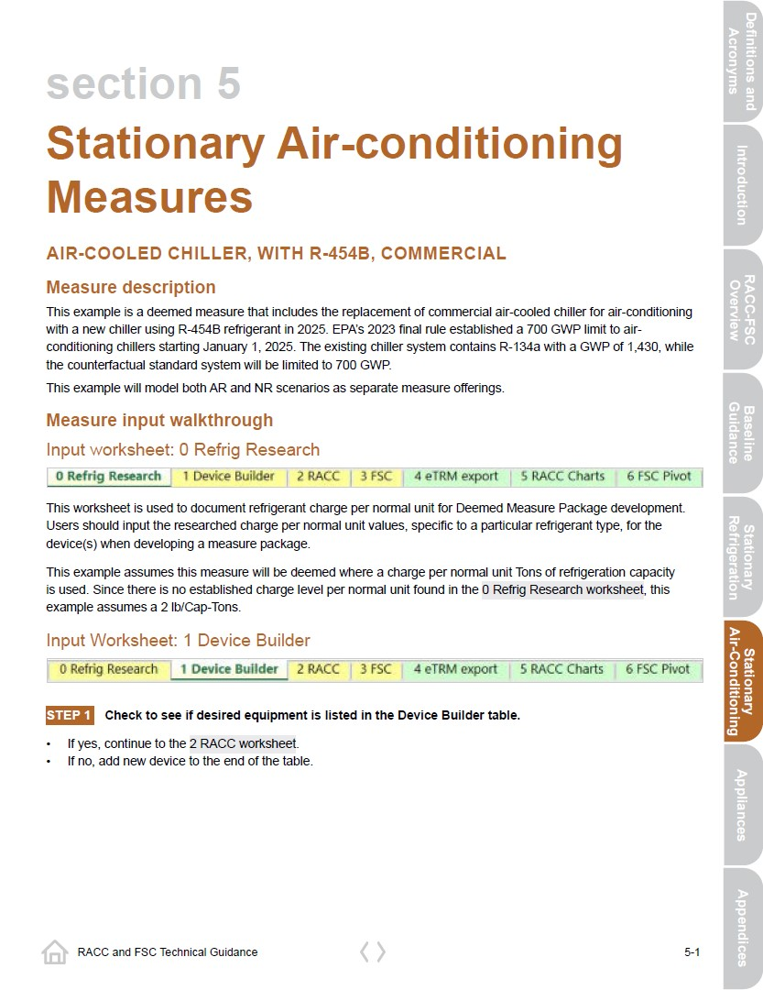
Example Walkthroughs
HVAC Measures
Sample of measure example type:
Residential central heat pump, replacing gas furnace with/without AC (Fuel Sub)
Residential ductless heat pump, replacing gas furnace with/without AC (Fuel Sub)
HVAC Chiller
Commercial unitary RTU

Slide 38
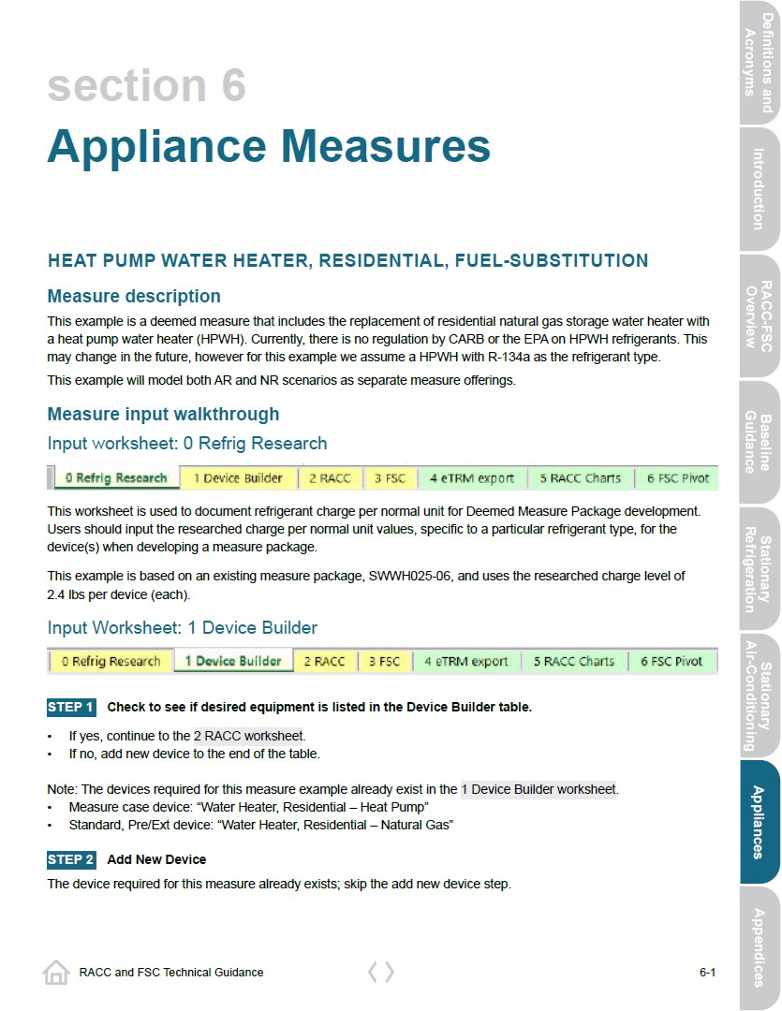
Example Walkthroughs
Appliance Measures
Measure examples included:
HP water heater
HP clothes dryer
Residential refrigerator/freezer

Slide 39
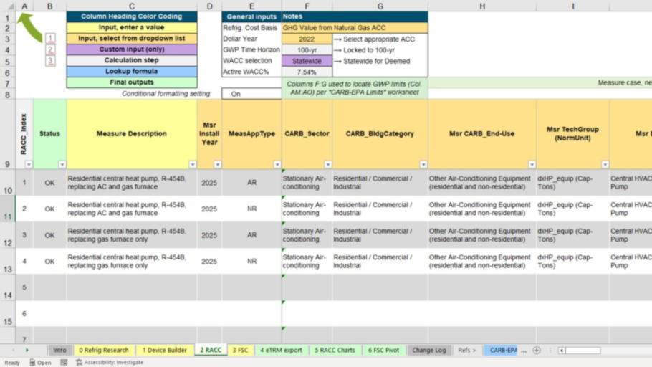
RACC-FSC Workbook Overview
Overview of Workbook
Residential Central Heat Pump Measure Example

Slide 40
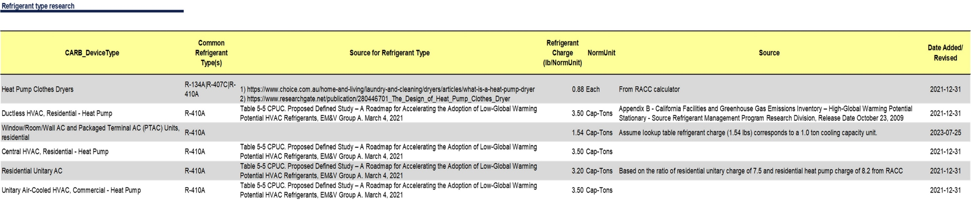
RACC-FSC Worksheets – 0_Refrig Research
Purpose of 0 Refrig Research worksheet:
Document and substantiate refrigerant charge per normal unit
Residential Central Heat Pump Example:
Used existing research into charge levels
  3.5 lbs./cap-Tons (HP)
  3.2 lbs./Cap-Tons (AC)

Slide 41
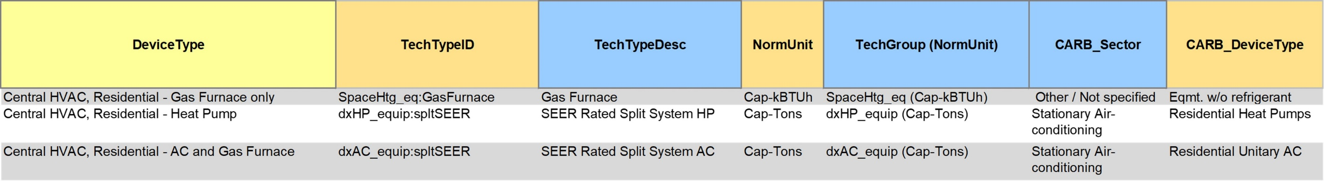
RACC-FSC Worksheets – 1_Device builder
Purpose of 1 Device Builder worksheet:
Define devices to be used in 2 RACC, 3 FSC worksheet calculations
Device properties: Tech type, Normal units, CARB device type/leakage rates, refrigerant charge
Residential Central Heat Pump Example:
Devices for this measure already in 1 Device Builder

Slide 42
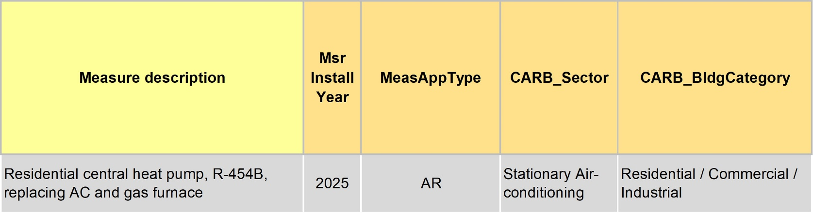
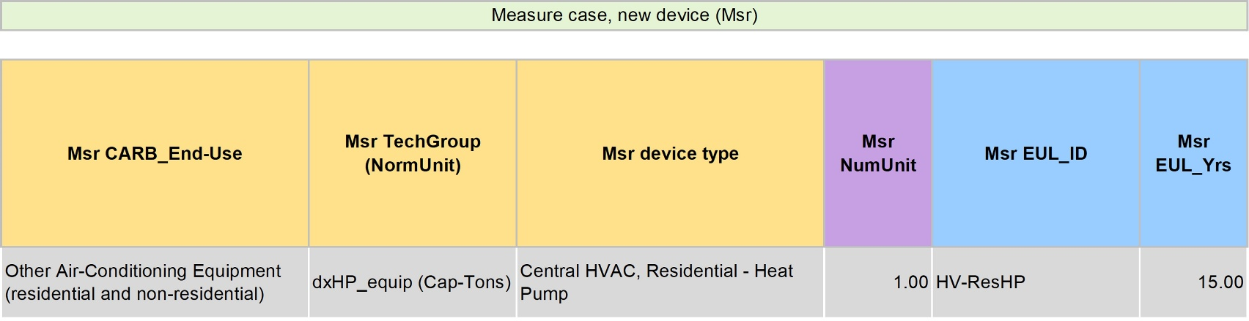
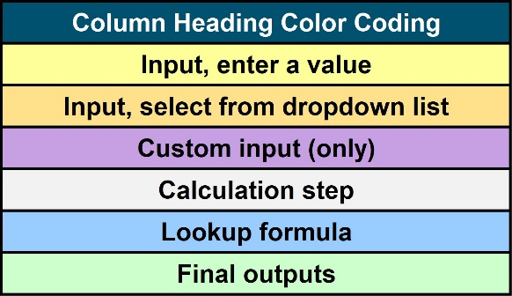
RACC-FSC Worksheets – 2_RACC
Purpose of 2 RACC worksheet:
Calculate refrigerant emissions and avoided cost impacts
Residential Central Heat Pump Example:
General parameters
Specify device types (Msr, Std, Pre/Ext)
Select refrigerant types
Refrigerant charge

Slide 43
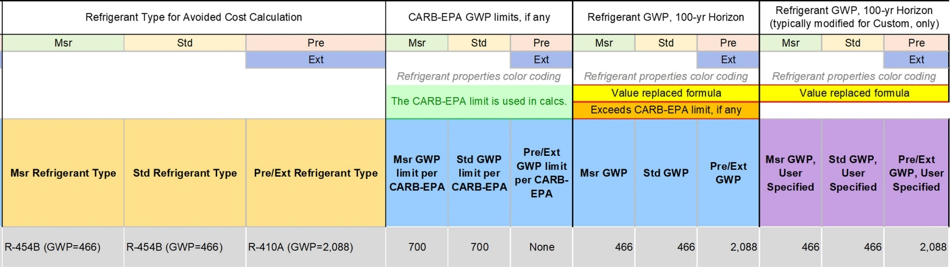
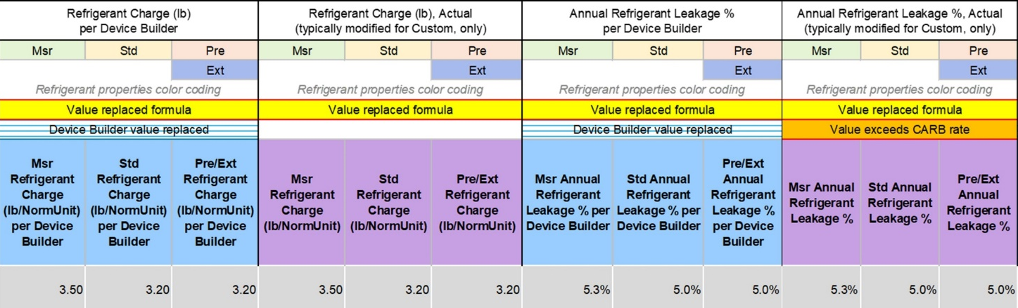
RACC-FSC Worksheets – 2_RACC (continued)
Purpose of 2 RACC worksheet:
Calculate refrigerant emissions and avoided cost impacts
Residential Central Heat Pump Example:
General parameters
Specify device types (Msr, Std, Pre/Ext)
Select refrigerant types
Refrigerant charge & leakage rates

Slide 44
RACC-FSC Worksheets – 3_FSC (continued)
Purpose of 3 FSC worksheet:
Assess whether measure permutations pass the fuel substitution tests
Residential Central Heat Pump Example:
Measure offering classifications & assign RACC calculation
Imputed cooling (optional)
Annual energy usage

Slide 45
RACC-FSC Worksheets – 3_FSC (continued)
Purpose of 3 FSC worksheet:
Assess whether measure permutations pass the fuel substitution tests
Residential Central Heat Pump Example:
Measure offering classifications & assign RACC calculation
Imputed cooling (optional)
Annual energy usage
Gas furn. w/ imputed cooling
Gas furnace & AC

Slide 46
RACC-FSC Worksheets – 3_FSC
Purpose of 3 FSC worksheet:
Assess whether measure permutations pass the fuel substitution tests
Residential Central Heat Pump Example:
Measure offering classifications & assign RACC calculation
Imputed cooling (optional)
Annual energy usage
Gas furn. w/ imputed cooling
Gas furnace & AC

Slide 47

Next Steps

Slide 48
RACC-FSC Use Cases
Measure Packages and Custom Applications Uses | Worksheet(s) to Complete
Measure Package/Custom Application Changes | 2 RACC | 3 FSC
Type of refrigerant changes | X | Only for fuel-substitution measures
Weight/charge of refrigerant changes | X
EUL/RUL of refrigerant-using equipment changes | X
Claiming avoided emission when retired equipment’s remaining refrigerant is recovered/reclaimed and documented *Documentation requirements are still very much under development and will need to be agreed upon during measure package/custom application development for avoided emissions credit to be claimed. | X
Fuel-substitution measure w/o refrigerant (e.g., induction range) *Even though equipment contains no refrigerant, information entered on 2 RACC is used by 3 FSC. | X ($0)* | X
Changes to equipment efficiency only (not refrigerant) | Not needed | Not needed

Slide 49

RACC-FSC_v3.0 Uses
RACC-FSC_v3.0 w/2022 ACCs
  New measure offerings to existing PY2024-25 measure packages
  New, mid-cycle measure packages
  Mid-cycle measure package updates
    HVAC system, chiller, and product updates for PY2025 using EPA limit of GWP ≤ 700
RACC-FSC_v3.0 w/2024 ACCs
  Measure package updates for PY2026-27
    Due April 30 for measure packages that were due to be submitted by March 31

Slide 50
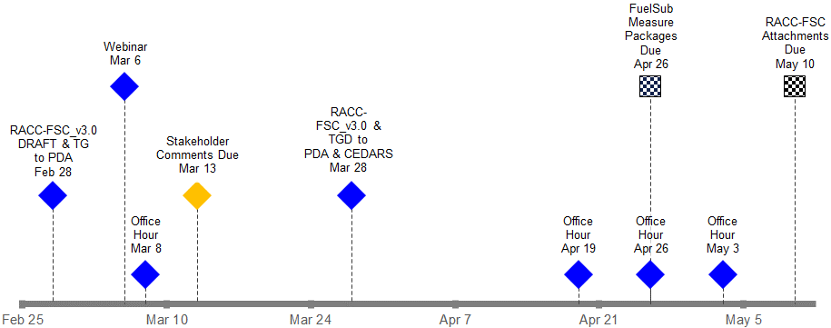
Timeline and Support
CEDARS
Office Hours (email DEERsupport@dnv.com)
  RACC-FSC_v3.0 Workbook
  RACC-FSC Technical Guidance Document
  Measure example workbooks (from guidance document)
  Planned date/times:
    Friday, March 8, 9-10 AM (during comment period)
    Friday, April 19, 9-10 AM
    Friday, April 26, 9-10 AM
    Friday, May 3, 9-10 AM

Slide 51




Questions?
CONTACTS
Brad Hoover
Project Sponsor
Brad.Hoover@dnv.com
Rachel Murray
Subject Matter Expert
Rachel.Murray@dnv.com
Bryan Kilgore
Project Manager
Bryan.Kilgore@dnv.com
Draft RACC-FSC posted to PDA: 2-28-2024 | Comments due by: 3-13-2024
Title?

