Slide 1
California LifeLine Third Party Administrator
Presentation to the Administrative Committee
March 11, 2024

Slide 2
Completed Initiatives
California LifeLine Customer Portal, Phase I – December 15
Commission-issued personal identification numbers (PINs) replaced with registered usernames and passwords
Registered users choose their multi-factor authentication (MFA) method: email, SMS text, or phone call
Online form completion and upload functionality offered by the public website remains the same but without the traditional PIN requirement
Registered users have the option to provide gender, race/ethnicity, and household income information
Registered users gain new self-help functionality:
Canceling pending transfers
Self-initiating removals from Program
Viewing font and language preferences
Viewing current address information stored with the TPA
Viewing Program anniversary dates (for renewal)

Slide 3
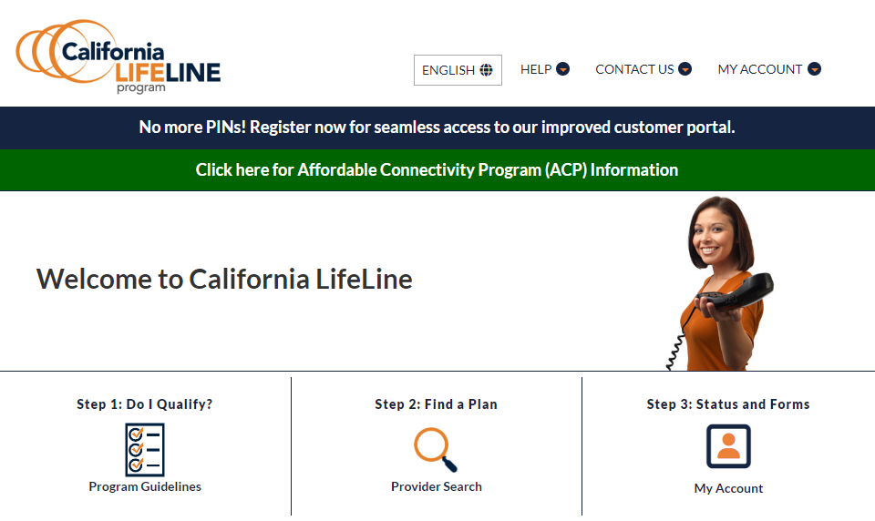
Completed Initiatives
California LifeLine Customer Portal, Phase I – December 15
The landing page for the California LifeLine public website displays a new banner informing visitors that PINs are no longer required

Slide 4
Completed Initiatives
California LifeLine Customer Portal, Phase I - New FAQs
Visitors who click anywhere on the “No More PINs!” banner are redirected to a FAQ page about the new Portal
The FAQs will evolve as the TPA’s Call Center fields users’ questions. The new FAQs are:
What is the California LifeLine Customer Portal?
Do I use a personal identification number (PIN) to login to the California LifeLine Customer Portal?
How do I login to the California LifeLine Customer Portal?
I can’t remember the email address I used when I registered for the California LifeLine Customer Portal. How do I get help?
I can’t remember my password. How do I get help?
Once I have registered my email address and password for the California LifeLine Customer Portal, why do I need to verify my access with a one-time verification code?

Slide 5
Completed Initiatives
California LifeLine Customer Portal, Phase I - New FAQs
What is Multi-Factor Authentication (MFA)?
Does registering for MFA give the California LifeLine Program access to my phone or my email?
What MFA methods are available for my California LifeLine Customer Portal account?
How soon will the California LifeLine Administrator contact me with the one-time verification code?
After I receive the one-time verification code from the California LifeLine Administrator, how quickly do I need to enter the code on the California LifeLine Customer Portal?
Do I need to save the one-time verification code I receive from the California LifeLine Administrator?
How often do I need to authenticate my identity with MFA?
Can I change my MFA method?
How do I get help with MFA?

Slide 6
Completed Initiatives
Registered Portal Users – Beginning of day on Monday, March 4
43,776 Registered Portal Users
38,133 wireless
5,643 wireline

Slide 7
Completed Initiatives
Collection of Additional Demographic Data from LifeLine Applicants and Subscribers
Annually, the CPUC must report to the California Legislature about the degree of achievement of universal telephone service for California residents, including Program penetration rates by income, ethnicity, and geography
The California LifeLine Customer Portal, Phase I, requests from portal users, during the registration process, voluntary responses to questions about
Total combined income of all members of portal users’ households
Portal users’ race/ethnicity
Portal users’ gender
Beginning December 15, 2023, collection of the additional demographic data has been introduced in new enrollment and renewal forms
The Service Provider Intake API, known as SPIA, has similarly been enhanced to collect the additional demographic data from applicants and subscribers

Slide 8
Completed Initiatives
Collection of Additional Demographic Data from LifeLine Applicants and Subscribers
Counts of Registered Portal Users who have… | Counts
Provided a response to at least one demographic question, regardless of whether the value is 'PreferNotToRespond' | 42,964
Not responded to any of the demographic questions | 812
Responded to the Gender question with a response other than "Prefer Not To Respond" | 40,819
Responded to the Race question with a response other than "Prefer Not To Respond" | 38,744
Responded to the Income Range question with a response other than "Prefer Not To Respond" | 37,043
Responded "Prefer Not To Respond" to at least one of the demographic questions | 8,471

Slide 9
Completed Initiatives
Customer Portal, Phase 1.1 Enhancements Deployed Thursday, February 22
Allowing registered Portal users to view and download Program decision letters
Providing registered Portal users, who have received correctible denials, details so they understand why they received the correctible denial and may avoid the same errors when completing their second chance forms
Highlighting for registered Portal users when their Undeliverable Mail flag is active so they can update their addresses with their Service Providers
New FAQs about viewing Program decision letters on the Portal and explaining that wireless participants are notified of Program decisions by SMS texts rather than mailed notifications
Adding code to leverage Google Analytics for evaluating the utilization of links to the Portal in SMS messages
Updating the Affordable Connectivity Program (ACP) public website page with information about the winding down of ACP

Slide 10
Upcoming Initiatives
California LifeLine Customer Portal, Phase II
Targeted for February 2024
Enhancing the “My Account” Portal functionality to enable registered portal users to view and download Program decision letters
Implementing a “lookback” for the weekly USAC federal broadband-only subscribers lists
Targeted for February 2024
Augmenting Program waste, fraud, and abuse prevention measures

Slide 11
Upcoming Initiatives
Collecting and handling demographics of benefit qualifying persons (BQP)
Formalizing an enrollment pathway for low-income California residents who do not have assigned SSNs

Slide 12
Database Matching to Confirm Eligibility
The significant positive impact to the Program from the integration with the CalFresh Confirm Hub is undeniable
During 2023, approval decisions were rendered for:
666,024 applicants’ enrollments based on CalFresh Confirm matches
469,673 subscribers’ renewals based on CalFresh Confirm matches
USAC utilizes a federal data connection with the federal data connections with the Centers for Medicare and Medicaid Services (CMS) to verify participation in Medicaid
The Program’s attempts to gain access to a CMS data connection have been unsuccessful

Slide 13
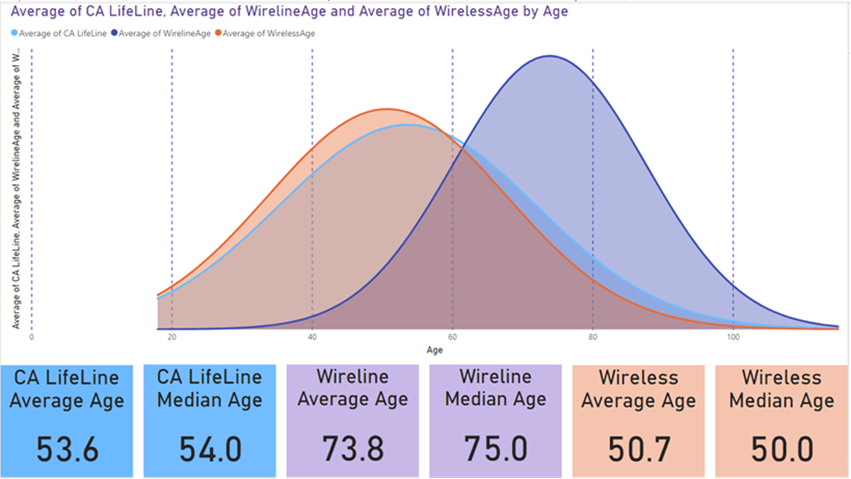
Program Participation – LifeLine Subscribers – Age Distribution

Slide 14
Program and Operations Reports
Program Participation – Active LifeLine Subscribers
Program Participation - Top 20 Counties
Wireless: Response & Approval Rates – All Form Types
Wireline: Response & Approval Rates – All Form Types
Top 5 Denial Reasons – New Enrollment Applications
Top 5 Denial Reasons – Renewal Forms
Subscriber Count Trends for Largest Service Providers
Top 5 Service Providers by Subscriber Counts
Enrollment Eligibility Methods – Program versus Income
Enrollment Eligibility Methods – By Qualifying Program
Enrollment Application Volumes By Received Channel
Renewal Form Volumes By Received Channel
Renewal Rate
Standalone IEH Volume By Received Channel
Call Volumes – English & Spanish
Call Volumes – Other Supported Languages

Slide 15
Program Participation – Active LifeLine Subscribers
Current: Total Number of Active LifeLine Subscribers as of March 1, 2024
Wireless: 1,094,738
Wireline: 136,145
Total: 1,230,883
December 2023 Administrative Committee Meeting: Total Number of Enrolled Subscribers as of December 1, 2023
Wireless: 1,000,314
Wireline: 150,821
Total: 1,151,135

Slide 16
Top 20 Counties By Active Subscribers’ LifeLine Service Addresses
County | Total Active Subscribers
Los Angeles | 345,630
San Diego | 88,733
San Bernardino | 84,600
Riverside | 80,685
Orange | 75,907
Sacramento | 61,239
Fresno | 51,945
Kern | 48,851
Alameda | 37,391
San Francisco | 34,319
Santa Clara | 31,417
San Joaquin | 28,905
Stanislaus | 21,383
Contra Costa | 21,054
Tulare | 18,383
Imperial | 17,512
Ventura | 14,845
Merced | 13,447
Monterey | 12,586
Solano | 12,474
91.39% of active subscribers have service addresses located within these counties

Slide 17
Wireless: Response & Approval Rates – All Form Types
Month Year | # Total | # Responded | % Responded | # Approved | % Approved | % Qualified or Renewed
Mar 2023 | 165,362 | 140,429 | 84.9% | 133,839 | 95.3% | 80.9%
Apr 2023 | 153,488 | 135,339 | 88.2% | 130,839 | 96.7% | 85.2%
May 2023 | 151,348 | 139,868 | 92.4% | 136,559 | 97.6% | 90.2%
Jun 2023 | 148,142 | 132,736 | 89.6% | 129,705 | 97.7% | 87.6%
Jul 2023 | 125,383 | 117,772 | 93.9% | 113,070 | 96.0% | 90.2%
Aug 2023 | 197,069 | 176,768 | 89.7% | 173,793 | 98.3% | 88.2%
Sep 2023 | 191,983 | 173,727 | 90.5% | 170,206 | 98.0% | 88.7%
Oct 2023 | 190,271 | 175,391 | 92.2% | 172,317 | 98.2% | 90.6%
Nov 2023 | 199,114 | 179,486 | 90.1% | 175,387 | 97.7% | 88.1%
Dec 2023 | 185,228 | 167,181 | 90.3% | 162,633 | 97.3% | 87.8%
Jan 2024 | 189,329 | 172,355 | 91.0% | 168,271 | 97.6% | 88.9%
Feb 2024 | 183,407 | 165,277 | 90.1% | 160,358 | 97.0% | 87.4%
Totals | 2,080,124 | 1,876,329 | 90.2% | 1,826,977 | 97.4% | 87.8%
% Responded: #Responded / #Total
% Approved = #Approved / #Responded
% Qualified or Renewed = #Approved / #Total

Slide 18
Wireline: Response & Approval Rates – All Form Types
Month Year | # Total | # Responded | % Responded | # Approved | % Approved | % Qualified or Renewed
Mar 2023 | 6,937 | 4,349 | 62.7% | 3,634 | 83.6% | 52.4%
Apr 2023 | 5,257 | 3,060 | 58.2% | 2,612 | 85.4% | 49.7%
May 2023 | 3,725 | 2,966 | 79.6% | 2,639 | 89.0% | 70.8%
Jun 2023 | 3,979 | 2,152 | 54.1% | 1,963 | 91.2% | 49.3%
Jul 2023 | 2,462 | 2,043 | 83.0% | 1,873 | 91.7% | 76.1%
Aug 2023 | 12,135 | 10,884 | 89.7% | 10,674 | 98.1% | 88.0%
Sep 2023 | 31,940 | 30,707 | 96.1% | 30,219 | 98.4% | 94.6%
Oct 2023 | 27,855 | 24,299 | 87.2% | 23,762 | 97.8% | 85.3%
Nov 2023 | 42,391 | 36,959 | 87.2% | 35,794 | 96.8% | 84.4%
Dec 2023 | 25,130 | 21,285 | 84.7% | 20,678 | 97.1% | 82.3%
Jan 2024 | 13,964 | 11,579 | 82.9% | 11,273 | 97.4% | 80.7%
Feb 2024 | 5,978 | 4,271 | 71.4% | 3,976 | 93.1% | 66.5%
Totals | 181,753 | 154,554 | 85.0% | 149,097 | 96.5% | 82.0%
% Responded: #Responded / #Total
% Approved = #Approved / #Responded
% Qualified or Renewed = #Approved / #Total

Slide 19
Top 5 Denial Reasons – New Enrollment Applications
December 2022 – November 2023
Denial Code | Type | Description
8-9 | Hard Denial | Second chance application form not returned by the due date
6-22 | Correctible Denial | Documentation submitted does not meet eligibility guidelines
6-21 | Soft Denial | Initial application form not returned by the due date
5-12 | Hard Denial | Active Phone Number & Service Start Date not received within 30 days of status code 53
5-16 | Hard Denial | Identity Verification form not returned by the due date

Slide 20
Top 5 Denial Reasons – Renewal Forms
December 2022 – November 2023
Denial Code | Type | Description
22-15 | Soft Denial | Initial renewal form not returned by the due date
24-8 | Hard Denial | Second chance renewal form not returned by the due date
24-9 | Hard Denial | Second chance renewal form was returned to the TPA as non-deliverable as addressed
21-13 | Hard Denial | Identity Verification form not returned by the due date
22-17 | Correctible Denial | Subscriber did not initial question acknowledging no other member of the subscriber’s household is already receiving a LifeLine benefit

Slide 21
Top 5 Service Providers by Subscriber Counts

Slide 22
Top 5 Service Providers by Subscriber Counts
Service Provider | Mar 2023 | Apr 2023 | May 2023 | Jun 2023 | Jul 2023 | Aug 2023 | Sep 2023 | Oct 2023 | Nov 2023 | Dec 2023 | Jan 2024 | Feb 2024
TruConnect | 176,384 | 177,611 | 174,553 | 171,096 | 176,643 | 184,753 | 208,046 | 245,217 | 277,677 | 308,547 | 338,237 | 376,149
TracFone dba SafeLink | 157,143 | 160,295 | 166,360 | 174,760 | 179,603 | 190,844 | 198,579 | 203,401 | 207,824 | 208,856 | 211,941 | 215,958
Assurance Wireless by T-Mobile | 356,082 | 347,965 | 341,155 | 333,271 | 303,712 | 299,324 | 284,564 | 261,094 | 222,538 | 188,922 | 167,082 | 158,355
Pacific Bell by AT&T | 160,507 | 159,823 | 158,962 | 157,938 | 156,809 | 155,606 | 154,199 | 152,831 | 149,624 | 146,637 | 143,562 | 141,579
Boomerang Wireless dba enTouch Wireless | 97,196 | 98,688 | 101,504 | 105,291 | 107,204 | 108,650 | 106,944 | 104,699 | 102,686 | 97,913 | 99,040 | 97,249

Slide 23
Enrollment Eligibility Methods – Program versus Income

Slide 24
Enrollment Eligibility Methods – By Qualifying Program

Slide 25
Enrollment Application Volume By Received Channel March 2023 – February 2024
# Enrollment application forms received

Slide 26
Renewal Form Volume By Received Channel
March 2023 – February 2024
# Renewal forms received

Slide 27
Renewal Rate
December 2022 – December 2023*
Outcomes have been recorded for all renewal processes started on and between 12/11/2022 and 12/11/2023
Total renewal processes started: 899,506
Total Hard Denials: 171,030
Renewal Rate: 80.99%
*Note: 12/11/2022 and 12/11/2023 is the period used to calculate the renewal rate because final dispositions have been recorded for all renewal processes started during the one (1) year period

Slide 28
Standalone IEH Volume By Received Channel
March 2023 – February 2024
# Standalone IEH forms received Note: Standalone IEH process was deployed 3/31/2023

Slide 29
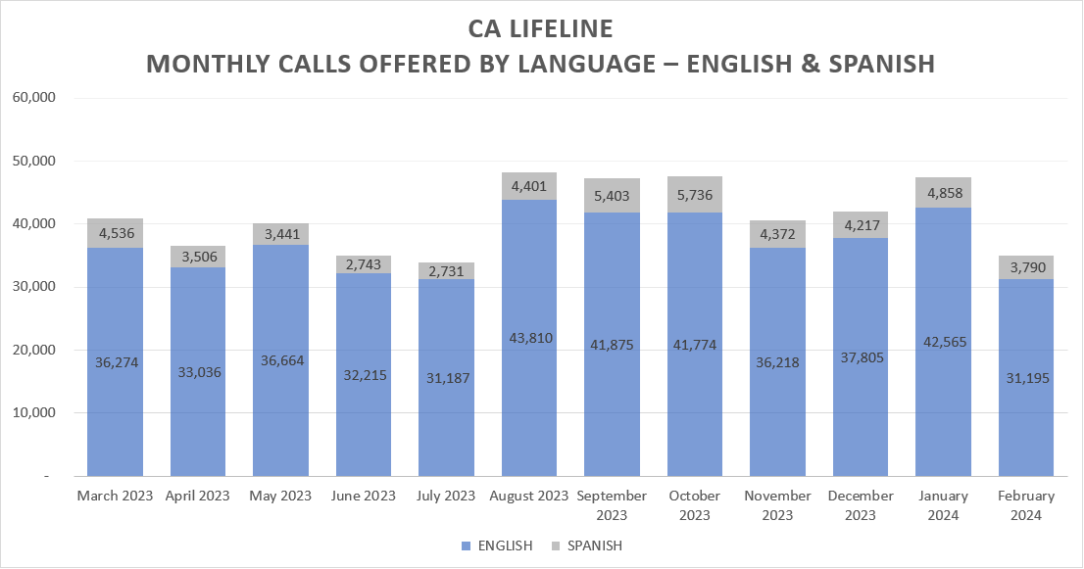
Monthly Inbound Call Volumes – English & Spanish March 2023 through February 2024

Slide 30
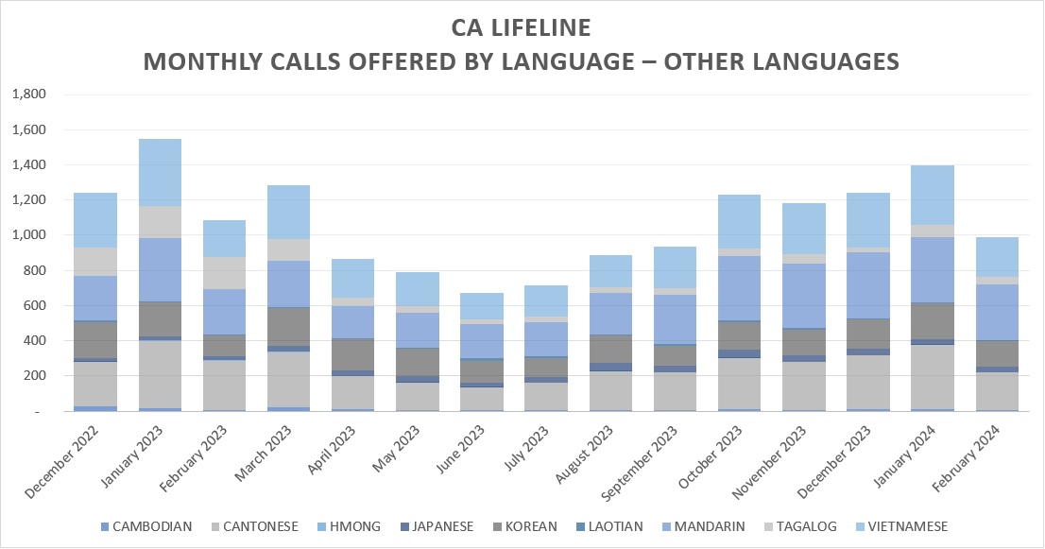
Monthly Inbound Call Volumes – English & Spanish March 2023 through February 2024

