Slide 1
California LifeLine Third Party Administrator
Presentation to the Administrative Committee
March 30, 2023

Slide 2
Renewal Process Resumption – Statistics and Progress
July 1 through October 31 “Catch Up” Period [Subscribers Active Through Entire Renewal Timeline]:
476,530 renewal processes started
28.76% required Household Worksheets (HHWS)
18.66% “Day 0” CalFresh Confirm PASS rate
3.81% CalFresh Confirm PASS rate before issuing a soft denial due to nonresponse
1.23% CalFresh Confirm PASS rate before issuing a hard denial due to nonresponse
Final decisions
Approved – initial form: 264,784
Approved – 2nd form: 31,292
Hard denied – initial form: 1,133
Hard denied – 2nd form: 114,544

Slide 3
Renewal Results, Including Preemptive Recertification
For the period of November 11, 2021, through June 30, 2022, 353,557 subscribers were preemptively recertified
For the renewal catchup period of July 1, 2022, through February 19, 2023, renewal approval decisions were registered for 296,076 subscribers
78.26% is the final renewal rate for the combined preemptive recertification and renewal catch up period
Note: The renewal rate reported during the March 2020 ULTS Administrative Committee Meeting was 49.9%

Slide 4
Renewal Process Resumption – Statistics and Progress
November 1, 2022, through March 3, 2023, “Post-Catch Up” Period [Subscribers Active Through Entire Renewal Timeline]:
268,894 renewal processes started
17.17% required Household Worksheets (HHWS)
77.78% “Day 0” CalFresh Confirm PASS rate
6.20% CalFresh Confirm PASS rate before issuing a soft denial due to nonresponse
2.62% CalFresh Confirm PASS rate before issuing a hard denial due to nonresponse
Final decisions
Approved – initial form: 202,022
Approved – 2nd form: 4,145
Hard denied – initial form: 2,921
Hard denied – 2nd form: 32,184

Slide 5
“Post-Catchup” Renewal Results
For the renewal “post-catchup period” of November 1, 2022, through March 3, 2023, renewal processes started for 268,894 subscribers and approval decisions have been registered for 206,167 subscribers
76.67% is the renewal rate for this subscriber population, through March 19, 2023

Slide 6
CalFresh Confirm Hub Impact - Renewals
268,894 renewal processes started between 11/1/2022 and 3/3/2023 for subscribers. We do not have results for all these subscribers yet because some are still within their 105-day renewal timelines
173,211 subscribers were found in CalFresh Confirm on day 0 and were renewed
758 subscribers were found in CalFresh Confirm by the reviewer during the review of their initial renewal forms and were renewed
1,498 subscribers were found in CalFresh Confirm before issuing a soft denial for nonresponse to the initial renewal form and were renewed
45 subscribers were found in CalFresh Confirm by the reviewer during the review of their second chance renewal forms and were renewed
411 subscribers were found in CalFresh Confirm before issuing a final hard denial for nonresponse to the initial renewal form and were renewed
175,923 subscribers were renewed based on CalFresh Confirm matches
As of 3/19/2023, for this population of subscribers, 206,167 subscribers have been successfully renewed
85.33% of the subscribers successfully renewed have renewed due to positive CalFresh Confirm matches

Slide 7
New TPA Contract Deliverables
Geocoding
Standalone Household Worksheet Process
Expanded Reporting to the CPUC
Expanded Self-help Options for Service Providers

Slide 8
New TPA Contract Deliverables - Standalone Household Worksheet Process
Household worksheets will no longer be a part of the annual renewal form packets
Subscribers’ mid-term service address changes will be evaluated for household worksheets
If a subscriber’s new service address matches the service address of an existing active subscriber, the subscriber whose address has changed must complete a household worksheet
Subscribers have thirty (30) calendar days to submit completed worksheets
Subscribers may submit completed worksheets to the TPA by mail, through CaliforniaLifeLine.com, through the TPA’s interactive voice response system, and through a Service Provider which uses the Service Provider Intake API (SPIA)
Benefits:
The LifeLine Administrator is better able to monitor compliance with the “one benefit per economic household” Program rule
Aligns to USAC’s household worksheet approach
More subscribers will be submitted on day 0 for CalFresh Confirm database matching

Slide 9
New TPA Contract Deliverables – Expanded Reporting
Connection and Conversion Reports for Wireline Service Providers
Inward/Outward
Participant Emails
Webchat
Waste, Fraud, and Abuse Prevention
External Eligibility
Determination Invoice
Outage and TPA System Availability
Inbound Mail
Outbound Mail
Outbound Dialer
Inbound Calls
TPA Operations
Call Center Invoice
Daily Service Providers’ Requests and Error Activity
Public Website Analytics
National Change of Address
Enrollment, Caseload, and Population
Enrollment Statistics
Review Queue Snapshot

Slide 10
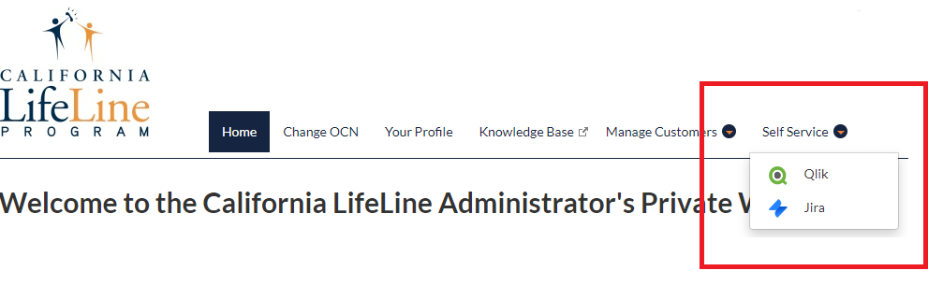
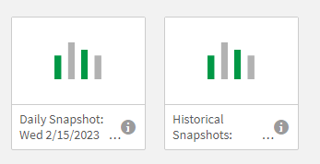
New TPA Contract Deliverables – Expanded Self-help Options for Service Providers
The TPA’s Daily Review Queue Snapshot is now available in Qlik
The TPA offers 1 Qlik license per Service Provider
Service Provider representatives with Qlik access may navigate to Qlik through the Self-Service menu item on the private website
The Daily Snapshot updates at 5 AM PT daily
The Historical Snapshots provide a user access to previously published Daily Review Queue Snapshots starting January 25, 2023

Slide 11
Program and Operations Reports
Program Participation – Active LifeLine Subscribers
Wireless: Response & Approval Rates – All Form Types
Wireline: Response & Approval Rates – All Form Types
Top 5 Denial Reasons
Subscriber Count Trends for Largest Service Providers
Enrollment Eligibility Methods – Program versus Income
Enrollment Eligibility Methods – By Qualifying Program
Enrollment Application Volume By Received Channel
Renewal Form Volume By Received Channel
Call Volumes – English & Spanish
Call Volumes – Other Supported Languages

Slide 12
Program Participation – Active LifeLine Subscribers
Current: Total Number of Active LifeLine Subscribers as of March 1, 2023
Wireless: 954,950
Wireline: 168,776
Total: 1,123,726
December 2022 AC Meeting: Total Number of Enrolled Subscribers as of December 1, 2022
Wireless: 1,029,083
Wireline: 194,518
Total: 1,223,601

Slide 13
Wireless: Response & Approval Rates – All Form Types
Month /Year | # Total | # Responded | % Responded | # Approved | % Approved
Mar 2022 | 133,780 | 122,663 | 91.7% | 120,533 | 98.3%
Apr 2022 | 129,631 | 119,464 | 92.2% | 116,733 | 97.7%
May 2022 | 138,954 | 127,091 | 91.5% | 120,227 | 94.6%
Jun 2022 | 137,389 | 122,977 | 89.5% | 118,779 | 96.6%
Jul 2022 | 125,364 | 113,846 | 90.8% | 110,915 | 97.4%
Aug 2022 | 191,822 | 174,339 | 90.9% | 171,147 | 98.2%
Sep 2022 | 211,606 | 188,609 | 89.1% | 181,954 | 96.5%
Oct 2022 | 264,663 | 202,030 | 76.3% | 187,793 | 93.0%
Nov 2022 | 256,948 | 190,492 | 74.1% | 177,724 | 93.3%
Dec 2022 | 233,506 | 178,319 | 76.4% | 167,146 | 93.7%
Jan 2023 | 190,680 | 165,392 | 86.7% | 158,923 | 96.1%
Feb 2023 | 163,871 | 139,387 | 85.1% | 133,277 | 95.6%
Total | 2,178,214 | 1,844,609 | 84.7% | 1,765,151 | 95.7%

Slide 14
Wireline: Response & Approval Rates – All Form Types
Month Year | # Total | # Responded | % Responded | # Approved | % Approved
Mar 2022 | 3,146 | 2,412 | 76.7% | 2,255 | 93.5%
Apr 2022 | 2,575 | 1,708 | 66.3% | 1,583 | 92.7%
May 2022 | 3,010 | 2,126 | 70.6% | 1,978 | 93.0%
Jun 2022 | 2,413 | 1,600 | 66.3% | 1,471 | 91.9%
Jul 2022 | 2,345 | 1,528 | 65.2% | 1,405 | 92.0%
Aug 2022 | 17,478 | 16,802 | 96.1% | 16,562 | 98.6%
Sep 2022 | 46,585 | 43,760 | 93.9% | 42,580 | 97.3%
Oct 2022 | 46,538 | 38,098 | 81.9% | 36,281 | 95.2%
Nov 2022 | 48,654 | 38,012 | 78.1% | 36,137 | 95.1%
Dec 2022 | 33,542 | 25,978 | 77.4% | 24,844 | 95.6%
Jan 2023 | 16,032 | 13,443 | 83.9% | 12,867 | 95.7%
Feb 2023 | 6,626 | 5,168 | 78.0% | 4,572 | 88.5%
Mar 2023 | 5,060 | 3,117 | 61.6% | 2,603 | 83.5%
Total | 234,004 | 193,752 | 82.8% | 185,138 | 95.6%

Slide 15
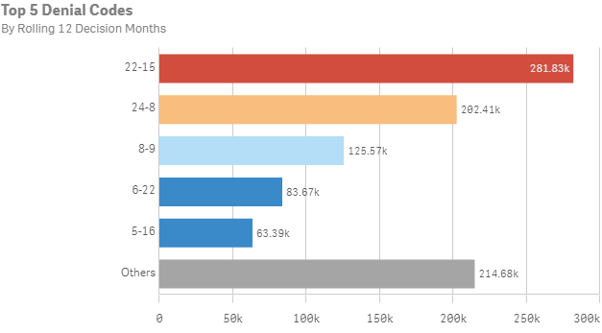
Top 5 Denial Reasons: March 2022 – February 2023
Denial Code | Type | Form | Description
22-15 | Correctible Denial | Renewal | Failure to return the renewal form by the due date
24-8 | Hard Denial | Renewal | Failure to return the renewal form by the due date
8-9 | Hard Denial | Application | Failure to return the application form by the due date
6-22 | Correctible Denial | Application | Documentation does not meet the eligibility guidelines.
5-16 | Hard Denial | Application | Failure to return ID verification form and documentation

Slide 16
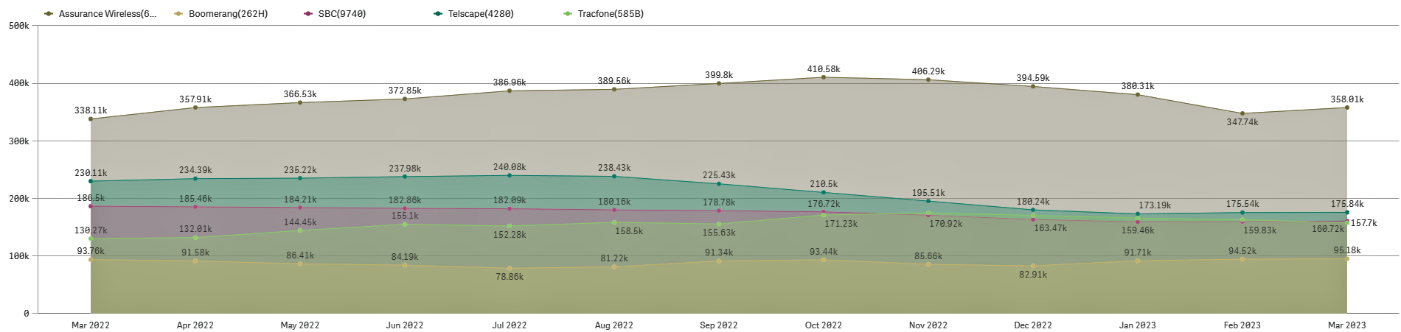
Top 5 Service Providers by Subscriber Counts

Slide 17
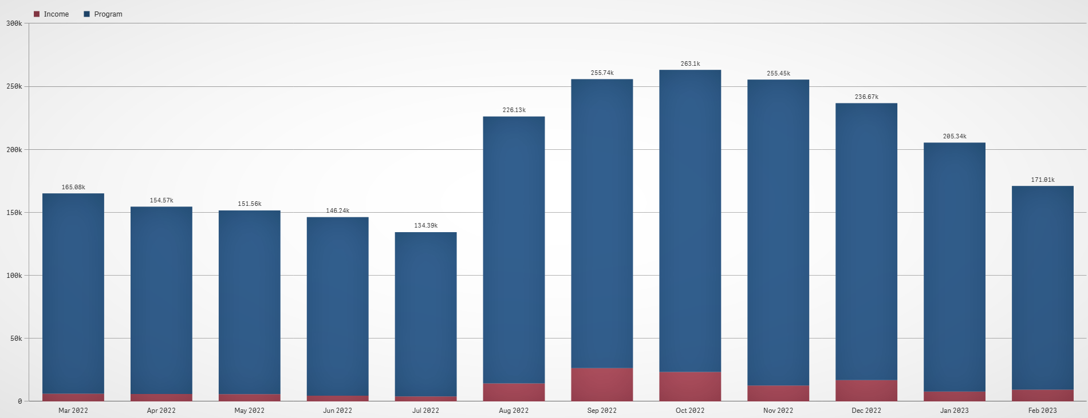
Enrollment Eligibility Methods – Program versus Income

Slide 18
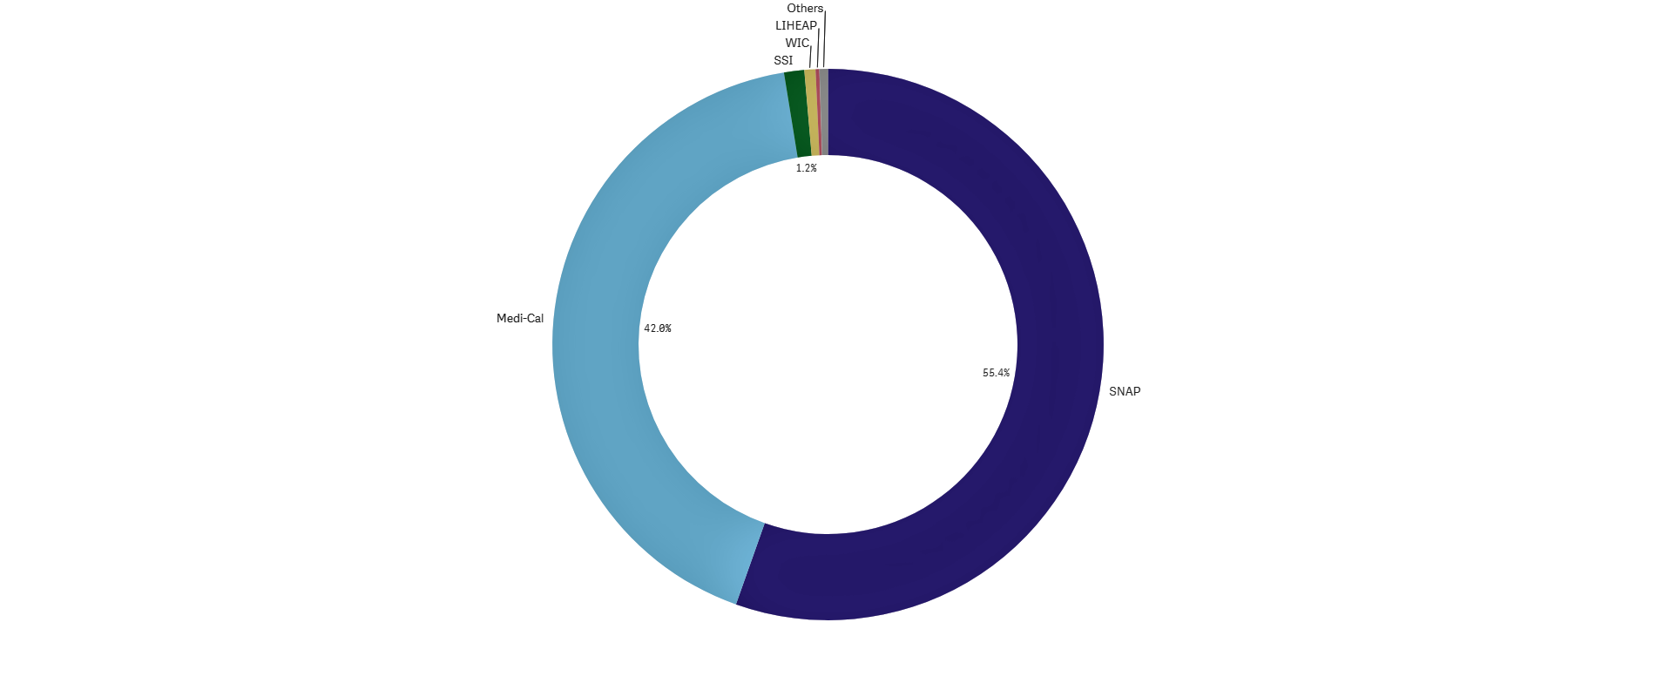
Enrollment Eligibility Methods – By Qualifying Program

Slide 19
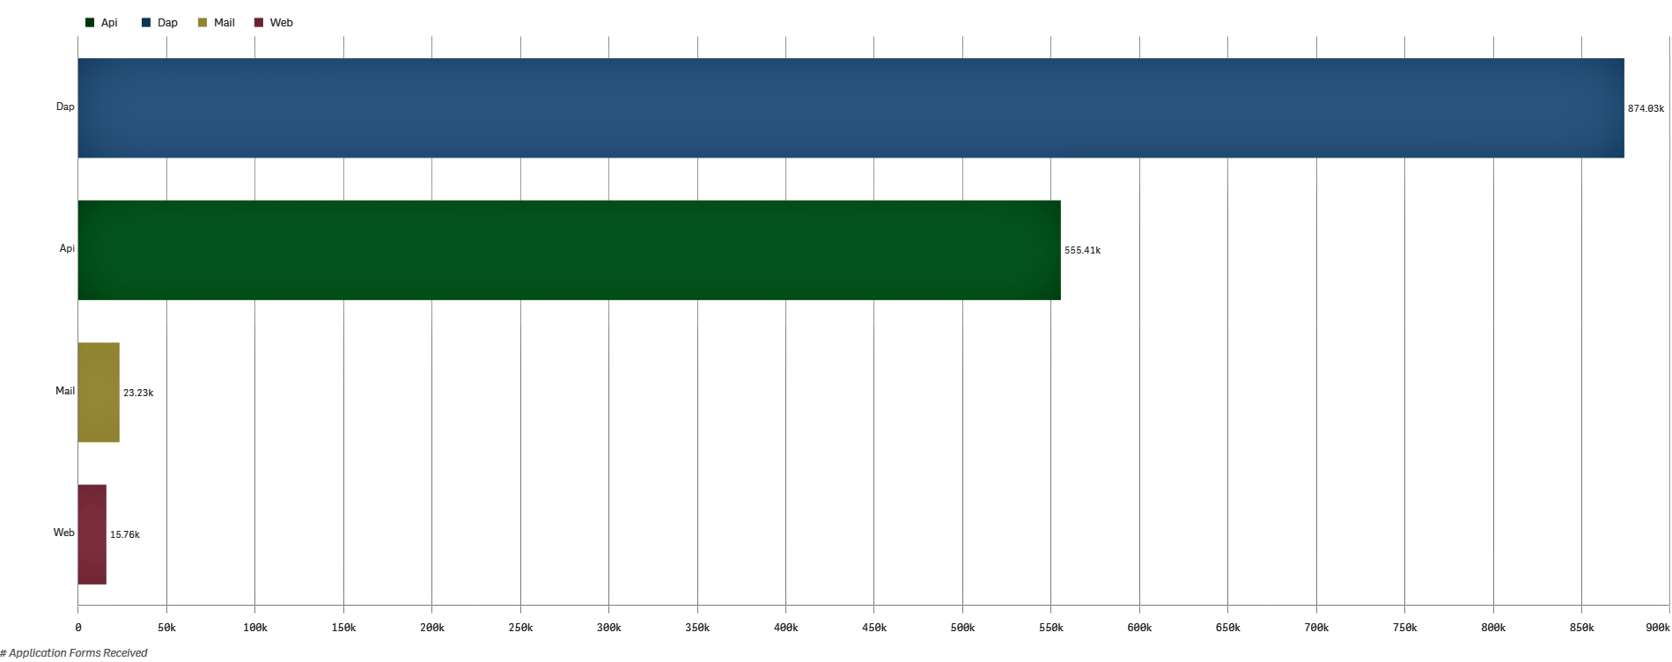
Enrollment Application Volume By Received Channel March 2022 through February 2023

Slide 20
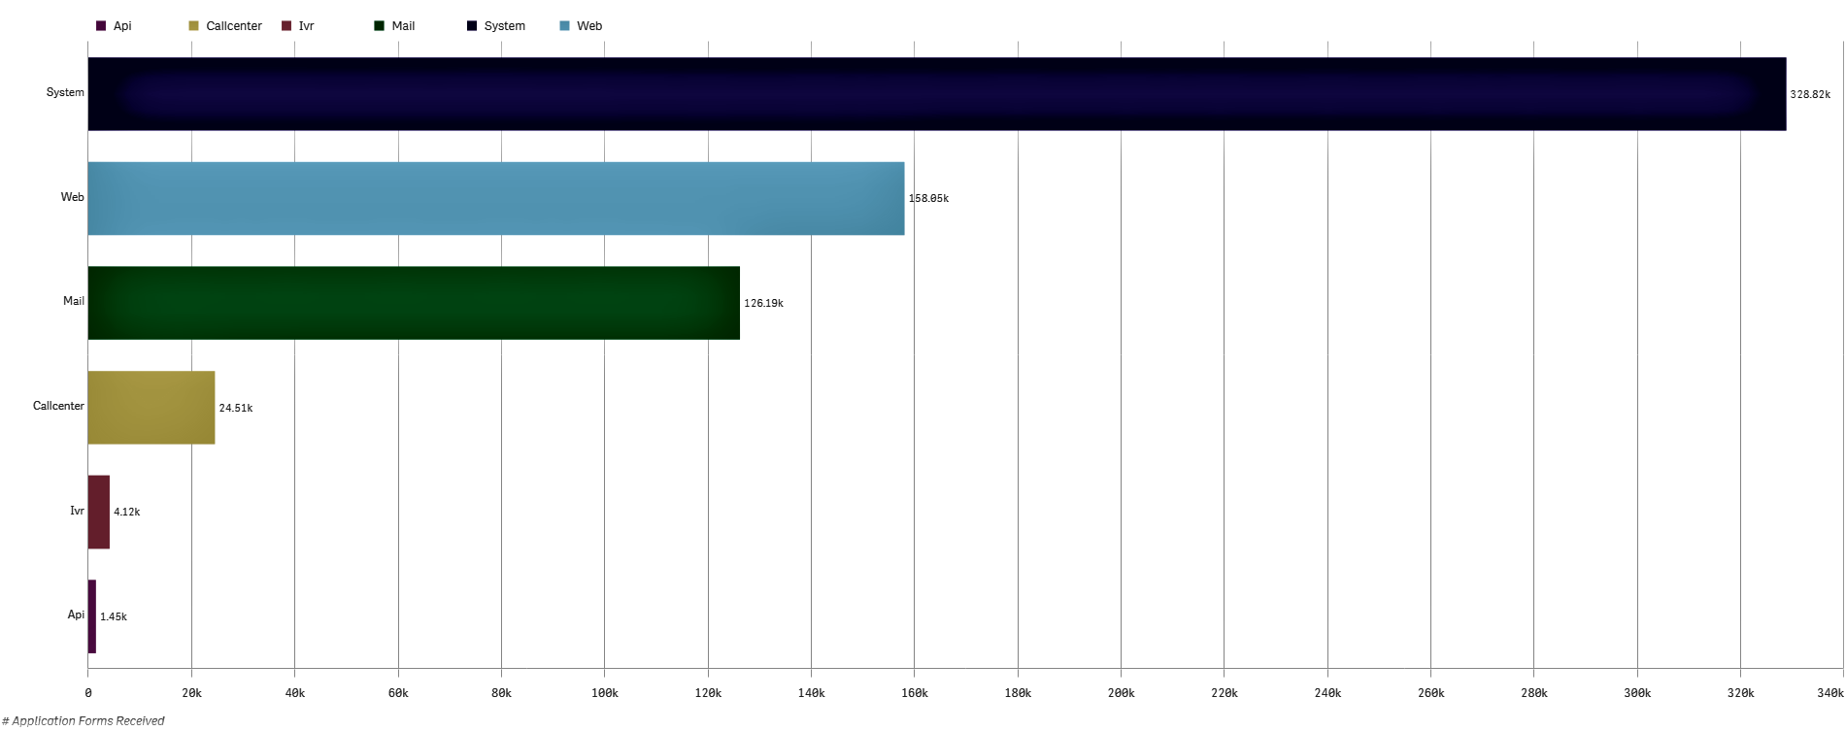
Renewal Form Volume By Received Channel
March 2022 – February 2023

Slide 21
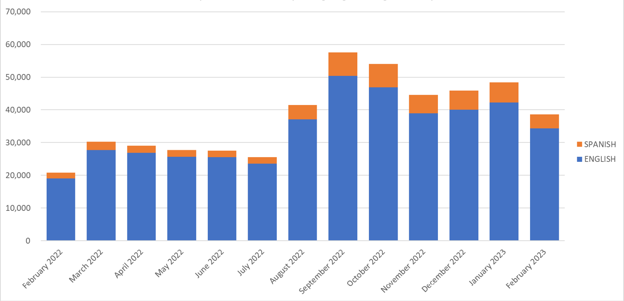
Monthly Inbound Call Volumes – English & Spanish March 2022 through February 2023

Slide 22
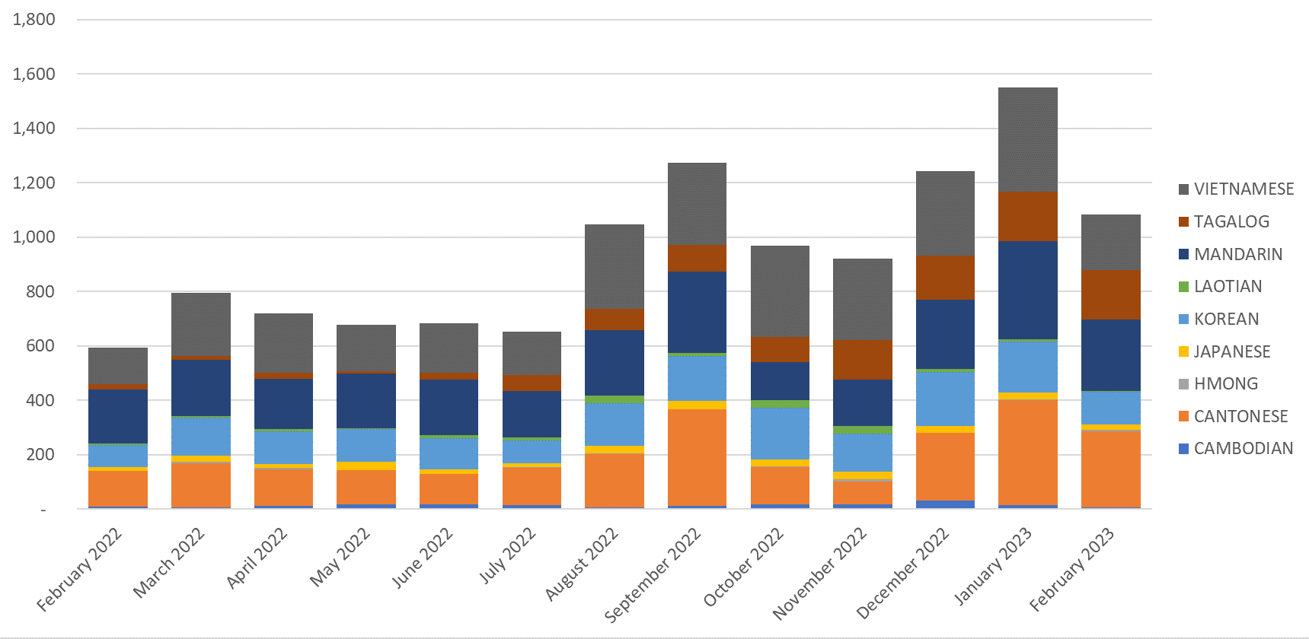
Monthly Inbound Call Volumes – Other Languages
March 2022 through February 2023

