Slide 1
California LifeLine Third Party Administrator
Presentation to the Administrative Committee
December 13, 2022

Slide 2
Renewal Process Resumption – Key Data Points
July 1 through October 31 “Catch Up” Period [Active Subscribers]:
491,725 renewal processes started
28.94% required Household Worksheets (HHWS)
19.00% Day 0 CalFresh Confirm PASS rate
3.93% CalFresh Confirm PASS rate before issuing a soft denial due to nonresponse
1.31% CalFresh Confirm PASS rate before issuing a hard denial due to nonresponse
411,101 final decisions are registered [83.60% renewal processes completed]:
Approved – initial form: 269,050
Approved – 2nd form: 26,374
Hard denied – initial form: 1,133
Hard denied – 2nd form: 114,544

Slide 3
Renewal Results, Including Preemptive Recertification
For the period of November 11, 2021, through June 30, 2022, 353,557 Subscribers were preemptively recertified
For the renewal catchup period of July 1 through December 4, 2022, renewal approval decisions were registered for 295,424 subscribers
As of December 4, 2022, the renewal rate for the combined preemptive recertification and renewal catch up period is 76.78%
Note: The renewal rate reported during the March 2020 ULTS Administrative Committee Meeting was 49.9%

Slide 4
Completed Initiatives 9/21/2022 – 12/13/2022
Resumption of the Program’s annual renewal process
California DSS has updated its CalFresh webpage with a hyperlink to the California LifeLine public website. The hyperlink is found in the list of programs which are not administered by California DSS but may be of interest to consumers who receive CalFresh benefits. 1,232 visitors referred to CaliforniaLifeLine.com
SPIA enhancement – 40079 Errors – providing the OCN of the SP for active subscribers who are assigned the ULTS telephone numbers
SQL Server upgrade completed for the TPA’s database platform

Slide 5
Initiatives In Progress
Modernizing the Program’s Print Framework – Go Live 4/1/2023
Remove the barriers to adding and modifying forms, letters, and postcards, which is essential to implementing future initiatives
Increase accessibility and readability of complex communications through design and content improvements
Enable flexibility, inefficiencies, and cost savings for continuous improvement of the Program’s communication

Slide 6
Upcoming Initiatives
Personal Identification Number (PIN) removal and an identity authentication replacement to meet AB 74 Compliance (requires Print Framework Modernization as a prerequisite for form & letter changes)
De-coupling Household Worksheet (IEH) from the renewal process to a stand-alone process triggered by a service address change (requires Print Framework Modernization for form change)
Updating SMS text message opt-in and opt-out policies and procedures
Geo-coding active LifeLine subscribers for reporting and trend analysis
Registration and tracking of SPs’ representatives who interact with consumers
Documenting participants’ who qualify based on Benefit Qualifying Persons (BQP)
Developing and implementing a monthly connections and conversions report for wireline SPs
Preventing mid-service term Tribal changes across all Service Provider update methods
Implementing API to confirm federal Lifeline broadband-only subscribers administered by USAC

Slide 7
Program and Operations Reports
Program Participation – Active LifeLine Subscribers
Wireless: Response & Approval Rates – All Form Types
Wireline: Response & Approval Rates – All Form Types
Top 5 Denial Reasons
Subscriber Count Trends for Largest Service Providers
Enrollment Eligibility Methods – Program versus Income
Enrollment Eligibility Methods – By Qualifying Program
Enrollment Application Volume By Received Channel, September 2021 - August 2022
Renewal Form Volume By Received Channel, November 2021 - August 2022
Call Volumes – English & Spanish
Call Volumes – Other Supported Languages
Inbound Call Reasons

Slide 8
Program Participation – Active LifeLine Subscribers
Current: Total Number of Active LifeLine Subscribers as of December 1, 2022
Wireless: 1,029,083
Wireline: 194,518
Total: 1,223,601
September 2022 AC Meeting: Total Number of Enrolled Subscribers as of September 1, 2022
Wireless: 1,039,949
Wireline: 210,257
Total: 1,250,206

Slide 9
Wireless: Response & Approval Rates – All Form Types
Month Year | Total Forms | # Responded | % Responded | # Approved | % Approved
21-Dec | 161,133 | 151,696 | 94.14% | 147,728 | 97.38%
22-Jan | 140,933 | 128,853 | 91.43% | 125,099 | 97.09%
22-Feb | 113,648 | 103,681 | 91.23% | 100,880 | 97.30%
22-Mar | 133,937 | 122,820 | 91.70% | 120,690 | 98.27%
22-Apr | 129,820 | 119,653 | 92.17% | 116,922 | 97.72%
22-May | 139,125 | 127,262 | 91.47% | 120,398 | 94.61%
22-Jun | 137,538 | 123,126 | 89.52% | 118,928 | 96.59%
22-Jul | 125,526 | 114,008 | 90.82% | 111,077 | 97.43%
22-Aug | 191,977 | 174,494 | 90.89% | 171,300 | 98.17%
22-Sep | 211,602 | 188,604 | 89.13% | 181,948 | 96.47%
22-Oct | 264,507 | 201,877 | 76.32% | 187,639 | 92.95%
22-Nov | 257,921 | 191,484 | 74.24% | 178,717 | 93.33%
Totals | 2,007,667 | 1,747,558 | 87.04% | 1,681,326 | 96.21%

Slide 10
Wireline: Response & Approval Rates – All Form Types
Month Year | Total Forms | # Responded | % Responded | # Approved | % Approved
21-Dec | 23,537 | 22,643 | 96.20% | 22,498 | 99.36%
22-Jan | 14,103 | 13,272 | 94.11% | 13,174 | 99.26%
22-Feb | 3,659 | 3,089 | 84.42% | 2,990 | 96.80%
22-Mar | 3,164 | 2,430 | 76.80% | 2,273 | 93.54%
22-Apr | 2,591 | 1,724 | 66.54% | 1,599 | 92.75%
22-May | 3,025 | 2,141 | 70.78% | 1,993 | 93.09%
22-Jun | 2,428 | 1,615 | 66.52% | 1,486 | 92.01%
22-Jul | 2,364 | 1,547 | 65.44% | 1,424 | 92.05%
22-Aug | 17,498 | 16,822 | 96.14% | 16,575 | 98.53%
22-Sep | 46,748 | 43,914 | 93.94% | 42,713 | 97.27%
22-Oct | 46,727 | 38,273 | 81.91% | 36,440 | 95.21%
22-Nov | 48,900 | 38,232 | 78.18% | 36,339 | 95.05%
Totals | 214,744 | 185,702 | 86.48% | 179,504 | 96.66%

Slide 11
Top 5 Denial Reasons: December 2021 - November 2022
Denial Code | Type | Form | Description
5-16 | Hard Denial | Application | Failure to return ID verification form and documentation
6-22 | Correctible Denial | Application | Documentation does not meet the eligibility guidelines.
24-8 | Hard Denial | Renewal | Failure to return the renewal form by the due date
8-9 | Hard Denial | Application | Failure to return the application form by the due date
22-15 | Correctible Denial | Renewal | Failure to return the renewal form by the due date

Slide 12
Top 5 Service Providers by Subscriber Count

Slide 13
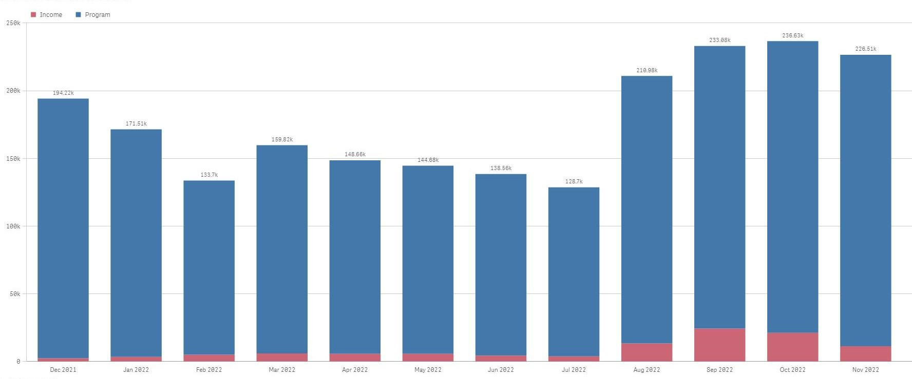
Enrollment Eligibility Methods – Program versus Income

Slide 14
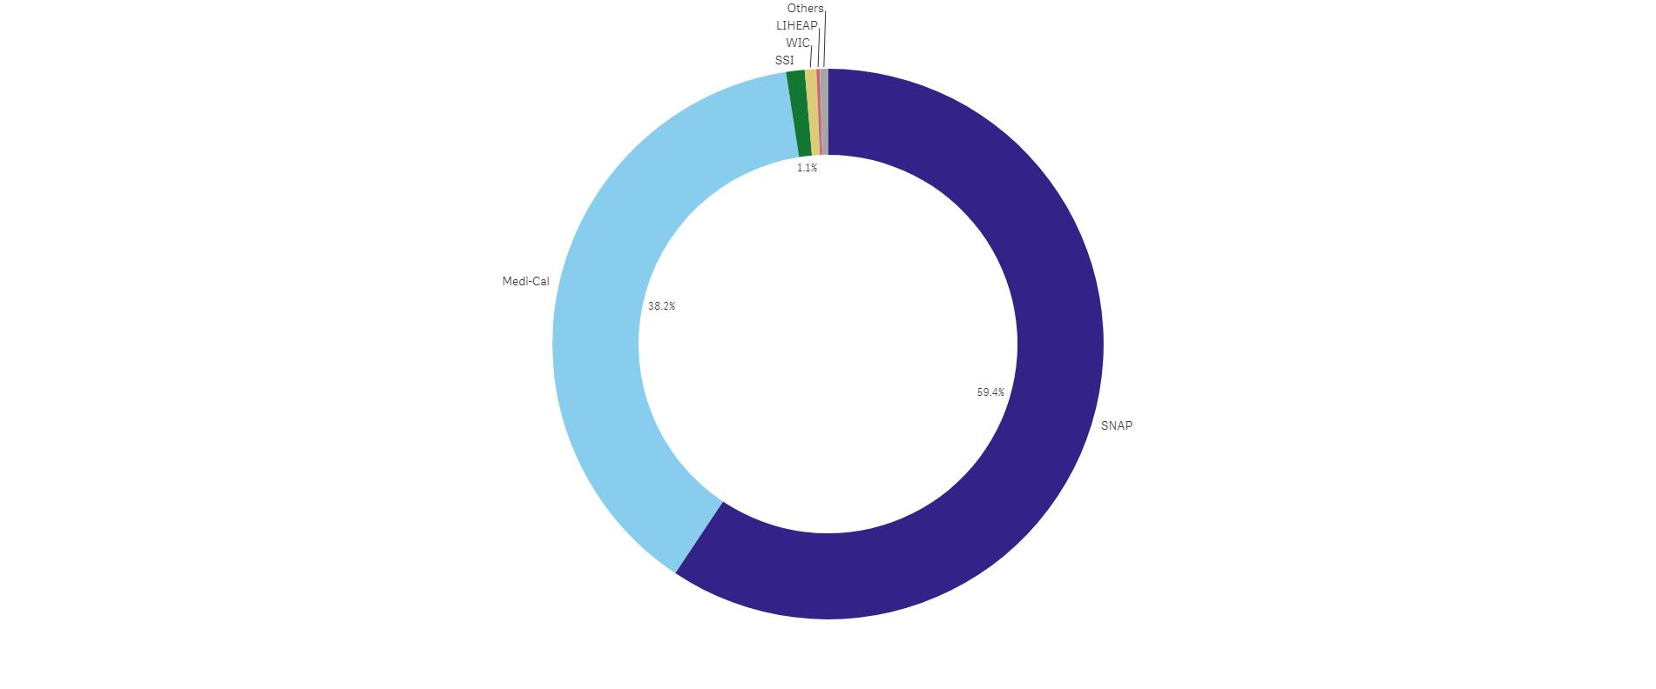
Enrollment Eligibility Methods – By Qualifying Program

Slide 15
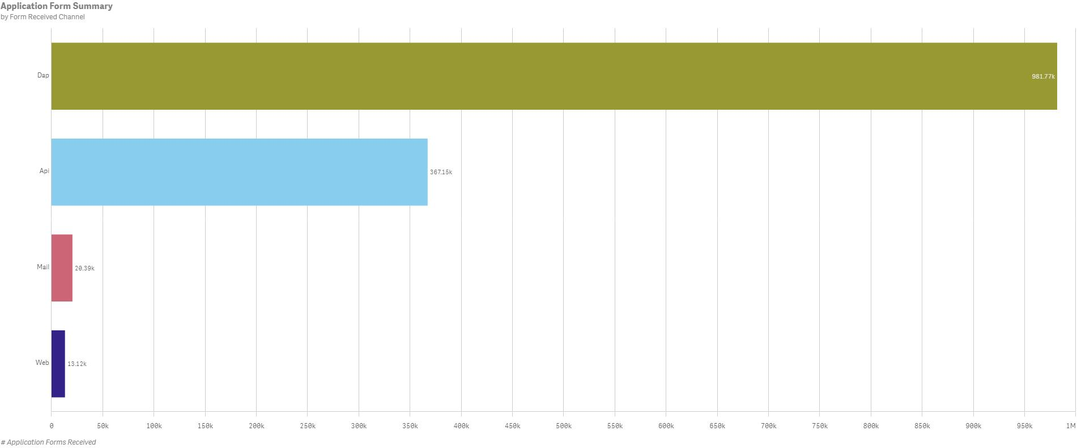
Enrollment Application Volume By Received Channel December 2021 - November 2022

Slide 16
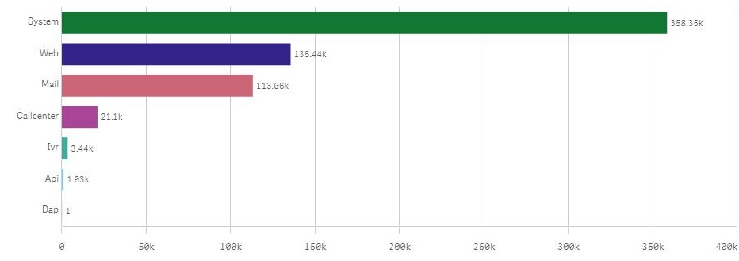
Renewal Form Volume By Received Channel
December 2021 - November 2022

Slide 17
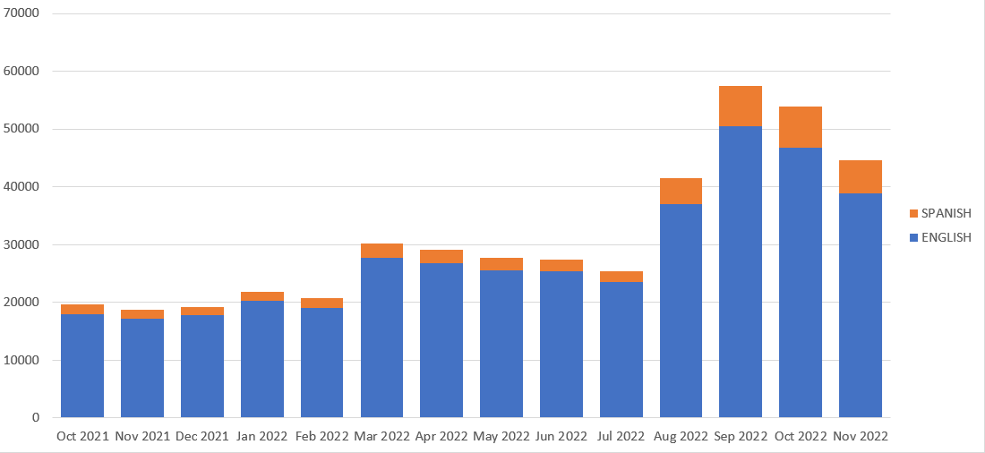
Monthly Inbound Call Volumes – English & Spanish

Slide 18
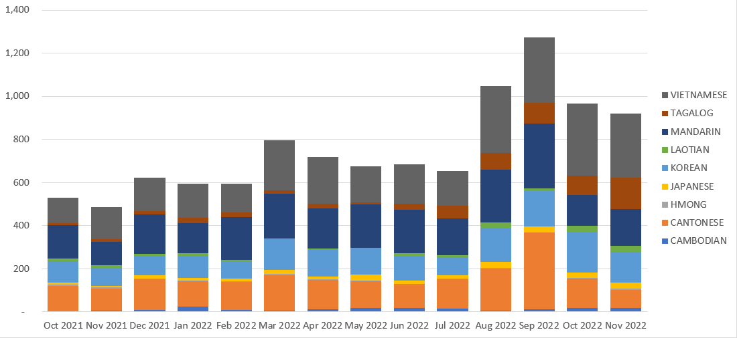
Monthly Inbound Call Volumes – Other Supported Languages

Slide 19
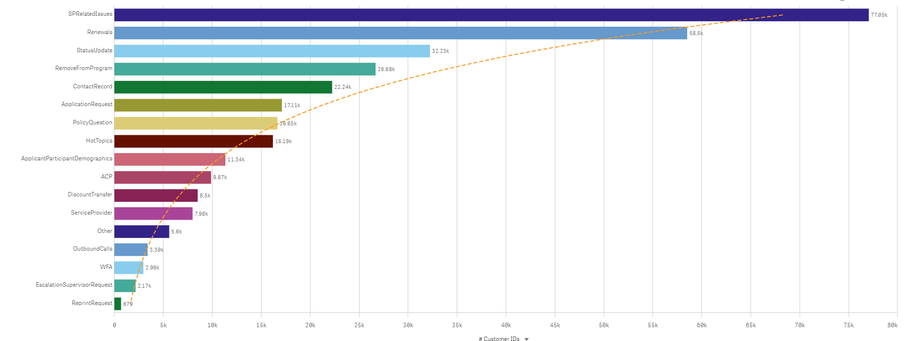
Inbound Call Reasons

