Slide 1
California LifeLine Third Party Administrator
Presentation to the Administrative Committee
September 20, 2022

Slide 2
Preemptive Recertification – Final Results
For the period of November 11, 2021, through June 30, 2022
353,557 Subscribers preemptively recertified as a result of CalFresh Confirm eligibility checks
    28.59% of the total 1,236,733 active LifeLine Subscribers on June 30th
    Wireless subscribers = 289,111 [28.32% of active wireless subscribers]
    Wireline subscribers = 64,446 [30.00% of active wireline subscribers]
Positive Impact:
  Improved Subscriber Renewal Experience & Provided Upfront Benefit Stability & Certainty
  Decreased the number of subscribers required for renewal catch up period
  Delivered Fiscally Sound Use of Program Funds
  Provided opportunity to fine tune CalFresh Confirm Hub to meet our Program requirements

Slide 3
Renewal Process Resumption – Key Data Points
July 1 through September 11:
  263,952 renewal processes started
    284 subscribers started renewal during the July 30-day Ramp Up
    255,162 started renewal on or after August 1 – Official & Full Volume Start
  19.28% Day 0 CalFresh Confirm PASS rate
  3.01% CalFresh Confirm PASS rate before issuing a soft denial due to nonresponse
  28.39% required Household Worksheets (HHWS)
  94,515 final decisions are registered in the TPA’s system [35.8%]:
      Approved – initial form: 91,485
      Approved – 2nd form: 1,098
      Hard denied – initial form: 1,133
      Hard denied – 2nd form: 799

Slide 4
CalFresh Confirm Hub Updates
Success Story I
Hub capacity constraints were identified where the Program’s increased volume of real-time eligibility checks tied to the renewal resumption and more SPs using SPIA would not be met
  Through a cooperative partnering, DSS reprioritized its budget & development, set up a UAT environment for TPA, and then released a Dedicated Server into production just in time to meet the Program’s significantly higher capacity needs that began in August
Success Story II
Data refreshes of active SNAP participants from CalFresh’s 58 counties were inconsistent
  There are now dependable weekly data refreshes reporting into Hub from all counties

Slide 5
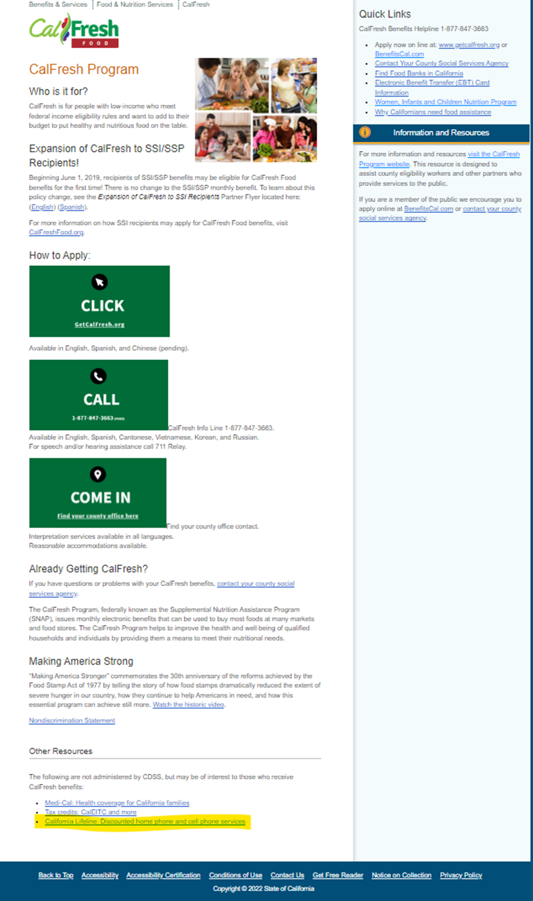
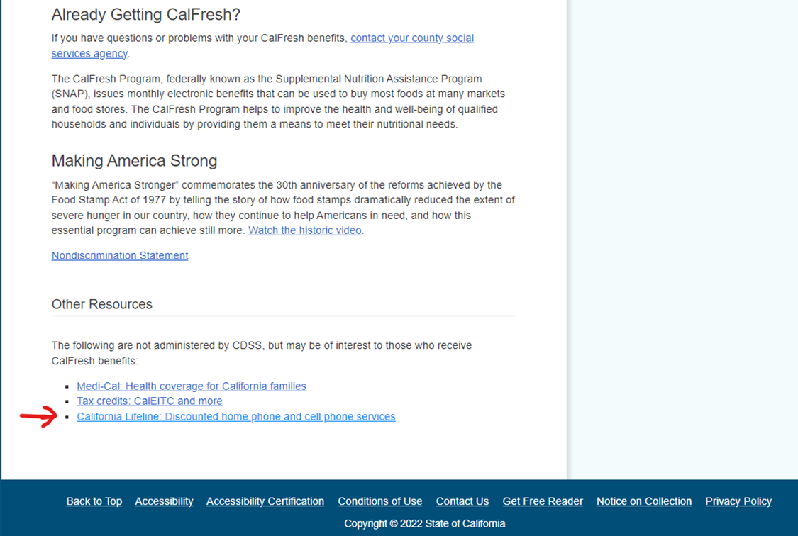
Success Story III
DSS CalFresh adds the California LifeLine Program website link on its website, and establishes a first-time inter-agency outreach partnership https://www.cdss.ca.gov/calfresh

Slide 6
Completed Initiatives 6/28/2022 – 9/20/2022
Renewal Resumption
Transitioned 8 wireless Service Providers to the Service Provider Intake Application Programming Interface (SPIA). 11 of the 13 wireless SPs have moved from DAP to SPIA
SPIA connects SPs’ systems to the TPA system and enables real-time submissions and status reviews for new subscriber enrollment, updates, disconnects, removals, and LifeLine application mailing requests
SPIA seamlessly inserts Metadata captured by SPs’ systems into application submissions
SPIA streamlines all subscriber processes by displaying immediate responses that identify required documentation from subscribers to SPs’ systems, and aiding SPs to work with their customers to complete TPA displayed actions needed

Slide 7
Initiatives In Progress
Modernizing the Program’s Print Framework – Go Live 4/1/2023
Remove the barriers to adding and modifying forms, letters, and postcards, which is essential to implementing future initiatives
Increase accessibility and readability of complex communications through design and content improvements
Enable flexibility, inefficiencies, and cost savings for continuous improvement of the Program’s communication

Slide 8
Upcoming Initiatives
Personal Identification Number (PIN) removal and an identity authentication replacement to meet AB 74 Compliance (requires Print Framework Modernization as a prerequisite for form & letter changes)
De-coupling Household Worksheet (IEH) from the renewal process to a stand-alone process triggered by a service address change (requires Print Framework Modernization for form change)
Updating SMS text message opt-in and opt-out policies and procedures
Geo-coding active LifeLine subscribers for reporting and trend analysis
Registration and tracking of SPs’ representatives who interact with consumers
Documenting participants’ who qualify based on Benefit Qualifying Persons (BQP)
Developing and implementing a monthly connections and conversions report for wireline SPs
Preventing mid-service term Tribal changes across all Service Provider update methods
Implementing API to confirm federal Lifeline broadband-only subscribers administered by USAC

Slide 9
Program and Operations Reports
Program Participation – Active LifeLine Subscribers
Wireless: Response & Approval Rates – All Form Types
Wireline: Response & Approval Rates – All Form Types
Top 5 Denial Reasons
Subscriber Count Trends for Largest Service Providers
Enrollment Eligibility Methods – Program versus Income
Enrollment Eligibility Methods – By Qualifying Program
Enrollment Application Volume By Received Channel, September 2021 - August 2022
Renewal Form Volume By Received Channel, November 2021 - August 2022
Call Volumes – English & Spanish
Call Volumes – Other Supported Languages
Inbound Call Reasons

Slide 10
Program Participation – Active LifeLine Subscribers
  Current: Total Number of Active LifeLine Subscribers as of September 1, 2022
  Wireless: 1,039,949
  Wireline: 210,257
  Total: 1,250,206
  June 2022 AC Meeting: Total Number of Enrolled Subscribers as of June 1, 2022
  Wireless: 1,008,727
  Wireline: 217,187
  Total: 1,225,914

Slide 11
Wireless: Response & Approval Rates – All Form Types
Month Year | Total Forms | # Responded | % Responded | # Approved | % Approved
Sep-21 | 98,190 | 90,627 | 92.30% | 87,154 | 96.20%
Oct-21 | 102,379 | 95,064 | 92.90% | 92,945 | 97.80%
Nov-21 | 196,981 | 188,749 | 95.80% | 186,537 | 98.80%
Dec-21 | 161,133 | 151,696 | 94.10% | 147,728 | 97.40%
Jan-22 | 140,933 | 128,853 | 91.40% | 125,099 | 97.10%
Feb-22 | 113,648 | 103,681 | 91.20% | 100,880 | 97.30%
Mar-22 | 133,937 | 122,820 | 91.70% | 120,690 | 98.27%
Apr-22 | 129,820 | 119,653 | 92.17% | 116,922 | 97.72%
May-22 | 139,125 | 127,262 | 91.47% | 120,398 | 94.61%
Jun-22 | 137,527 | 123,115 | 89.52% | 118,917 | 96.59%
Jul-22 | 125,525 | 114,007 | 90.82% | 111,076 | 97.43%
Aug-22 | 193,112 | 175,629 | 90.95% | 172,428 | 98.18%
Totals | 1,672,310 | 1,541,156 | 92.16% | 1,500,774 | 97.38%

Slide 12
Wireline: Response & Approval Rates – All Form Types
Month Year | Total Forms | # Responded | % Responded | # Approved | % Approved
Sep-21 | 1,749 | 887 | 50.70% | 733 | 82.60%
Oct-21 | 1,687 | 790 | 46.80% | 629 | 79.60%
Nov-21 | 24,609 | 23,730 | 96.40% | 23,590 | 99.40%
Dec-21 | 23,537 | 22,643 | 96.20% | 22,498 | 99.40%
Jan-22 | 14,103 | 13,272 | 94.10% | 13,174 | 99.30%
Feb-22 | 3,659 | 3,089 | 84.40% | 2,990 | 96.80%
Mar-22 | 3,164 | 2,430 | 76.80% | 2,273 | 93.54%
Apr-22 | 2,591 | 1,724 | 66.54% | 1,599 | 92.75%
May-22 | 3,025 | 2,141 | 70.78% | 1,993 | 93.09%
Jun-22 | 2,440 | 1,627 | 66.68% | 1,498 | 92.07%
Jul-22 | 2,379 | 1,562 | 65.66% | 1,438 | 92.06%
Aug-22 | 17,716 | 17,039 | 96.18% | 16,775 | 98.45%
Totals | 100,659 | 90,934 | 90.34% | 89,190 | 98.08%

Slide 13
Top 5 Denial Reasons: September 2021- August 2022
Denial Code | Type | Form | Description
5-12 | Hard Denial | Application | An active phone number and service start date was not provided by the carrier within 30 days from receipt of status code 53
6-21 | Correctible Denial | Application | We do not have evidence that the Application Form was returned to us.
6-22 | Correctible Denial | Application | Documentation provided does not meet the eligibility guidelines.
5-16 | Hard Denial | Application | Applicant failed to return ID verification form and documentation (for IDV)
8-9 | Hard Denial | Application | We do not have evidence that the Application Form was returned to us.

Slide 14
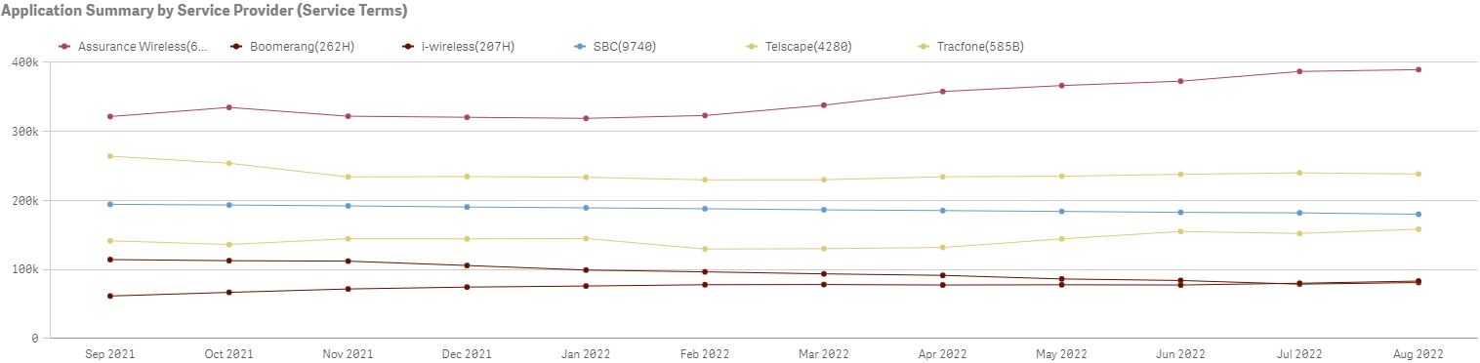
Subscriber Count Trends for Largest Service Providers

Slide 15
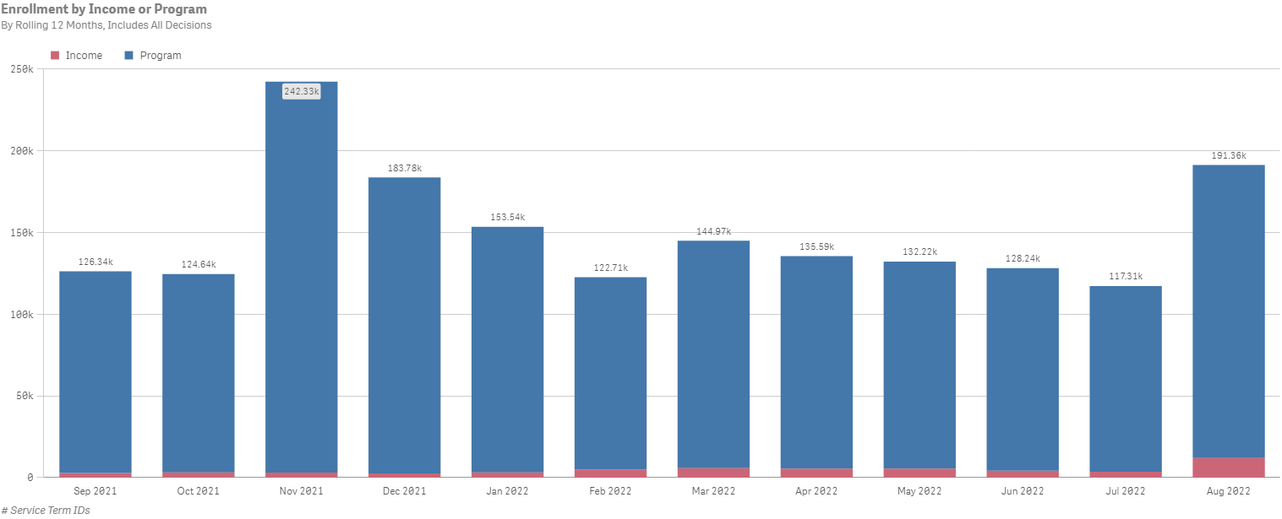
Enrollment Eligibility Methods – Program versus Income

Slide 16
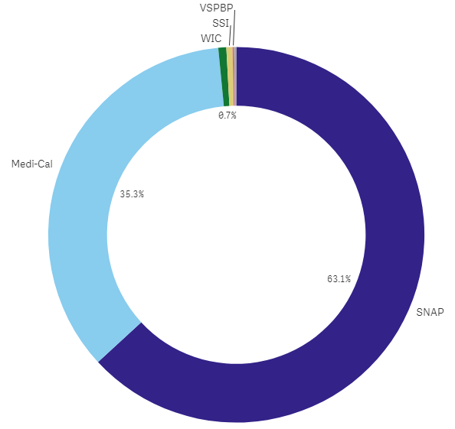
Enrollment Eligibility Methods – By Qualifying Program

Slide 17
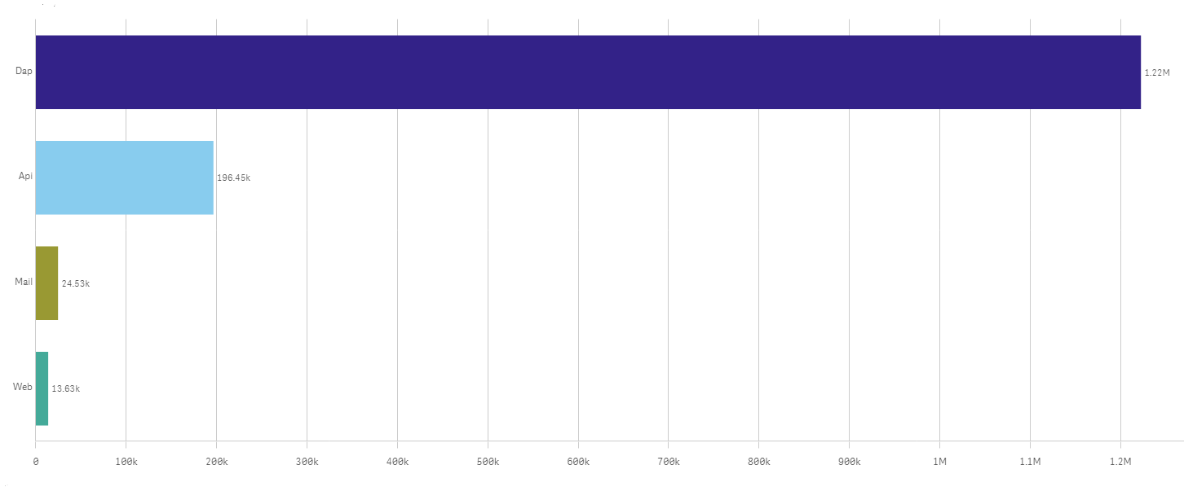
Enrollment Application Volume By Received Channel September 2021 - August 2022

Slide 18
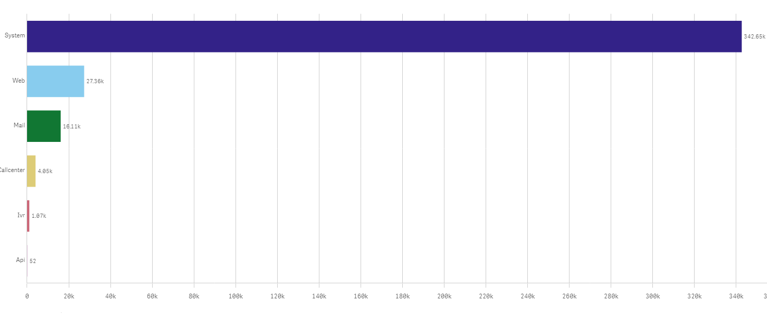
Renewal Form Volume By Received Channel
November 2021 - August 2022

Slide 19
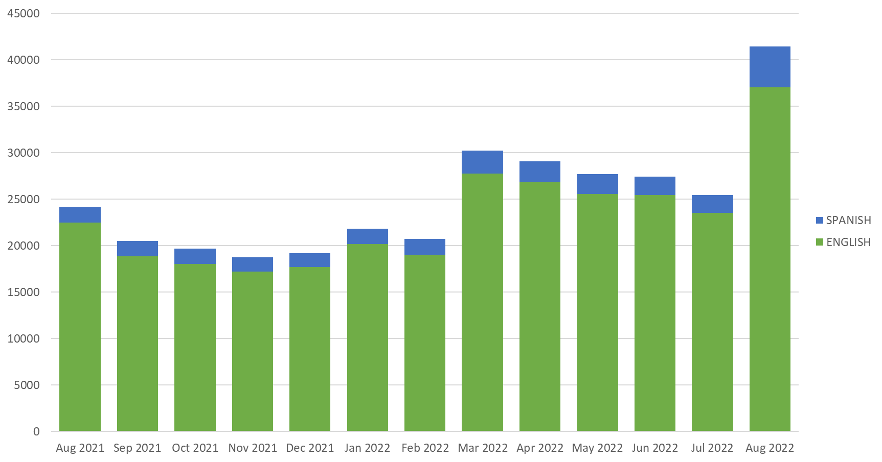
Monthly Inbound Call Volumes – English & Spanish

Slide 20
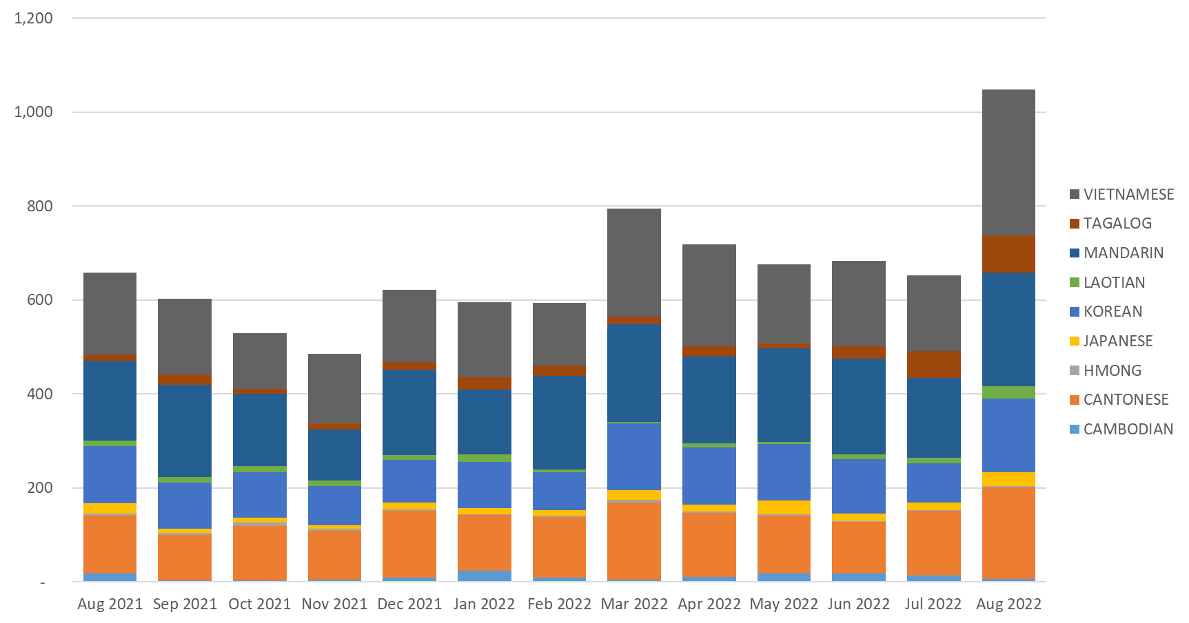
Monthly Inbound Call Volumes – Other Supported Languages

Slide 21
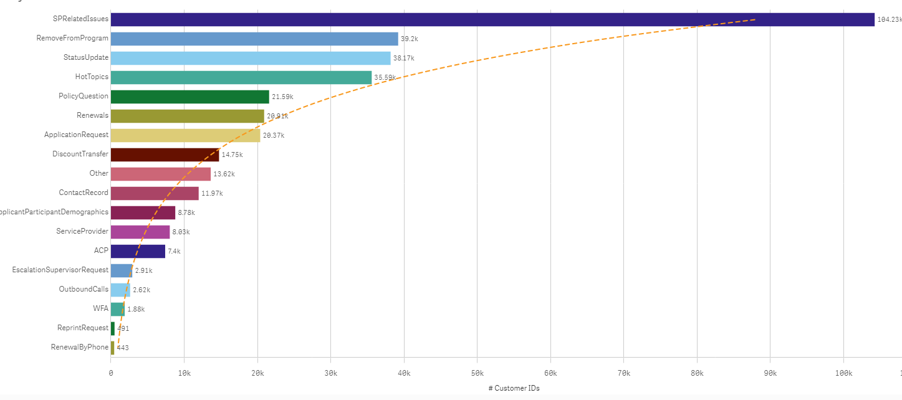
Inbound Call Reasons

